Slide 1
Automotive SW in Open ecosystems: is not (yet) mainstream
Vishal Suresh
AOSS Starnberg, June 2026

Slide 2
Infineon’s top market position is built on system competence based on an industry-leading product portfolio
Automotive semiconductors (2025 total market: $74,408m; +6.4% y-y)
Infineon’s 2025 market share and position by region
#1
#2
#1
#1
#1
#2
MCUs
Power
Sensors¹
TechInsights: Automotive Semiconductor Vendor Market Shares. April 2026. ¹ Sensors: S&P Global: Automotive Semiconductor Market Shares 2025. April 2026.
Notes:
Infineon has once again been named the global #1 automotive semiconductor provider since 2019
In MCUs, Infineon achieved a significant increase in its market share to 32% (28.4% in CY23)!
Infineon became #1 in Europe and #2 in North America
Continued #1 position in power semiconductors based on industry's broadest product portfolio
Undisputed #1 in automotive NOR Flash memory ICs

Slide 3
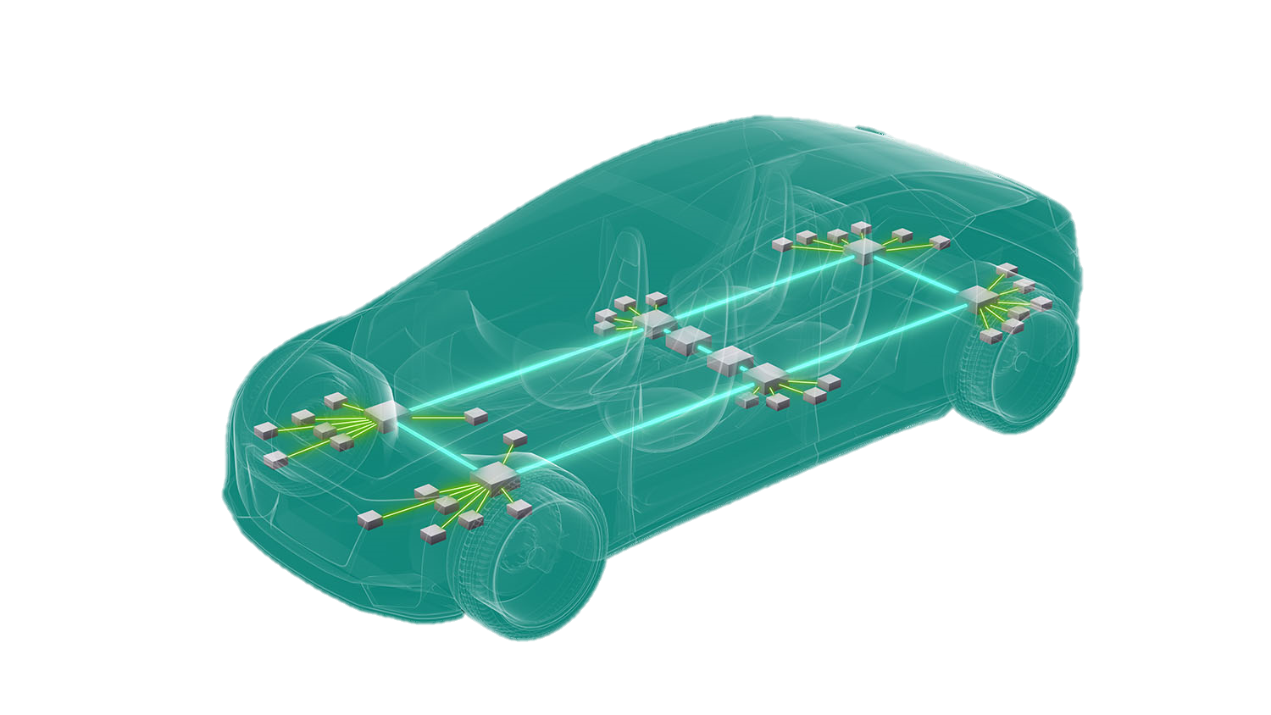
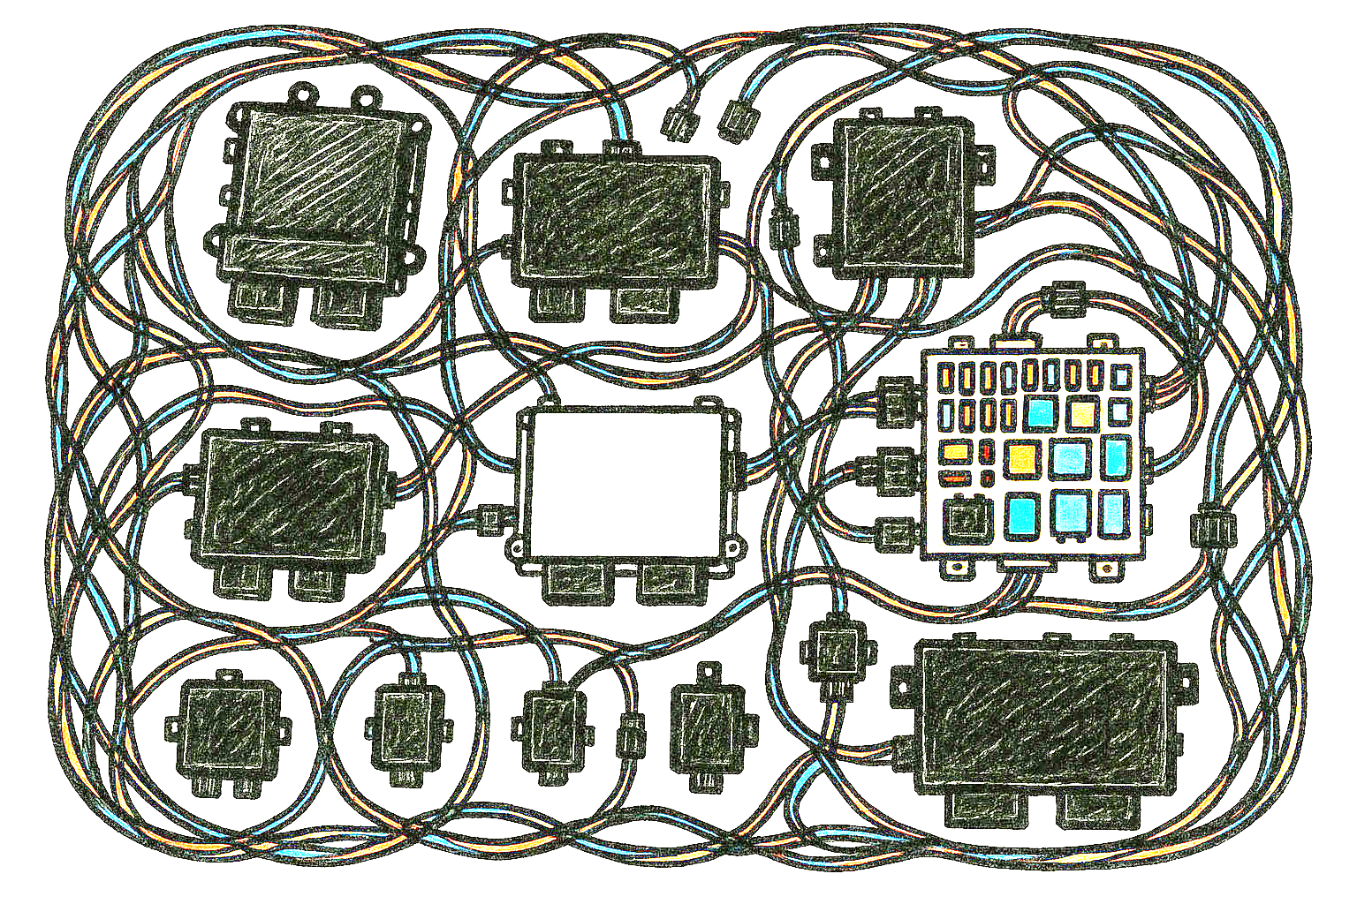
Software-Defined-Vehicles demand dependable computing –
Infineon’s market-leading solutions ensure safety and reliability
Challenges
Modularity & continuous feature upgrades
Consolidation of ECUs and wiring harness
Scalability across vehicle models
Holistic developer journey
Solution
Dependable microcontroller portfolio as the backbone for scalable EE architectures
Efficient, reliable compute, control and high-speed communication
Virtualization; AI acceleration
SW & Tools ecosystem
70 – 110 ECUs
Up to 5 km wiring harness
10 – 15 car models
Notes:
# It’s all about SW and having an efficient and reliable computing, control and communication architecture in place
# Challenge with todays architecture
many ECUs + very complex wiring harness + wide spectrum of different models per OEM
# New EE architectures are in development ww to fix these issues
# As market leader IFX AURIX and TRAVEO MCU architectures are at the forefront of architectural change
# AURIX architecture of choice in highly dynamic market environments like China and the silicon valley
# On average 2-3 MCUs per car in new types of systems like zone controllers, domains or future car computers

Slide 4
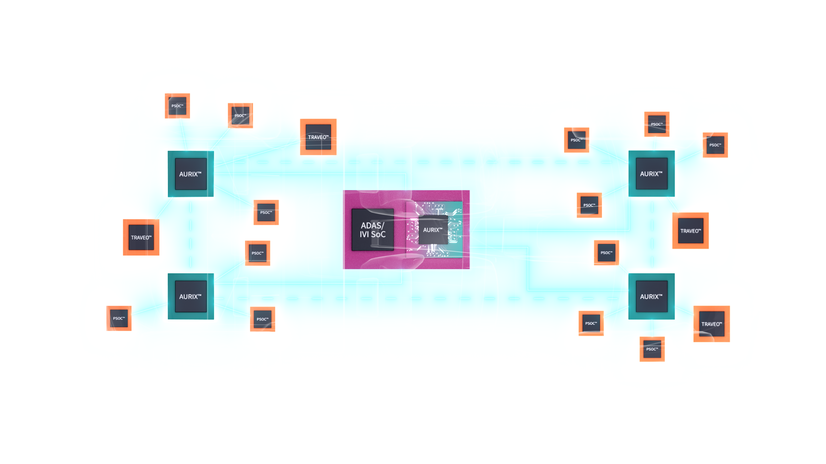
Infineon belief: Intelligent Zone controllers and balanced centralization is the backbone of Software-defined-Vehicles
Optimized system cost & flexibility through zonal intelligence and balanced centralization
Cost-effective networking by keeping traffic local
Clean integration of power distribution and I/O
Improved safety and security via separation and containment
Simple software deployment and reconfiguration
Notes:
Lower system cost through zonal intelligence and balanced centralization
Distributing real-time and safety-critical compute into Zone Controllers reduces the need for an oversized, high-ASIL “mega” central computer and allows cost-optimized central compute sizing.
More cost-effective networking by keeping traffic local
Zonal processing and filtering keep high-bandwidth sensor/actuator traffic within the zone, reducing backbone bandwidth, TSN feature requirements, and redundancy needs—often enabling simpler Ethernet designs overall.
Higher platform flexibility across variants
Intelligent zones can abstract endpoint ECU differences and provide a stable “zonal interface” to the rest of the vehicle, making it easier to mix-and-match variants and suppliers without redesigning the whole architecture.
Simpler software deployment and reconfiguration
Zonal compute enables modular rollouts (by zone), staged updates, and localized rollback/containment. This reduces fleet update risk and improves reconfigurability compared to “everything depends on the center” deployments.
Cleaner integration of power distribution and I/O
With more capability in the zone, the Zone Controller can better coordinate I/O and power management (e.g., smart power distribution concepts), reducing harness complexity and supporting safer, more diagnosable power control rather than relying on a purely passive I/O aggregator.
Improved safety and security via separation and containment
Distributing tactical (hard real-time) control into zones enables clearer isolation boundaries between tactical and strategic functions, limiting fault propagation and enabling more targeted safety mechanisms.
Reduced attack surface and better resilience
Zonal partitioning limits blast radius: compromising a function or network segment is more likely to be contained within a zone rather than exposing the entire tactical control plane through a single centralized choke point.

Slide 5
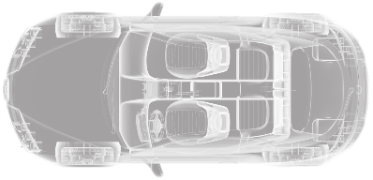

Impact on evolving E/E architectures on IFX software portfolio
SW Architecture trends
Impact on Infineon
HPC
Open Source
OEM involvement
ISO21434
Unix-based, POSIX, open source
MCU Safety Companion → offload MPU
Service based Com
Hypervisor
Time-to-Market
ASPICE
ISO26262
Zone / Domains
Virtualization
New Runtimes
HW-accelerated coms, security, AI, filters
SecOC, MacSec
AUTOSAR and beyond
Service to signal (Some/IP, DDS..)
PQC
AUTOSAR
ThreadX
DDS
NuttX
FreeRTOS
Zephyr
Some/IP
Edge ECU
1722
Shift Left
Sense & control
Bare metal, small RTOS
Pre-processing
Signal based Com / raw data
MBD
CI/CD
vHIL
RUST

Slide 6


Holistic customer journey
Infineon and ecosystem software enabling the customer journey
from evaluation to productive development
Awareness
Discover
Evaluate
Develop
Produce
Grow
Customer
Stage
become aware
consider
compare
test
prototype
decide
order
receive
SW dev
trouble-
shoot
optimize
renew
Virtual Prototype
Early software development
Regression testing and fault injections
Lifecycle Management Services
SW Support &
Maintenance
Compiler revalidation
Frozen branch
Custom features
Open-source community support
HW abstraction layer
Open-source engagements
MCU SW Portfolio
MCAL, IVN, Security, Safety,
PMIC, iLLD (incl. Secure boot, Power mgmt.)
Infineon
SW offerings
AURIX™ Configuration Studio
Runtime SW
Tools
DRIVECORE Software Bundles
Runtime Software: MCAL, Safety, Autosar, Comms, Security SW
Tools: VP, HSP, Compiler, Debugger, IDE, PPU Toolchain, …

Slide 7





Customer journey
We offer a comprehensive HAL portfolio for our MCUs providing
multiple options to our Customers
Commercial RTOS
AUTOSAR
NuttX
Zephyr
freeRTOS
OS
Hardware Abstraction Layer/Driver Offering
HAL
iLLDs
MCAL
MCAL
NuttX Drivers
Zephyr Drivers
iLLDs
Infineon MCU
Productive SW Infineon
Partner offering
Open-source contributions (Reference Code)

Slide 8








However, the open-source eco-system needs to find its way into SOP
Step 1 - Upstream: Contribution to FOSS RTOS projects
Step 2 – Downstream - Value Chain for Safety, Security, Liability
Contributors
Maintainer
Distributor
Customer
PoC projects
Or
SDV OEMs
(Partner, Univ., Customers)
Who ?
Series development incl. safety
Extensions
Safety libraries
CRA
Security libraries
ASPICE
Liability
Tests

Slide 9
The Bifurcated Software Ecosystem Problem: Call for Action
Dual Software Ecosystems: high-performance platforms and MCU-based systems
Industry open-source initiatives focus only on HPC
Community initiatives for MCU SW stacks are fragmented with no established path to SOP
AUTOSAR remains the only HAL standard ➔ ease of use & open innovation needs attention
What can this community do to address these challenges ?

