Slide 1
API Standardization in JASPAR for SDV
2026 June 30
Kazuo Tsubouchi
Chairperson
JASPAR API WG

Slide 2
Agenda
JASPAR Overview
API Standardization in JASPAR
Collaboration with COVESA
Conclusion

Slide 3
JASPAR Overview
What is JASPAR?
Japan Automotive Software Platform and Architecture
Established in 2004
Focuses on the standardization of automotive software and E/E architecture
Mission
Through standardization activities in Japanese automobile industry,
we will realize the following.
Development of common foundation for automotive industry
Increased development productivity
Promoting technological development
JASPAR promotes the standardization of vehicle systems in Japanese automotive industry

Slide 4
JASPAR Member
JASPAR Member
Total corporate members: 206 (as of Jun 2026)
In addition to the above, group companies (44) and universities and research institutes (14) participated
Board Members
5 companies lead JASPAR's activities as board companies.
Toyota Motor Corporation
Nissan Motor Co., Ltd.
Honda Motor Co., Ltd.
DENSO CORPORATION
Toyota Tsusho Corporation
12
OEMs
63
Member Domain
41
Telecommunications,
trading companies
Tier1
Supplier
33
57
Semiconductor
Parts supplier
Software/Tools
Vendors
Industry breakdown of corporate members
Consist of OEMs, suppliers, SW development companies, and various other companies/organizations related to automotive industry

Slide 5
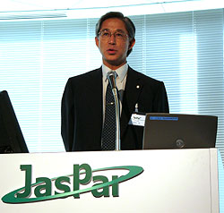
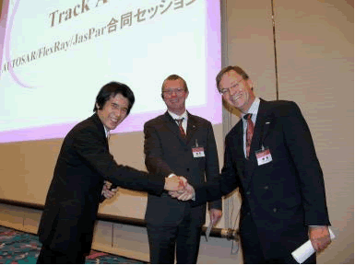
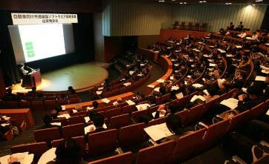
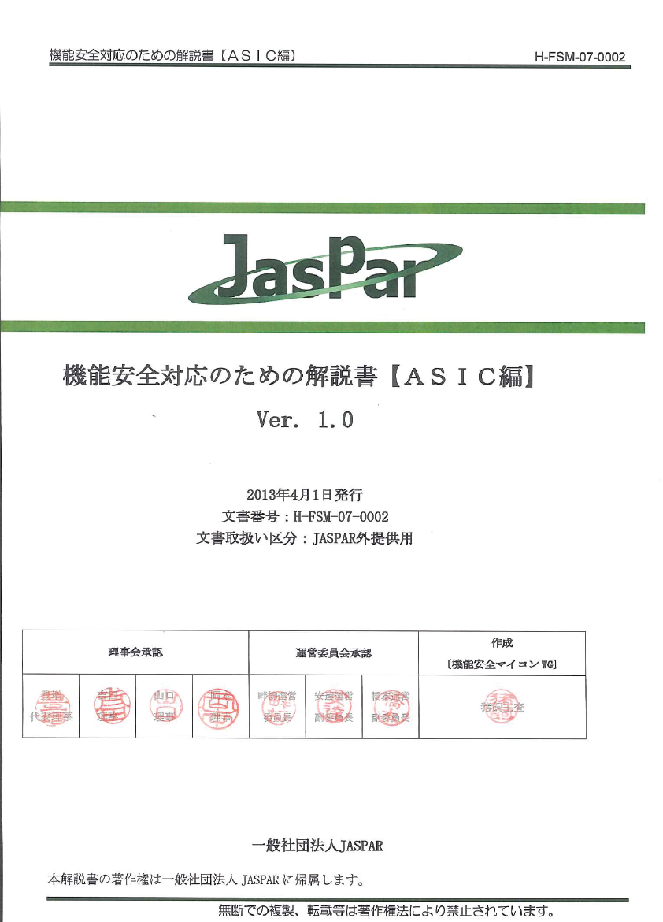
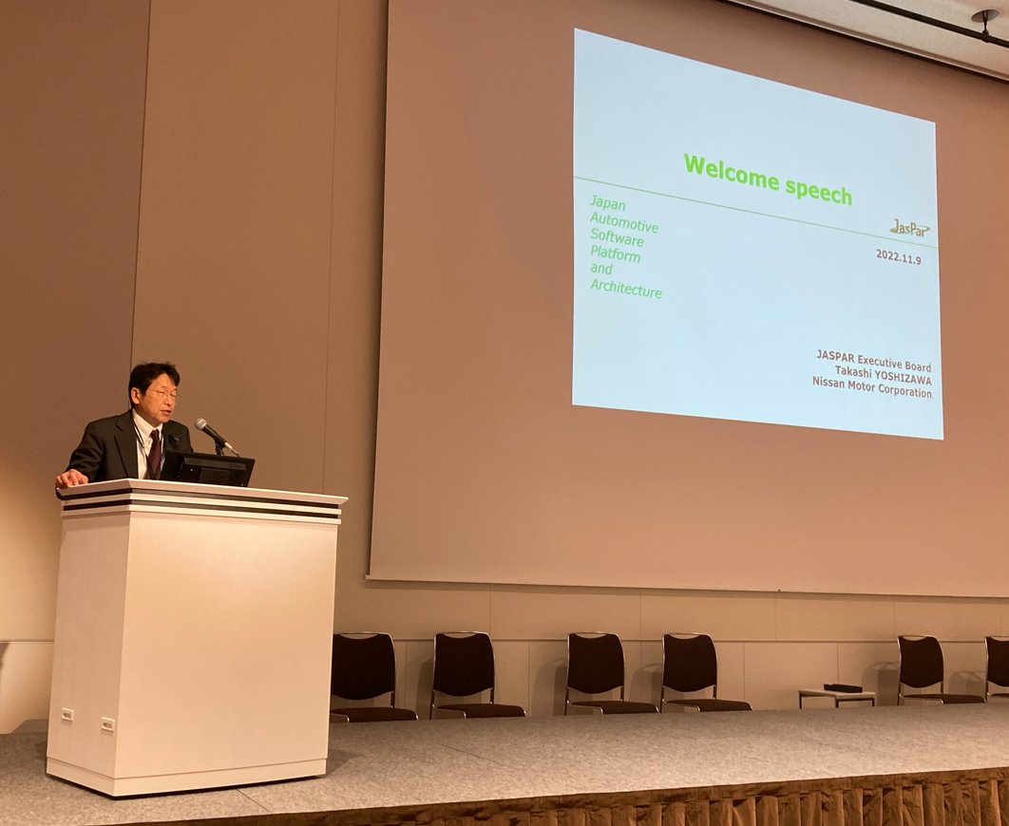
JASPAR 20 Years of History
2004
2005
2006
2007
2008
2009
2010
2011
2012
2013
2014
2015
2016
2017
2018
2019
2020
2021
2022
2023
2025～
FlexRay / AUTOSAR
Functional Safety
Bluetooth, Connectivity
Ethernet
September 2004
Establishment of JASPAR
In 2007
FlexRay/AUTOSAR
and Declaration of Cooperation
Security, OTA
Vehicle I/F
In 2010
National Professional
Achievement Presentation
In 2013
Functional Safety Manuals
In 2022
Hosted IEEE International
Conference
In 2023
Signed AUTOSAR
MoU
September 2024
JASPAR 20th Anniversary
First year of SDV
SDV
206 companies
Number of Member Companies
189 companies
Board Member
120 companies
140 companies
Regular Member
49 companies
Associate Member

Slide 6

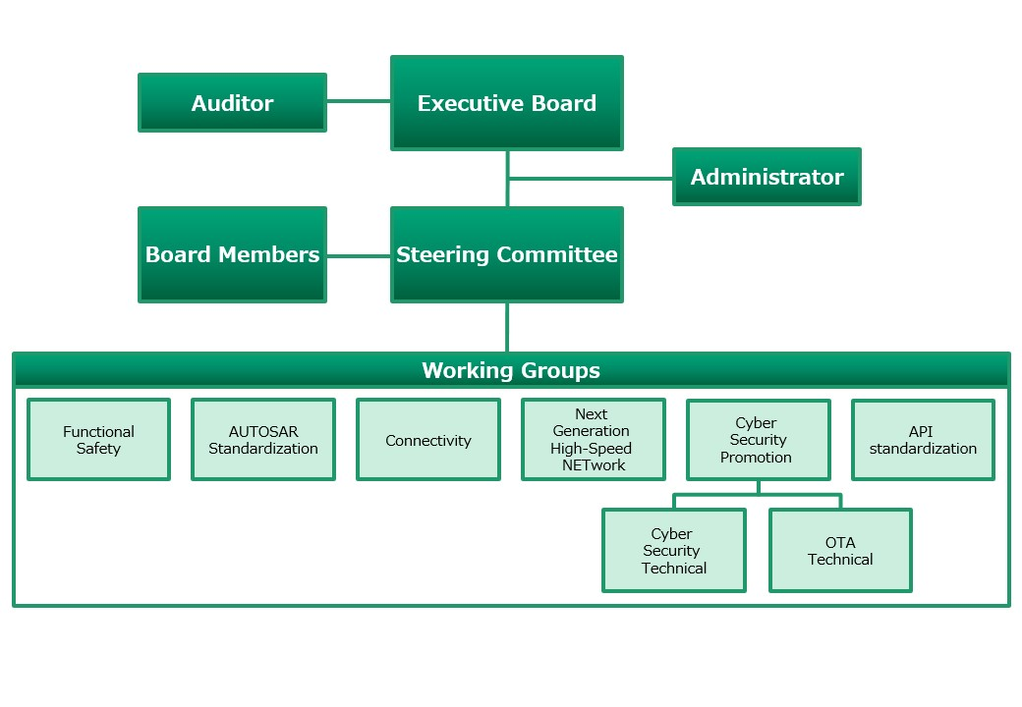
JASPAR Working Groups
Newly established in 2025 Feb
7 WGs have been formed to focus on specific technical fields and issues.

Slide 7
Agenda
JASPAR Overview
API Standardization in JASPAR
Collaboration with COVESA
Conclusion

Slide 8







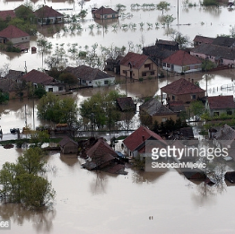
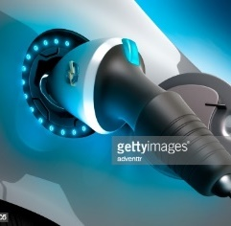



JASPAR for the next 20 years
The mobility industry is challenging a once-in-a-century transformation
MaaS
Intelligence
₿
₿
₿
BLOCKCHAIN
Mesh
₿
₿
₿
Manufacturing
Service Shifts
ICE BAN
BCP
Electrification
Rule making
Enabling SDV is the most important theme for the industry to address for the next 20 years
Notes:
I may be stating the obvious, but it is said that the mobility industry is currently experiencing a once-in-a-century transformation.
There is a global shift towards electrification, as well as improvements in autonomous driving and driving assistance systems, thanks to AI technologies.
Additionally, changes in lifestyles and social structures have created new needs, such as Mobility as a Service (MaaS) and ride-sharing, where people want to use vehicles without owning them.
As JASPAR is responsible for the development of in-vehicle software platforms and E/E architecture in Japan, we need to address this transformation over the next 20 years.
---
釈迦に説法とは思いますが、現在、モビリティ業界は100年に一度の大変革期を迎えていると言われております。
一時の勢いを失いかけてはおりますが、GXを背景とする世界的な電動化へのシフト、
また、AIの劇的な発展に伴い、自動運転技術、運転支援技術も目覚ましく進歩し、普及いたしました。
また、生活様式や社会構造の変化から、例えばMaaSやシェアリングといった車を所有しないが使いたい、といった新しいニーズも生まれております。
様々な社会環境の変化、エンドユーザのニーズの変化、一昔前の車とは要素技術も激変いたしました。
しかし、日本の車載のソフトウェアプラットフォームとE/Eアーキテクチャの発展を担うJASPARは、
次の20年に向けて、この変革期を迎え撃つ使命があります。

Slide 9
Consequence of SDV
SDV will formulate a new mobility ecosystem
1. Technological innovation, Improvement of competitivenss
Quickly adopt the latest technology with OTAs to maintain and improve the competitiveness of your products
2. Improve user experience
It can be customized according to the user's needs, providing a more comfortable and convenient travel experience
3. Transformation of the industrial structure
New players related to software development will enter the market, and the economy will be stimulated by creative services and products.
consumer electronics
satellite
infrastructure
IT Vendors
entertainment
service
software
V-OS
E&E
semiconductor
Power unit
battery
SDV will create new business opportunities for the entire automotive industry
Collaboration/Standardization is so important to realize the SDV
Notes:
SDVs represent a new era of mobility society. More and more new partners will join the market and formulate a new mobility ecosystem. This will create new business opportunities for new partners.
SDVs are not just a dream car concept. As I mentioned earlier, SDVs represent a new era of mobility society. Consequently, the number of stakeholders will be greater than ever before. They have the potential to bring very positive effects to Japan's economy and the entire automotive industry.
To reiterate:
We can quickly adopt the latest technologies through OTA updates, maintaining and enhancing product competitiveness.
Customization according to user needs will be possible, providing a more comfortable and convenient mobility experience.
Another important point is:
3. Transformation of the industrial structure.
SDVs will increase the number of stakeholders compared to the traditional automotive industry. In particular, they will encourage the entry of new players related to software development, which is expected to invigorate the market with innovative services and products. Furthermore, there are expectations for entry from sectors where Japan has high competitiveness but has not previously been involved in the automotive field, such as the content industry.
However, it is not guaranteed that this will have a positive effect on all businesses represented here. Some may find themselves at a disadvantage. Nevertheless, when we look at the overall ripple effects of SDVs, I believe the positive impacts will outweigh the negatives. Therefore, we need to seize this opportunity and embrace change.
--
SDVは単なる夢のクルマの話ではありません。
先ほど申し上げたように、SDVは新時代のモビリティ社会そのものです。
その分、ステークホルダもこれまで以上に多くなります。
日本の経済、自動車産業全体に対しても、非常にポジティブな効果をもたらす存在になりえます。
一部繰り返しになりますが、
1. OTAで最新の技術を迅速に取り入れ、商品の競争力を維持、向上させることができます
2. ユーザーニーズに合わせたカスタマイズが可能となり、より快適で便利な移動体験が提供されます
そして、もう一つ重要なのが
3. 産業構造の変革 です。
SDVは従来の自動車産業よりステークホルダが増えます。
特に、ソフトウェアの開発に関連する新しいプレイヤーの参入を促し、独創的なサービスや製品により、市場の活性化が期待できます。
ソフトウェア以外にも、今まで自動車に携わっていなかった日本が高い競争力を持つ領域、例えばコンテンツ産業からの参入なども期待できます。
ただし、ここにいらっしゃる全ての方のビジネスに良い効果があるとは限りません。
中には、不利になる方が出てくる可能性も、もちろんあります。
ですが、SDVの波及効果を大局的に見ますと、良い効果の方が大きいのではないかと考えております。
だから、この機会をとらえて、我々は変わる必要があると考えます。

Slide 10


Standardization of APIs for SDV
Around the world
end user
Around the world
SW Engineer
Subscriptions
sale
Application
Store
Anyone can develop UX APP with standard APIs
Standard APIs
Breaking down programming language barriers with standard APIs
collaboration
Collaboration with other organizations
Vehicle coordination of OEMs in each country
SDV Alliance (e.g. COVESA)
SDV
SDV
SDV
SDV
Open SDV Initiative
To realize SDV, it is essential to standardize the APIs, which is the common language for SDV.

Slide 11
Structure of the API Standardization WG
Leadership
WG
Management
WG
Supervision
Admin
WG-PMO
Alliance
Tsubouchi (Honda)
Ando (Toyota)
Miwa (Nissan)
Group Activity
Mgmt.
Coordi-
nation
Alliance with other organizations
・Morita (Bosch)
Dev. Env.
Mgmt.
License
Mgmt.
Administrative tasks
Project Management
1) Strategy and Planning
2) Use Case Base Evaluation
3) Design and Development
Reference
Arch.
Rule &
process
Review
Deliverables
Use case
Ideation
Prioritize
APIs
System
Engineering
Define
JASPAR VSS
SWE
Engineering
Reference
vehicle and app
Define reference architecture diagram, API design rules, design process, and PoC plan
Participants:
Board member companies
Make use cases by research and ideation
System analysis and request APIs
Participants:
  Companies who plan to utilize the standardized APIs
Update VSS / vspec
Develop dadabroker, code generator for API and reference applications
Participants:
Companies with experience in implementing in-vehicle SW
More than 100 software engineers (from 38 companies) are actively working on the project

Slide 12
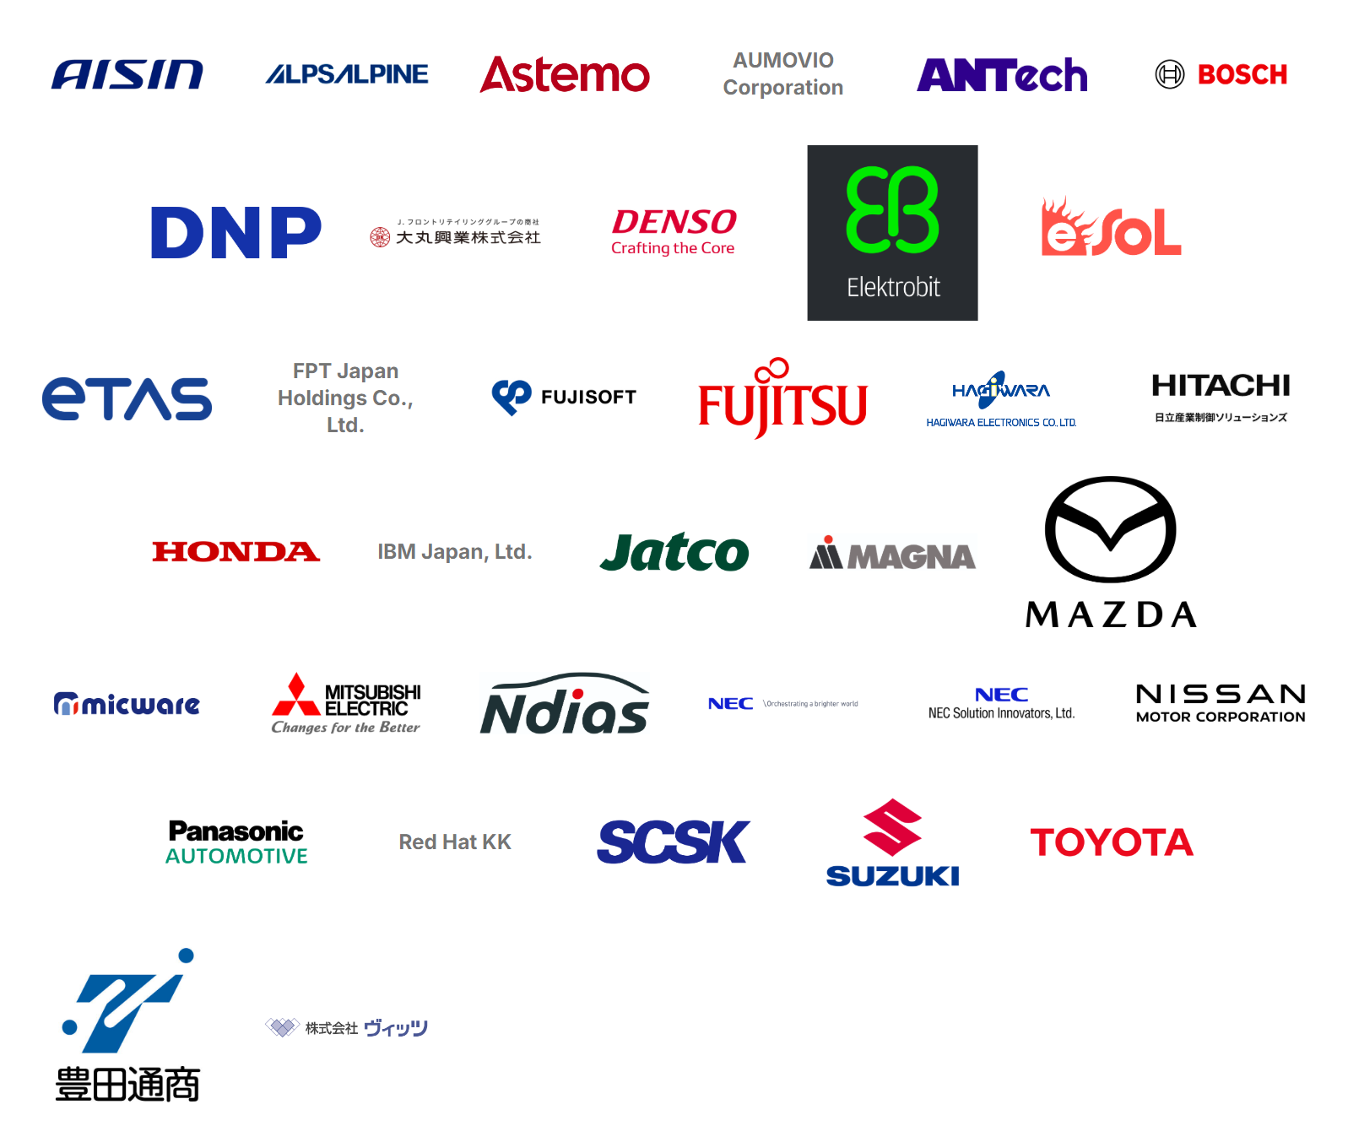
Contributors

Slide 13
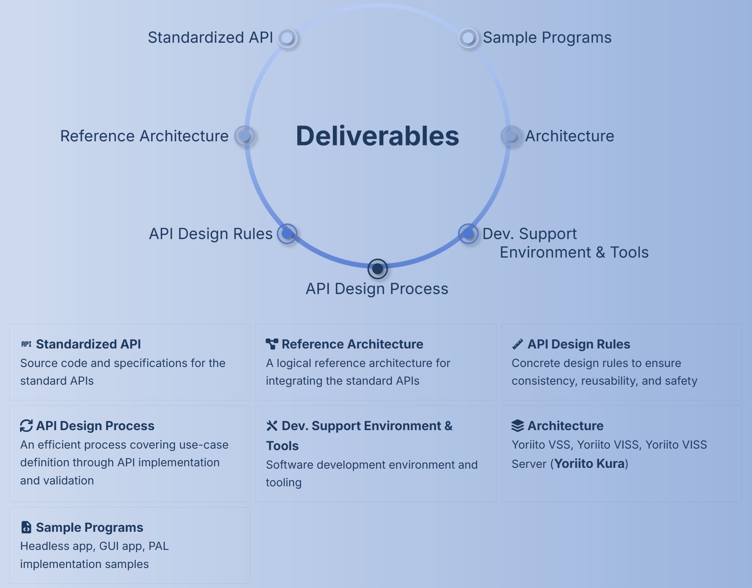
What will the JASPAR API WG provide?
Comprehensive and User-Friendly APIs
APIs which abstract vehicle functions
  I/F Spec Document
  Source Code
  API Testing Programs
  Sample Code (Tutorials)
Development Infrastructure/Tools
SDK/Runtime
API Management Infrastructure, etc.
+
Release the deliverables as OSS
Improve software development productivity
Build ecosystems

Slide 14
Achievement in FY2025
Based on COVESA VSS, JAPSAR implemented APIs that allows comprehensive control of vehicle signals
Prepared tutorials and various documentation so that new developers can easily start app development
Theme
Activities
Deliverables
API Planning
Define vehicle functions based on COVESA VSS
Investigated APIs to meet the use-cases
Define Vehicle Signals：631
Define Use cases： 117
API
Development
Design/
Implementation
Design and implement Signal APIs
Signal APIs： 10,132 APIs
API code： implement 375,773 LOC Test code 515,629 LOC
User support/
Quality control
Make tutorials and sample applications for onboarding new developers
Define quality criteria
HeadlessApplication code： 3,375 LOC
UI code： 2,114 LOC
Tutorial Documents: Many
Architecture/
Infrastructure
Architecture design, design guidelines
Build Development Infrastructure (SDK、Runtime、CLI、CI/CD、libraries)
JASPAR Databroker code： 97,000 LOC
Libraries
Documentation
  Design Doc
  Specification Doc
  Design/Implementation Guidelines
Many accomplishments in just one year!! Thanks to strong collaboration!

Slide 15
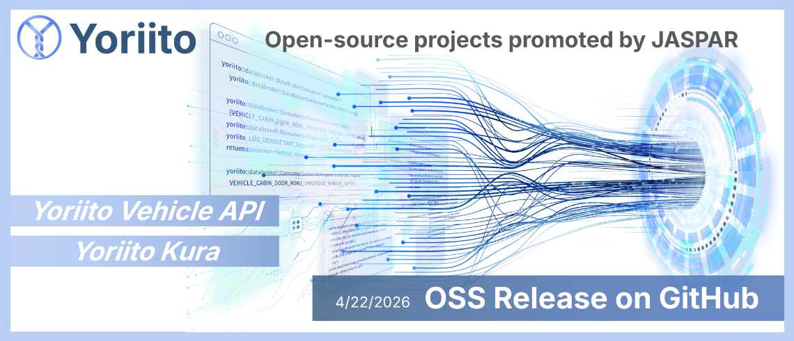
1st OSS Release Today!!
More open. More free. Automotive software—built by everyone
Notes:
成果物をOSS(Yoriito)で公開。自動車産業にとどまらず、多様な企業や開発者がSDV基盤の進化に参加できる環境を整備し、SDV時代における課題解決と、持続的なエコシステムの形成を推進していく。
日本の伝統的な織物文化において重要な役割を果たしている「撚糸（よりいと）」と、私たちのビジョンを重ね、「日本のSDVの発展を紡いでいくハブになりたい」という想いから付けたものです。
In traditional Japanese textile culture, "yoriito" (twisted yarn) plays an important role.
We chose this name to echo that idea and our vision — it expresses our desire to become a hub that weaves together the development of Japan's SDV.
What is Yoriito?
Yoriitoは、一般社団法人JASPARが推進するオープンソースプロジェクトで、世界有数の自動車メーカ、サプライヤ、ソフトウェア関連企業など、多様なプレイヤが参加しています
Yoriitoは、ソフトウェア開発を通じた協働を原動力に業界の垣根を越え、革新的なモビリティ社会を共創し、未来を担う人財が育つエコシステムの構築を目指します
Yoriito is an open-source project promoted by JASPAR (Japan Automotive Software Platform and Architecture), with participation from leading automakers, suppliers, and software companies worldwide.
Through collaboration driven by software development, Yoriito aims to transcend industry boundaries, co-create an innovative mobility society, and build an ecosystem that cultivates future-ready talent.

Slide 16
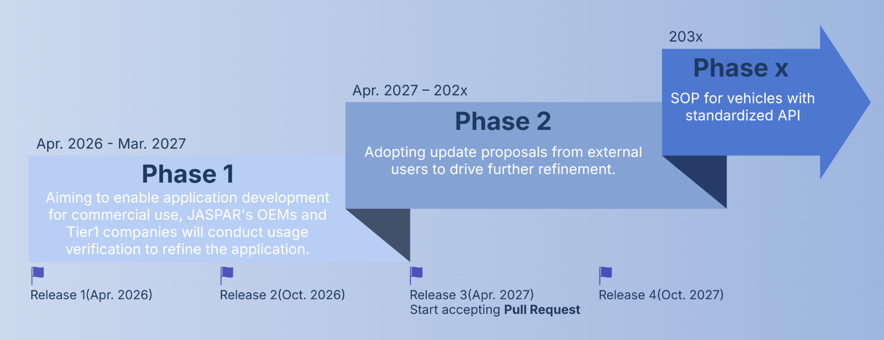
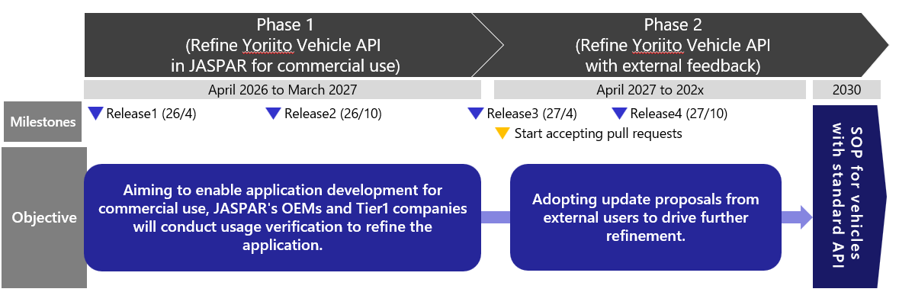
Roadmap

Slide 17
Architecture and scope
* Under development
*
Notes:
This diagram shows the overall architecture.
The Yoriito Vehicle API provides abstract APIs on top of vehicle‑specific implementations. These include:
Signal API
Access API
Platform Abstraction Layer, or PAL
Some components marked with an asterisk are still under development, but the architecture itself is stable and actively used in tutorials and demos.

Slide 18
Out-of-scope
Authentication and authorization methods: The methods for authentication and authorization (e.g., ID management, token/certificate handling, permission models) are out of scope for the Yoriito Vehicle API. This API defines its interfaces and behavior assuming it is called within a properly authenticated and authorized environment.
In-vehicle OS, middleware, and network stacks: The specifications and implementation methods for the in-vehicle OS, middleware, and network stacks (e.g., CAN, SOME/IP) are out of scope. The Yoriito Vehicle API focuses on the specifications of the abstract APIs (Signal API, Access API, PAL) that operate on top of them.
Vehicle Functions and Safety Concepts: The presence or absence of the vehicle functions themselves, their design policies, and safety concepts (e.g., HARA, ASIL) are out of scope. The scope of Yoriito Vehicle API is limited to how existing or company-defined vehicle functions are abstracted and provided as APIs.
UX design: UX designs such as application specifications, screen designs, and user operation flows are out of scope. The Yoriito Vehicle API focuses on defining common vehicle-function interfaces that are usable by applications.
Company-specific operational and lifecycle management: Company-specific operational and lifecycle management such as OTA update methods, application distribution channels, and auditing/logging practices are out of scope. The Yoriito Vehicle API only addresses the minimal items directly related to interoperability such as API versioning policies.
Notes:
It is also important to clearly define what is out of scope.
Authentication and authorization mechanisms are not part of this API.
We assume the API is used in a properly secured environment.
In‑vehicle OS, middleware, and network stacks are also out of scope.
The API is designed to sit on top of those layers.
Vehicle functions themselves, safety concepts, UX design,
and company‑specific operations such as OTA or lifecycle management
are intentionally excluded.
Our goal is interoperability at the API level.

Slide 19
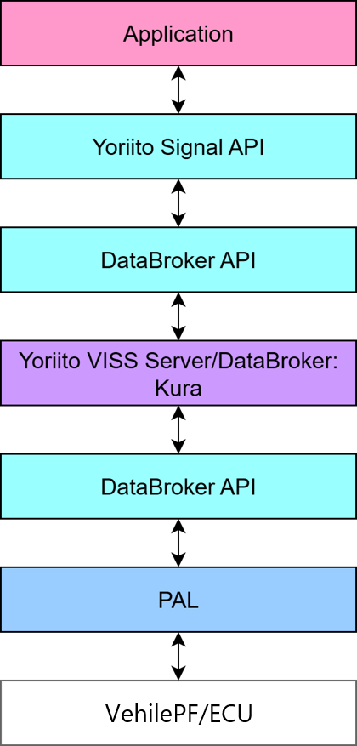
Key Components
Key Components of the Yoriito Vehicle API Basic Architecture are as follows:
Yoriito Signal API:
An implementation of a vehicle API that can be commonly used across OEMs with different vehicle signal definitions
This API is defined based on COVESA’s VSS as its underlying data model.
DataBroker API:
A low-level client API for communicating with the Yoriito VISS Server/DataBroker
Yoriito VISS Server/DataBroker:
A data broker that serves as the core of communication between the application and PAL
Yoriito provides Kura as the reference implementation.
Kura is based on COVESA’s VISS v3, with several additional functions added by JASPAR that are considered necessary for in-vehicle use.
To enable an early launch of YoriiTo, it is currently implemented with proprietary extensions; however, JASPAR will continue discussions with COVESA going forward.
PAL (Platform Abstraction Layer):
Software that absorbs and abstracts differences in vehicle platforms
For more detailed information, please refer to the following
https://docs.yoriito.dev/design/architecture_overview/
Notes:
It is also important to clearly define what is out of scope.
Authentication and authorization mechanisms are not part of this API.
We assume the API is used in a properly secured environment.
In‑vehicle OS, middleware, and network stacks are also out of scope.
The API is designed to sit on top of those layers.
Vehicle functions themselves, safety concepts, UX design,
and company‑specific operations such as OTA or lifecycle management
are intentionally excluded.
Our goal is interoperability at the API level.

Slide 20
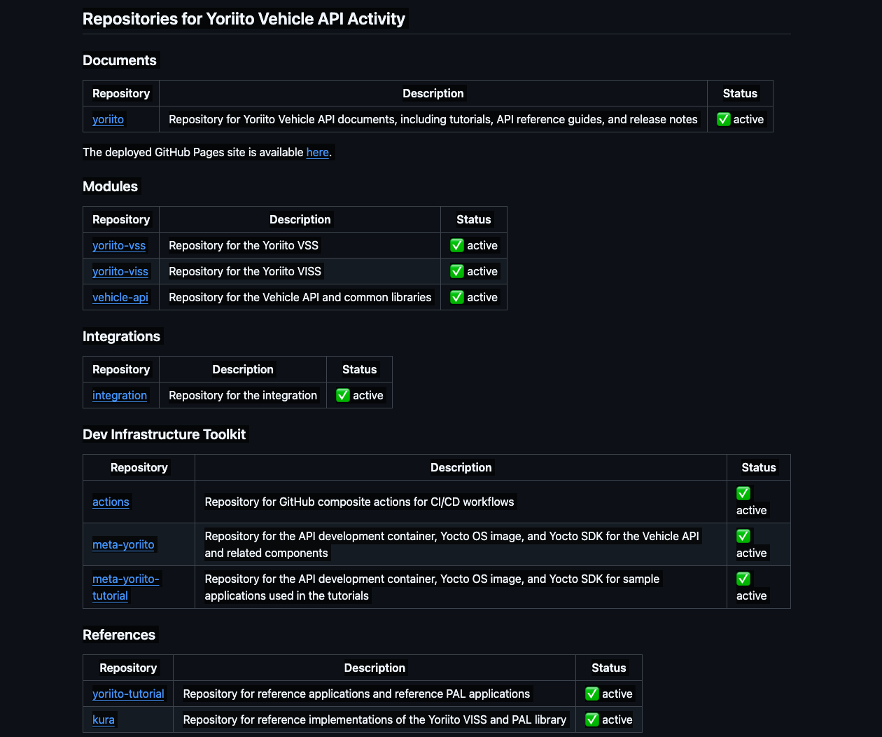
Repositories
https://github.com/yoriito/
Documents
https://github.com/yoriito/yoriito
Modules
https://github.com/yoriito/yoriito-vss
https://github.com/yoriito/yoriito-viss
https://github.com/yoriito/vehicle-api
Integrations
https://github.com/yoriito/integration
Dev Infrastructure Toolkit
https://github.com/yoriito/actions
https://github.com/yoriito/meta-yoriito
https://github.com/yoriito/meta-yoriito-tutorial
Reference
https://github.com/yoriito/yoriito-tutorial
https://github.com/yoriito/kura
Notes:
This slide lists the GitHub repositories.
We separate repositories into:
documents,
modules such as VSS, VISS, and vehicle‑api,
integration repositories,
development infrastructure toolkits,
and reference implementations and tutorials.
This structure allows users to focus only on what they need,
whether they are application developers or platform developers.

Slide 21
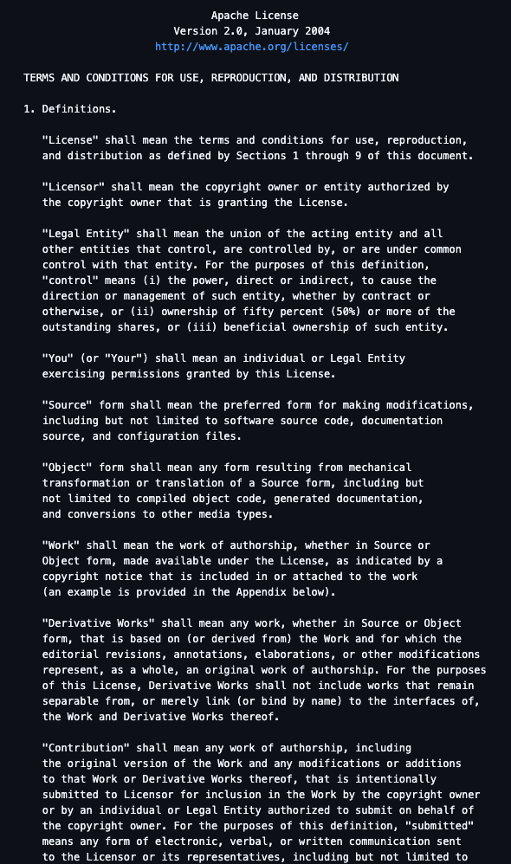
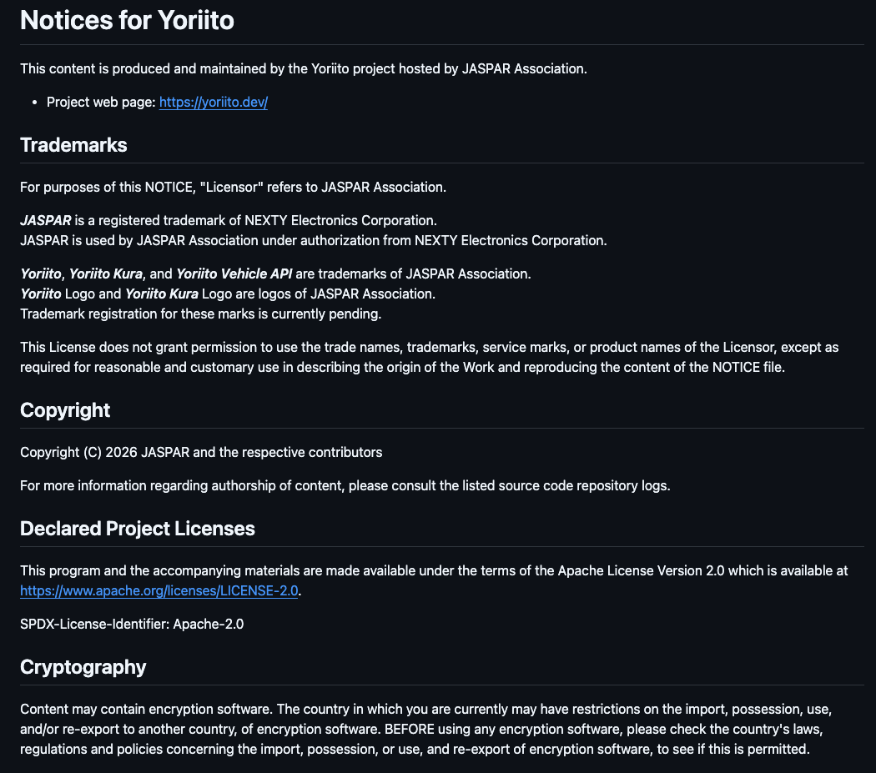
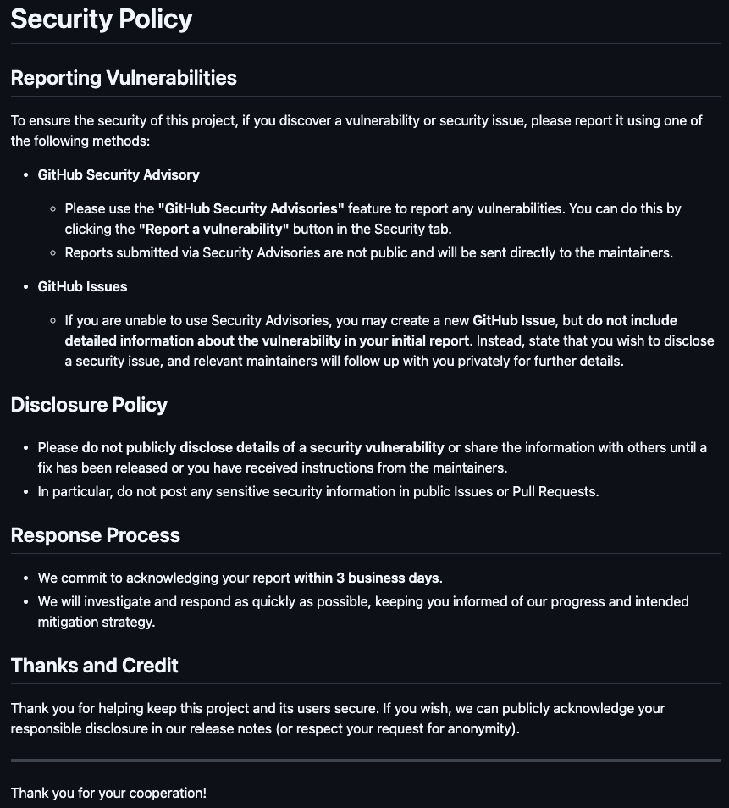
License, NOTICE and Security Policy
License is Apache-2.0
Copyright is JASPAR
Please support for security
Issues can be created.
However, non-security issues may be deprioritized because this release is still a draft / candidate.
Notes:
All Yoriito repositories are published under the Apache License 2.0.
Copyright is owned by JASPAR.
Regarding security:
issues can be created publicly,
but security‑related issues should follow our security policy.
Since this is still a draft or candidate release,
non‑security issues may be deprioritized.
We welcome feedback, especially from early adopters.

Slide 22
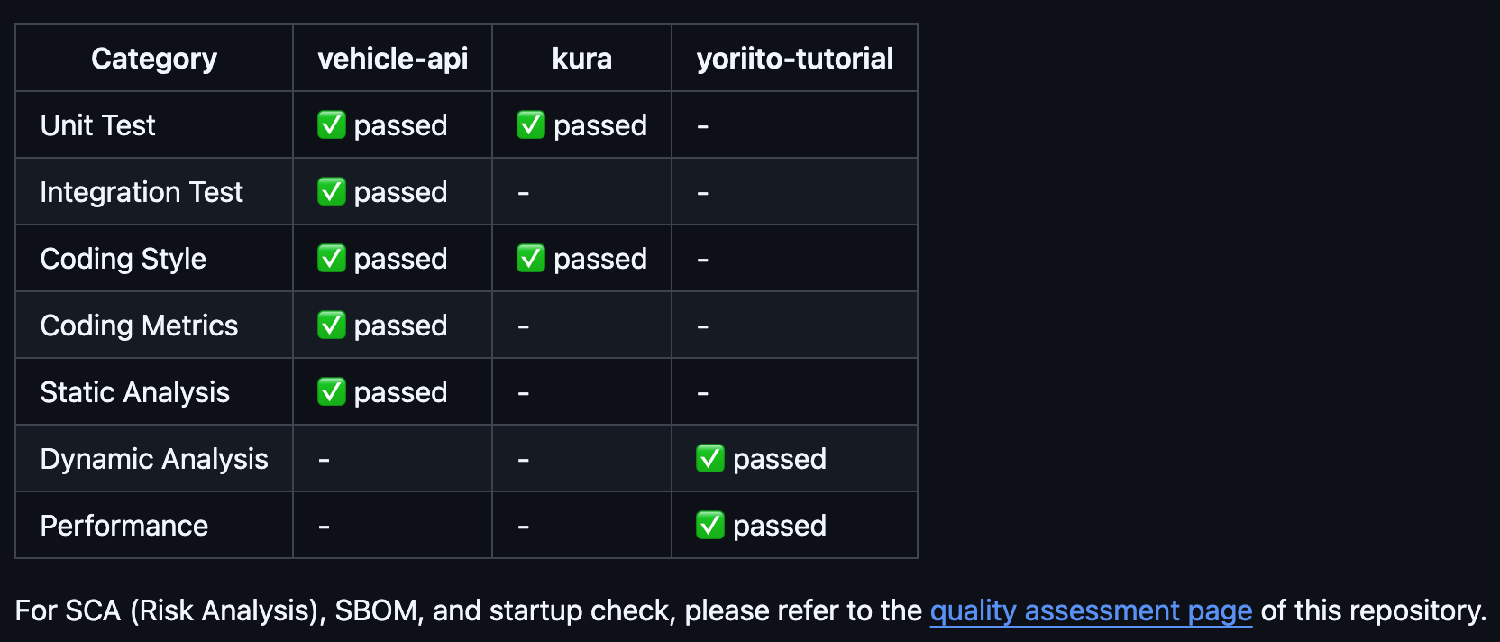
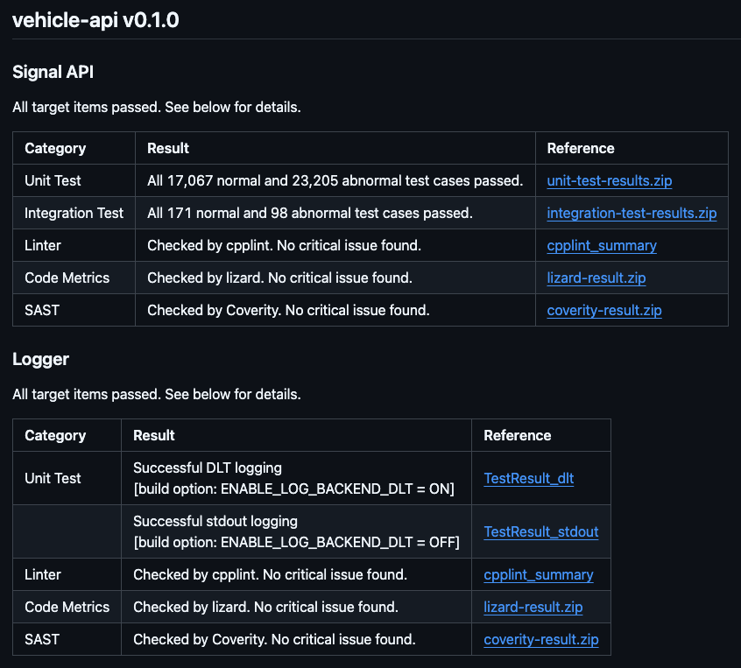
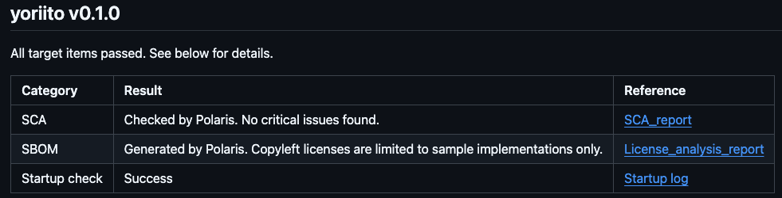
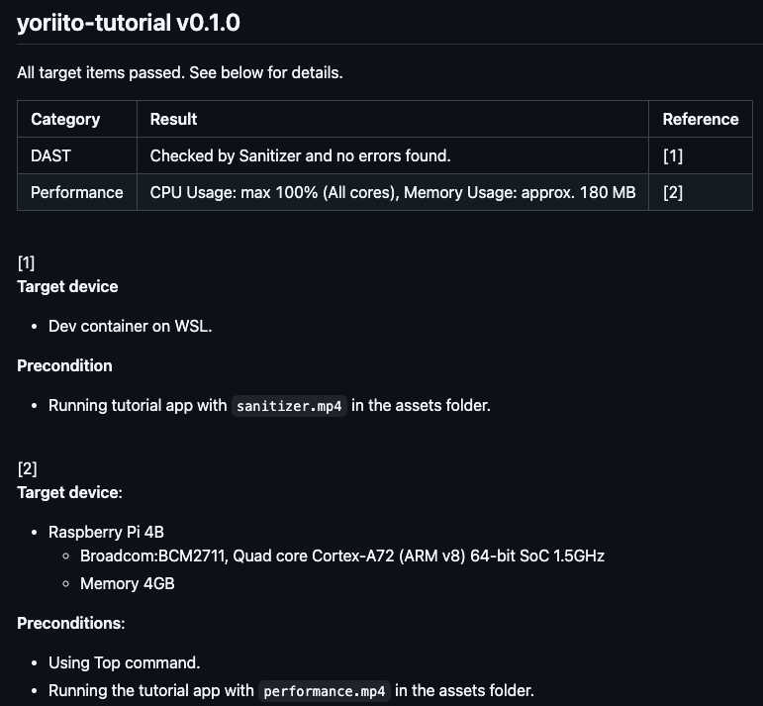
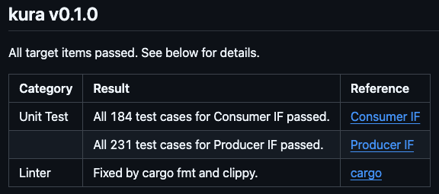
Quality Assessment
Checked below, refer to quality directory for more detail of each repository
Vehicle-api
yoriito
Yoriito-tutorial
kura
Notes:
Quality is an important aspect for us.
We perform quality checks on each major repository,
including vehicle‑api, yoriito core, kura, and the tutorial repository.
Detailed results are published in the quality directories of each repository,
so users can review them transparently.

Slide 23
Agenda
JASPAR Overview
API Standardization in JASPAR
Collaboration with COVESA
Conclusion

Slide 24
COVESA – JASPAR relationship
Specification
Implementation
COVESA
Use / Refer
JASPAR
API Standardization WG
Feedback
VSS
（Vehicle Signal Specification)
Overlay
(Add, Modify and delete)
Reference/
Sample
Application
JasPar
Vehicle Signal
VISS
（Vehicle Information Service Specification）
JasPar Databroker
JasPar Signal API
Implement
Implement

Slide 25
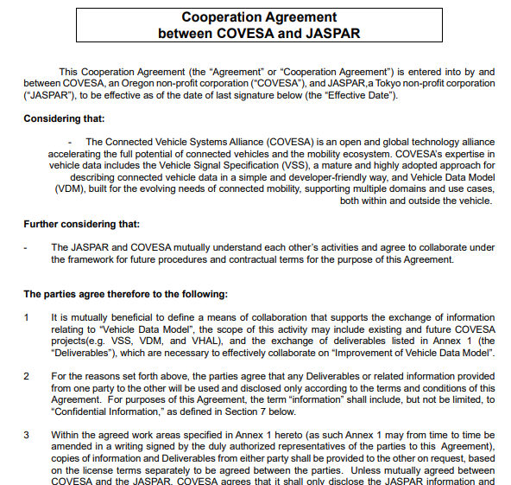
COVESA – JASPAR Collaboration
Signed MoU in 2025 Dec
Kicked-off Joint WG in 2026 March, started regular meetings
COVESA (Opened)
JasPar (Closed -> Opened(Yoriito))
MoU
COVESA EGs
COVESA-JASPAR
Joint Group (New)
JasPar named representative
(Experts / Observers)
JOIN
JOIN
API Standardization WG
Combined efforts and complementary each other to create better, more widely adopted standard!

Slide 26
Agenda
JASPAR Overview
API Standardization in JASPAR
Collaboration with COVESA
Conclusion

Slide 27
Conclusion
JASPAR has started API WG activities involving Japan's leading automobile-related companies since 2025 Feb
Started Signal APIs development (incl. databroker and development tools) based on COVESA VSS
JASPAR has just derivered the first set of APIs in 2026 as OSS
To promote broader adoption of the APIs, JASPAR is willing to collaborate with various open-source communities and standardization bodies.
27

Slide 28
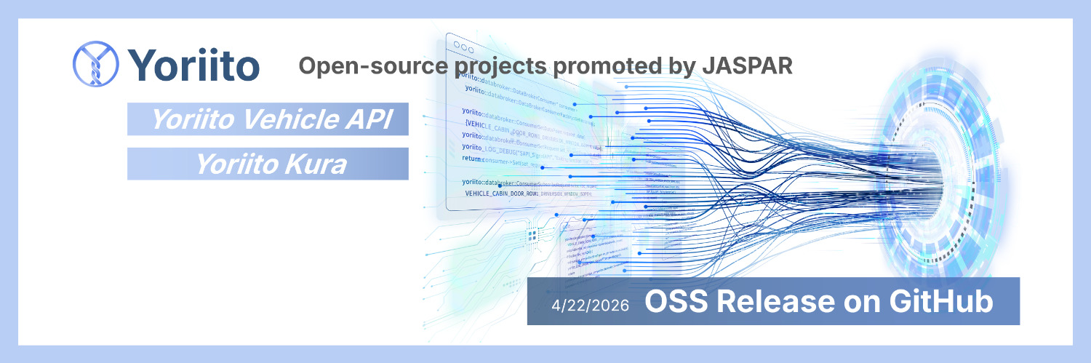



Scan the QR code to visit JASPAR and Yoriito website

Slide 29
Architecture Overview
Application
Access API(Under discussion)
Abstracted APIs (Abstract data structure (vehicle signals) and provide more user-friendly APIs)
Signal API
Access Vehicle Signals
Vehicle Signals are created based on COVESA VSS
(standardize signals for vehicle sensor/actuator)
PAL API
PAL: Platform Abstraction Layer
Abstract OEMs Middleware/OS
JasPar Access API
body
cabin
・・・
・・・
Access Library
JASPAR Scope
JasPar Signal API
Signal Library
JasPar PAL API
JasPar Databroker Client Library
JasPar Databroker
JasPar
Vehicle Signal
OEM A
OEM B
OEM C

Slide 30
Basic Structure of the API
What
Do What
・Headlights
・Windows
・Vehicle speed
・Turn on
・Open
・Read
Operate
Retrieve
Vehicle equipment and functions vary widely
⇒ Clean up similar/duplicated items based on COVESA VSS
(e.g. defroster, de-icer, defogger...)
"Operate" and “Retrieve"

Slide 31
API's "What" ... Operate/Retrieve
VSS^{[1]} : Classifies vehicle equipment and functions with tree structure (e.g., Body::Light::Fog Light::Front::ON state)
⇒ Based on this VSS data structure, define APIs that can operate/retrieve the VSS data
VSS Classification (Tree Structure)
Major Category
Overview
Number of Subcategories
Body
Body shape, hood/trunk, horn, rain sensor, windows, lighting system, side mirrors, etc.
14
Major Classification
Cabin
Shades, Air Conditioning, Roof/Doors, Rearview Mirror, Interior Lights, Seats, etc.
30
Vehicle
Body
Lights
Fog
Front
IsOn
Occupant
Occupant identification for each seat, head and eye position, etc.
3
Beam
・・・
LowVoltageBattery
(Auxiliary Battery) Nominal (fully charged) voltage/capacity, current voltage, current balance (current)
1
・・・
ADAS
Level, CC, LK, Obstacle Detection, ABS, TCS, ESC, EBD, DMS, etc.
11
Mirrors
Windshield
Exterior
Outside temperature, humidity, light intensity, etc.
1
Driver
User identification information, distracted driving detection, hands-off detection, information receptivity, fatigue level, heart rate, etc.
2
Cabin
・・・
Diagnostics
Retrieving active diagnostic trouble codes
1
Chassis
CurrentLocation
Retrieve location information, timestamp, etc.
3
・・・
Trailer
Retrieve whether a trailer is connected
1
AngularVelocity
Acquire acceleration in the roll, pitch, and yaw directions of the vehicle
1
Acceleration
Acquire vehicle acceleration in forward/backward, left/right, and up/down directions
1
Connectivity
Determines network connection status with cloud / Availability of offboard functions
1
VehicleIdentification
VIN, WMI, brand, model, year, body type, number, manufacturing date, color, etc.
1
Service
Maintenance service requirement, distance/time to service (dealer?)
1
Vehicle Signal Specification:
https://covesa.github.io/vehicle_signal_specification/
Chassis
Accelerator, brake, steering, parking brake, etc.
8
Powertrain
Engine/motor signals, fuel/battery signals, transmission signals, etc.
22

Slide 32
API "How to" ... Operations and Retrieval Methods
Operate Method
  Set
  (Application performs the operation
  at any desired time)
App
Headlight Set(On)
Vehicle
Retrieval Method
  Get
  (App retrieves data at any time)
  Subscribe
  (Retrieve when the value changes)
App
Headlight Get()
Vehicle
On
Physical button operation, etc.
App
Headlight Subscribe()
Vehicle
～
On, Off, …

Slide 33
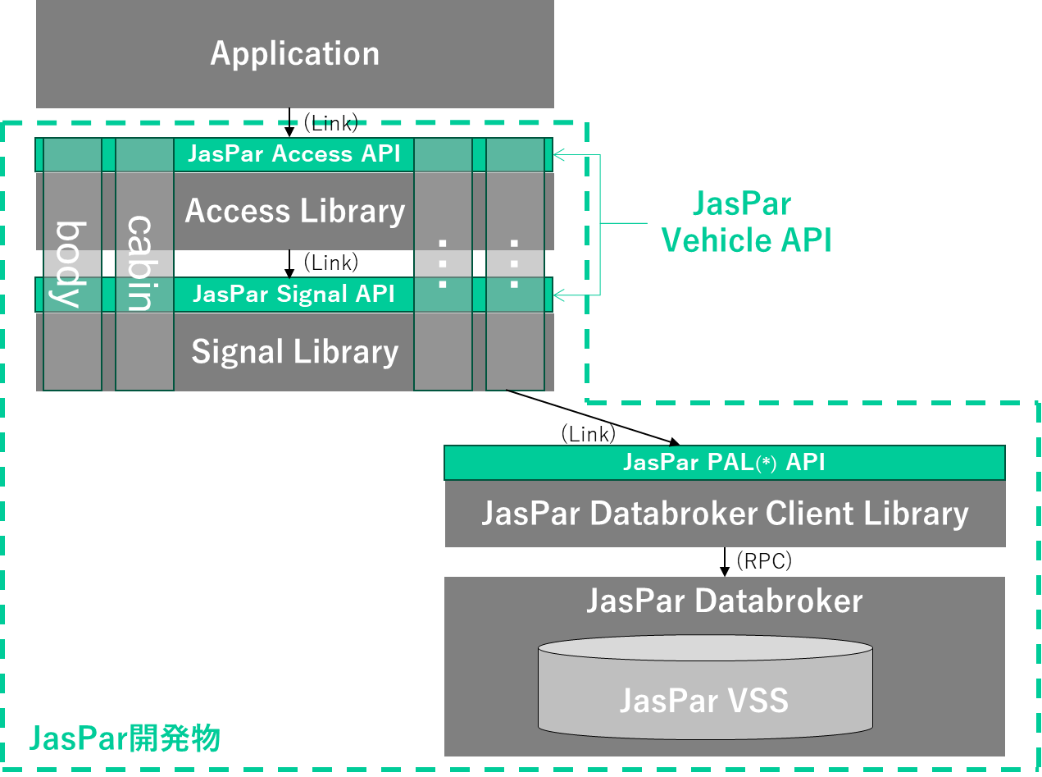
API Hierarchy: JasPar Signal API and JasPar Access API
To balance comprehensiveness and convenience, we define an Access API to enhance usability on top of the Signal API that utilizes VSS
✅ JasPar Access API (under detailed consideration)
Ex. TurnHeadLight(HeadLight::High)
...Turn headlights to high beam
Application developer can directly calls the Access APIs
Bundling Signal APIs to enhance usability
✅ JasPar Signal API
Ex. jaspar::vehicle::body::lights::beam::high::ison::Actuator::Set(true)
... Turns on the headlight high beams
Adopting the VSS tree structure
VSS node types
Overall Architecture
Use same name and type as VSS so that developer can easily find API

Slide 34
API Standardization Approach
Derivalables
(2) Scope of Standardization
(3) OSS
API
  I/F Spec Documentation (incl. behavior definitions)
  Source Code
  API Evaluation Program
  Sample Code
SW Development Process and Support Tools
  API Design & Development Process
  SDK, Runtime, and API Management Infrastructure
From Interface to API Implementation
Ensure the consistent behavior of APIs by standardizing the Middleware/HAL implementation.
Accelerate the development process by utilizing the software assets of participating companies.
  Release the Deliverables as OSS
By making them OSS, we aim to ensure that our standardized APIs will be widely used.
Promote collaborations with other OSS initiatives (such as COVESA, AGL and Eclipse) and ecosystems.
Through these 3 perspectives, we will promote the standardization of APIs and address related topics
34
Notes:
皆さん、如何でしたでしょうか？
次にこちらが、具体的なJASPARでのAPI標準化活動における内容です。
一番左が、作成するものです。
先ほどから説明していますように、APIの定義書だけでなく、それらを実装したソースコードや、評価仕様やサンプルアプリを提供します。
また、実際に利用する上で必要な、SDKなども提供する予定です。
真ん中の開発Scopeに関しても、前のページで説明した通り、APIとミドルウェア、そしてHALです。
また最後、一番右の部分に記載しているのは、成果物をOSSとして公開していく、という事です。
既存のJASPARでは、メンバー企業でしかJASPARの成果物を利用できませんでしたが、本活動に関してはOSS化することを前提に進めています。
公開時期は、少し先ですが、2026年の4月以降です。
前述の通り、JASPARとしては初のOSSによる提供になりますので、IPの扱いなど、色々変更や対応する事も多く、皆さんからすると少し時間かかりすぎと思われるかもしれませんが、必ずOSS化はしますので、しばらくお待ちください。
また、OSS化する前にこの活動にご興味ある場合は、是非JASPARに加入頂ければ、勿論可能です。
---
How was that, everyone?
Next, I’d like to walk you through the actual content of JASPAR’s API standardization activities.
On the left side, you can see what we plan to deliver.
As mentioned earlier, this includes not only API specification documents, but also the corresponding source code implementations,
evaluation criteria, and sample applications.
We also plan to provide SDKs and other tools necessary for practical use.
In the center, you’ll find the development scope, which—as explained on the previous slide—covers the API definitions,
middleware, and the HAL (Hardware Abstraction Layer).
Finally, on the right side, this show that we will release these deliverables as open source.
Traditionally, JASPAR deliverables have only been available to member companies.
However, for this initiative, we are proceeding with the assumption that everything will be made open source.
The release timing is a bit further out—scheduled for April 2026 or later.
As this will be JASPAR’s first open-source release, there are many adjustments to be made,
including how we handle intellectual property.
Some of you may feel the process is taking longer than expected, but rest assured—we are committed to making this open source, so please bear with us.
And if you’re interested in getting involved before the open-source release, we’d be happy to welcome you as a JASPAR member.
Participation is absolutely possible.

Slide 35
Roadmap
In the MVP phase, establish minimal APIs and infrastructure
For the Adoption phase, extend and promote the APIs so that many developer can use
2025/04
2025/12
2026/01
2026/12
MVP Phase
Adoption Phase
Develop minimal APIs and basis for the development
Develop primitive APIs for accessing vehicle data based on COVESA VSS.
Make design rules and development process. Set up development infrastructure.
Develop SDK to promote API adoption
Make process to support API adoption
(e.g. maintenance process, release process)
Activities
API evaluation (PoC)
Evaluate the APIs through application development
API improvement/extension
(e.g. support non-functional requirements, more abstracted APIs)
OSS preparation
Make processes for OSS development
OSS execution
Release deliverables as OSS.
Collaborate with other OSS community
Release Plan
●R1.0
(‘26/xx)

Slide 36
②API開発： COVESAとの関係
仕様定義
実装・検証
COVESA
参照
JASPAR
API技術WG
提案
JasPar
Vehicle Signal
VSS
（Vehicle Signal Specification)
追加・選択
車両信号の共通データモデル仕様
JasPar Databroker
VISS
（Vehicle Information Service Specification）
追加・選択
VSSで定義された車両信号データに
アクセスするためのAPI仕様
仕様策定はCOVESA、JASPARは利用、実装、Feedbackを行う

Slide 37
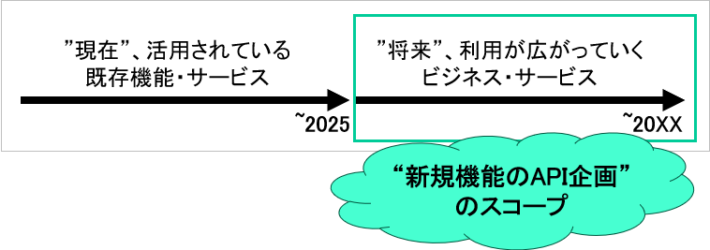
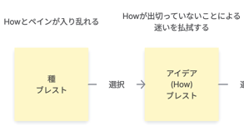
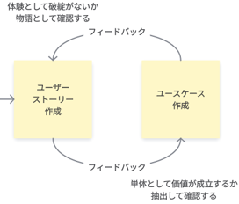
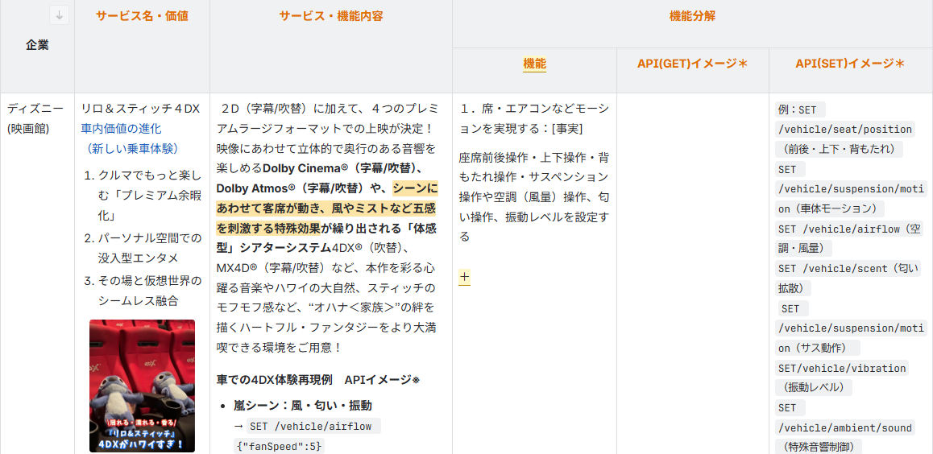
③API企画
“将来”、利用が広がっていくビジネス・サービスに必要となりそうなAPIの探索
「アイディエーション」 と 「サービス調査」 の2本立てで推進
API企画全体のスコープ
達成
目標
クルマを使ったビジネス・サービス案から
VSS発の検討で生まれないAPIの探索
JASPARの標準APIが将来のビジネス・
サービス実現に不足ないかの確認
実現したい機能やユーザペイン、あったらいいなという自由な発想でアイデアの種、Howをブレストにて創出
サービス情報
・提供企業
・サービス名、価値
・サービス内容
機能
GET/SET
まずは、浅く広く調査を実施
⇒注力先を検討中
(本格調査はFY26実施予定）
STEP1
STEP2
STEP3
STEP4
種
ブレスト
How
ブレスト
ユーザストーリ
作成
ユースケース
作成
選定
現状のJASPAR方針の「まずBody系」や「2030年前後のSOPへの採用を目標」 等を意識し、比較的 現実的なアイディアを選定（選定しなかったものはアイディアバンクへ）
今回選定しなかったアイディア例
・現状、検知方式・センサが無い
・現状、車両機構・アクチュエータが無い
・Body以外 (ex. AD/ADAS系)
・標準化の対象から外れそう・・・(競争領域案件)
  あらゆる業界(自動車業界も含む)のサービスを調査中
・開発インフラ ・データ/サーバー
・フリート/公共交通 ・保険
・インフラ ・販売
・エンタメ
・・・
どの業界を深掘りするのが良いか議論中

Slide 38


④開発環境：API開発の流れ
SDKによるAPIを開発
JasPar Access API
body
cabin
・・・
・・・
Access Library
JasPar Signal API
Signal Library
GHCR
jaspar-sdv-dev
アーキ
テクチャ
設計書
JasPar PAL(*) API
Container Image
(SDK)
JasPar Databroker Client Library
SDK
JasPar Databroker
設計
レビュー
CI/CDによる
SDK自動リリース
SDK(コンテナ)を
開発マシンへ展開
JasPar VSS
API開発者向けにSDKを作成して、効率よい開発を推進。26年度には、API利用者向けを開発開始

Slide 39
2026年1月末までのアウトプット
COVESA VSSを基に、車両信号を網羅的に操作できるAPIを実装。また、利用者が”すぐ使える”ようにするため、チュートリアルや各種ドキュメントも整備した。
活動テーマ
実施内容
想定成果物
現状の実績、主なアウトプット
API企画
車両機能網羅性を担保するため、COVESA VSSの信号をもとに車両機能を定義
上記のVSS企画以外に、車両利用者ニーズに対応するAPIの調査、企画を実施
定義した車両信号一覧
サービス調査結果
ユーザーストーリー
ユースケース
定義した車両信号数：631
調査サービス数： 83件
ユーザーストーリー： 23件
ユースケース： 117件
API
開発
設計
実装
定義された機能を基にSignalAPIの設計および実装
Signal API
Signal API本数： 10,132 /10,132
APIソースコード行数：
実装コード 375,773 /テストコード 515,629
利用検証
品質管理
API利用促進に向けたチュートリアル作成、
サンプルアプリ実装
品質基準の定義、利用検証
HeadlessApp/UIフレームワーク
チュートリアルドキュメント
HeadlessAppのソースコード行数： 3,375
UIのソースコード行数： 2,114
チュートリアルドキュメント
アーキ
開発環境
アーキテクチャ(JASPAR Databroker)の設計・構築、開発ガイドラインの作成
開発環境(SDK、シュミレーター、Runtime、CLI、CI/CD、各種ライブラリ)の検討
JASPAR Databroker
各種ライブラリ(loggin機能やPAL等)
各種設計書・実装ガイドライン
開発環境の構想書
JASPAR Databroker実装コード行数： 97,000
各種ライブラリ
各種ドキュメント
  設計書
  仕様書
  実装ガイドライン
計画通り推進している

Slide 40
今後の活動
成果物は26年度内に公開を目指す。公開後は、OEMやTier1企業を中心にAPIの利用検証を進め、得られたFBを基に機能拡充や品質向上を図り、半年ごとに更新していく予定。
API・関連ドキュメントの公開
API/基盤の拡張、ブラッシュアップ
目指す状態
APIを利用可能な状態で公開し、APIの存在を
多くの企業や関係者に広く認知させ、利用していただく
OEMやTier1企業を中心にAPIの利用検証を進め、
得られたFBを基に品質向上および機能拡充を図る
公開対象
利用者が迷わず使えるようにAPIのプログラムだけでなく、チュートリアル等のドキュメントも拡充させて公開する
Signal API
Kura（DataBroker）/JASPAR VSS
各種ライブラリ(loggong機能やPAL等)
HeadpessApp/UIフレームワーク(Flutter)
チュートリアル
仕様書等のドキュメント
OEMやTier1企業を中心にAPIの利用検証を行い、
アップデートしたものを公開する
Signal API (アップデート版)
Kura（Data Broker）/JASPAR VSS(アップデート版)
公開対象 選定の考え方
公開対象 選定の考え方
公開成果物
公開成果物
詳細・追加情報は
3月４日JASPAR活動報告会にて報告

