Slide 1
Abstract as sent
Title: The Vehicle OS Will Be Open — If the Industry Converges Now
Abstract:
Open source is becoming a strategic foundation for the software-defined vehicle — reducing duplicated investment, limiting lock-in, and enabling OEMs to compete on customer experience rather than base-platform plumbing. Yet today’s landscape remains fragmented across initiatives, regions, and layers of the stack.
This session examines how Eclipse S-CORE, JASPAR API, COVESA VSS, AGL, Eclipse Ankaios, and related efforts can converge into a credible global open-source Vehicle OS. It highlights what is already mature, where gaps remain, and why governance, commercial models, and adoption are now decisive. The focus is clear: moving from parallel building blocks to a shared industry platform within the E/E architecture.

Slide 2
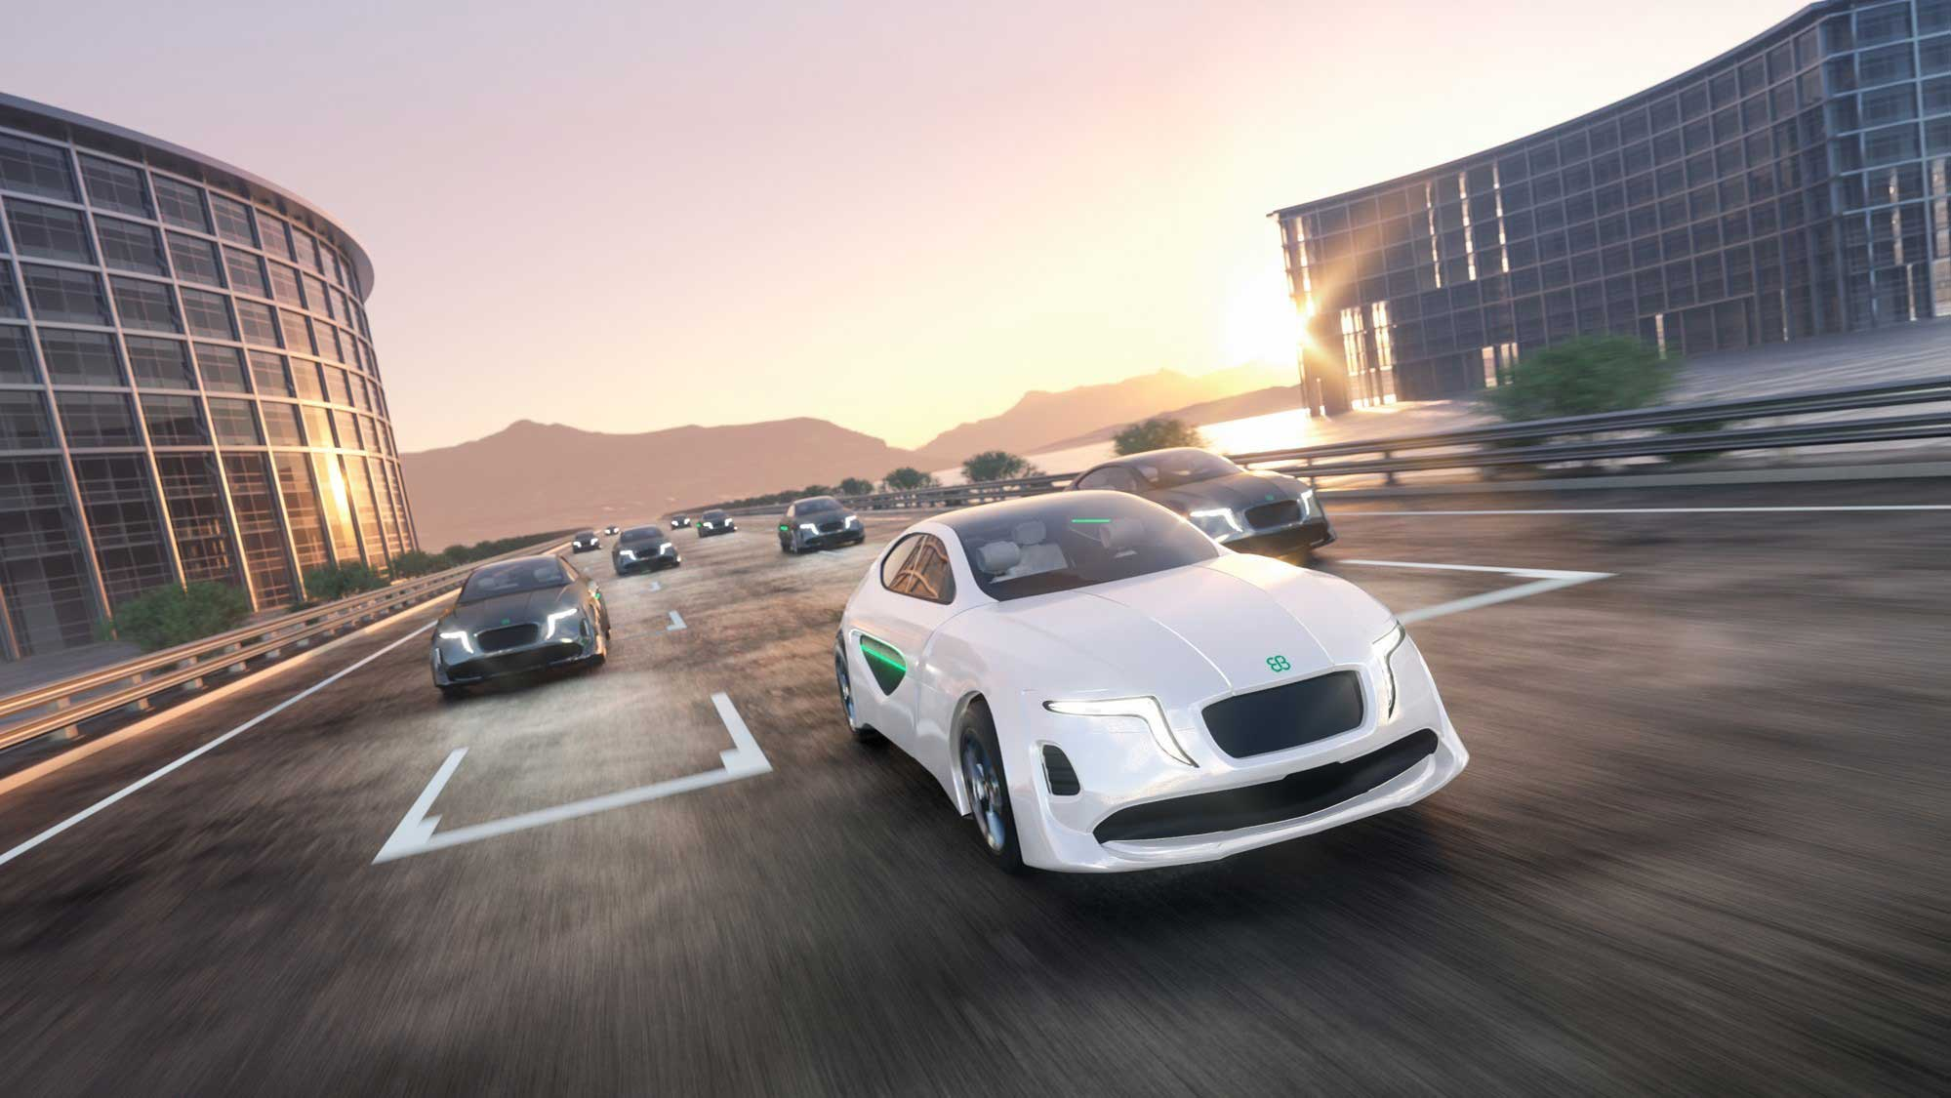
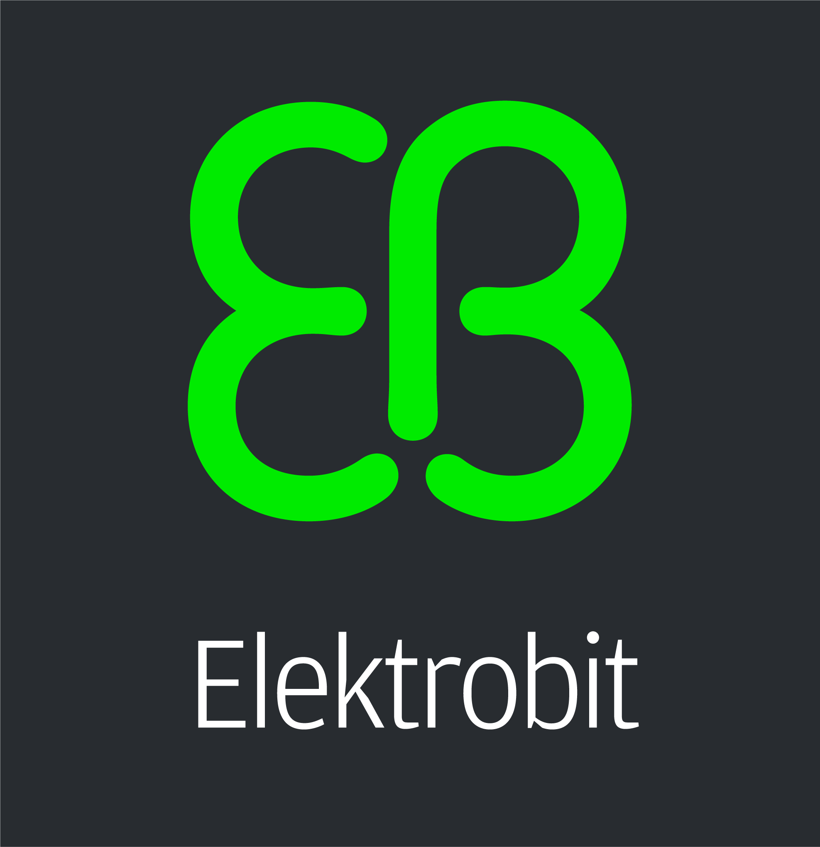
The Vehicle OS will be open — if the industry converges now
Maria Anhalt
Notes:
Open source is becoming a strategic foundation for the software-defined vehicle — reducing duplicated investment, limiting lock-in, and enabling OEMs to compete on customer experience rather than base-platform plumbing. Yet today’s landscape remains fragmented across initiatives, regions, and layers of the stack.
This session examines how Eclipse S-CORE, JASPAR API, COVESA VSS, AGL, Eclipse Ankaios, and related efforts can converge into a credible global open-source Vehicle OS.
It highlights what is already mature, where gaps remain, and why governance, commercial models, and adoption are now decisive. The focus is clear: moving from parallel building blocks to a shared industry platform within the E/E architecture.

Slide 3
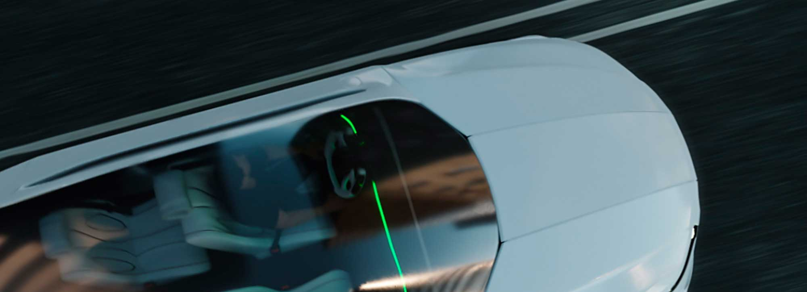
Content
01
02
03
The Vehicle OS
The Vehicle OS puzzle
The missing pieces

Slide 4
The Vehicle OS in the age of SDV
From distributed ECUs to one centralized, software-defined platform
What it is
One integrated software platform across central and zonal compute – abstracting hardware so features are developed, updated and scaled independently of the ECUs.
A leading example
Mercedes-Benz MB.OS – chip-to-cloud, spanning all four vehicle domains.
Peers: VW.OS, BMW, Toyota Arene, Stellantis STLA Brain, Tesla
Key ingredients
Mixed-criticality kernels (Linux, QNX, AUTOSAR)
Hardware abstraction and service-oriented middleware
Safety and security by design (ISO 26262, ISO 21434)
OTA, DevOps and cloud toolchains
What does the market ask for
Faster time-to-market and reuse across model lines
Lower cost through ECU consolidation
New revenue from software and data services
Less supplier lock-in via open standards

Slide 5
Why open-source powers the Vehicle OS
Open foundations are what make a modern automotive software platform buildable, shareable and scalable
01
A shared foundation
Linux, real-time kernels and service-oriented middleware give every Vehicle OS a proven base layer no single carmaker builds alone.
02
Open collaboration
Common standards and projects such as Eclipse SDV, JASPAR, AGL, AUTOSAR Adaptive and COVESA let carmakers and suppliers co-develop instead of reinventing.
03
Strategic advantage
Portable, reusable code speeds time-to-market, lowers cost and frees brands from vendor lock-in across every model line.

Slide 6
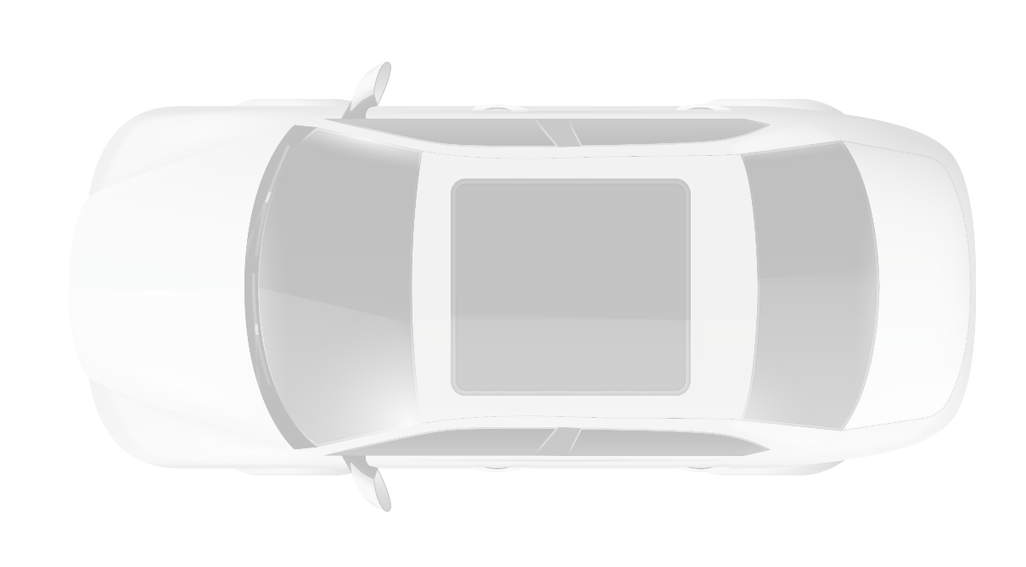
Open source in automotive today
Central ECU
(Body + Cockpit)
Eclipse S-CORE
Core stack for high-performance ECUs
JASPAR API
Standardized vehicle API and development environment
Central ECU (ADAS)
Zonal ECU
Automotive Grade Linux
Linux for IVI, Body and Gateway
Android Automotive
Open IVI platform and apps
COVESA VSS
Vehicle Signal Specification
Autoware
Open autonomous driving stack
RISC-V
Open hardware ISA
Zephyr RTOS
Real-time kernel for ECUs
Periph. Sens/Act
Periph. ECU
… and many others
Notes:
And just as an example, open source is in production and on the road, AOSP alone is estimated with 64% market share today for vehicle infotainment systems
And also for Elektrobit Open source is natural and part of our business, we are collaborating and contributing to multiple Open source and consortia activities

Slide 7
Content
01
02
03
The Vehicle OS
The Vehicle OS puzzle
The missing pieces

Slide 8
Why is a Vehicle OS so hard for the industry?
Challenges span technology, business model and innovation speed — the hardest barriers are organizational, not just technical
1
Technology & Engineering
2
Business & Commercial
3
Innovation Speed & Operating Model
Unwinding legacy E/E — 100+ distributed ECUs with tightly coupled hardware and software must be re-platformed onto centralized / zonal compute
Integration complexity — stitching fragmented software stacks from dozens of suppliers into one reliable, maintainable platform
Safety & security gating — ISO 26262 functional safety plus 500+ new global regulations slow every release and certification cycle
Decoupling & OTA — separating software from hardware and retrofitting robust over-the-air update pipelines onto existing vehicles
Huge, uncertain capex — VW's Cariad absorbed €14B+ and ~$7.5B operating losses before being recast as an integrator of partner code
Tier-1 dependency — leaning on suppliers means loss of control over the stack — a hard make-vs-buy dilemma
Unproven monetization — recurring subscriptions and OTA feature upgrades still earn far less than the promised software revenue
Talent gap & culture — competing with tech giants for software engineers (~150k projected shortfall) inside a hardware-first organization
Waterfall vs. agile — ASPICE-gated, phase-driven programs clash with continuous DevOps delivery and fast iteration
Cadence mismatch — multi-year vehicle development cycles cannot match tech-industry release speed
Software-native rivals — Tesla, BYD, NIO and Xpeng iterate years ahead; China is scaling SDVs fastest
Becoming a software company — the blocker is restructuring the operating model and culture, not just adopting new tooling

Slide 9
Distributed IP ownership — the journey to open source
Shared, co-developed code makes ownership the fourth hard challenge — and pushes the platform from proprietary toward open source
4
Distributed IP ownership
Why it points toward more open source
Joint ownership — co-developed code across OEMs, suppliers and consortia blurs who actually owns the IP
License compatibility — mixing copyleft and permissive licenses in one stack creates real compliance risk
Patent exposure — uneven indemnification and non-assertion leaves members open to third-party claims
Open vs. differentiate — contributing to shared platforms can erode the proprietary advantage OEMs rely on
Shared platforms spread the cost of non-differentiating software across the whole industry
Neutral, foundation-style governance stops any single OEM or supplier from owning the IP
Open licenses make patent, non-assertion and contribution terms explicit and predictable
Differentiation moves up the stack — to apps, data and experience, not the base platform
IP journey — from proprietary, member-gated terms to fully open source
AUTOSAR
JASPAR
SOAFEE
COVESA
Eclipse SDV
CLOSED SOURCE
OPEN SOURCE
Copyright-locked specs; commercial use needs a paid partnership licence; closed reference code
Member-gated deliverables under Japan IP rules; only now open-sourcing APIs via Yoriito
Open, fee-free architecture; public specs, but blueprints and voting stay member-governed
Open source by default — MPL-2.0 weak copyleft plus Apache-2.0; published IP policy
Fully open source (EPL-2.0 / Apache-2.0); Eclipse IP flow grants patent licence & non-assert
Notes:
Last point, „Differentiation moves up the stack“ refer to the Elektrobit SDV levels that already pitch in the same direction

Slide 10
What open-source covers — and what it doesn’t
Many open-source projects want to provide building blocks for the vehicle OS. Significant overlap and duplication slows progress and wastes effort.
Open-source coverage across the automotive stack
Applications & HMI
Navigation
Media / IVI
App store
OEM apps
3rd-party
What open-source covers
Open source
Vehicle services & API
Vehicle API
Connectivity
Diagnostics
OTA updates
Vehicle OS
Open standard / proprietary
Partial / framework only
Not covered — supplied by others
Middleware & comms
Comms stack
Data broker
Frameworks
Security
COVESA
JASPAR
Operating systems
RTOS
General-purpose OS
Safety OS
AUTOSAR
Eclipse SDV
Hypervisor
Hypervisor
Virtualization
Automotive Grade Linux
Linux Project
Xen Project
Hardware
SoC / MCU
Zephyr OS Project
RISC-V

Slide 11
Content
01
02
03
The Vehicle OS
The Vehicle OS puzzle
The missing pieces

Slide 12







The missing pieces
The recurring asks — whole-stack coverage, proprietary parts going open, clear IP ownership and clean interfaces — finally come together
The missing pieces:
1
Whole-stack coverage
One platform spanning every layer, not just isolated parts
2
A true open-source vehicle OS — owned clearly, openly licensed, whole-stack, cleanly interfaced, reusable across car lines
Proprietary goes open
Today’s closed blocks open up — e.g. AUTOSAR moving toward open source
3
Clear IP ownership
Unambiguous rights across the entire OS, not piecemeal
4
Long term maintenance
Ecosystem and community to support throughout the lifecycle

Slide 13


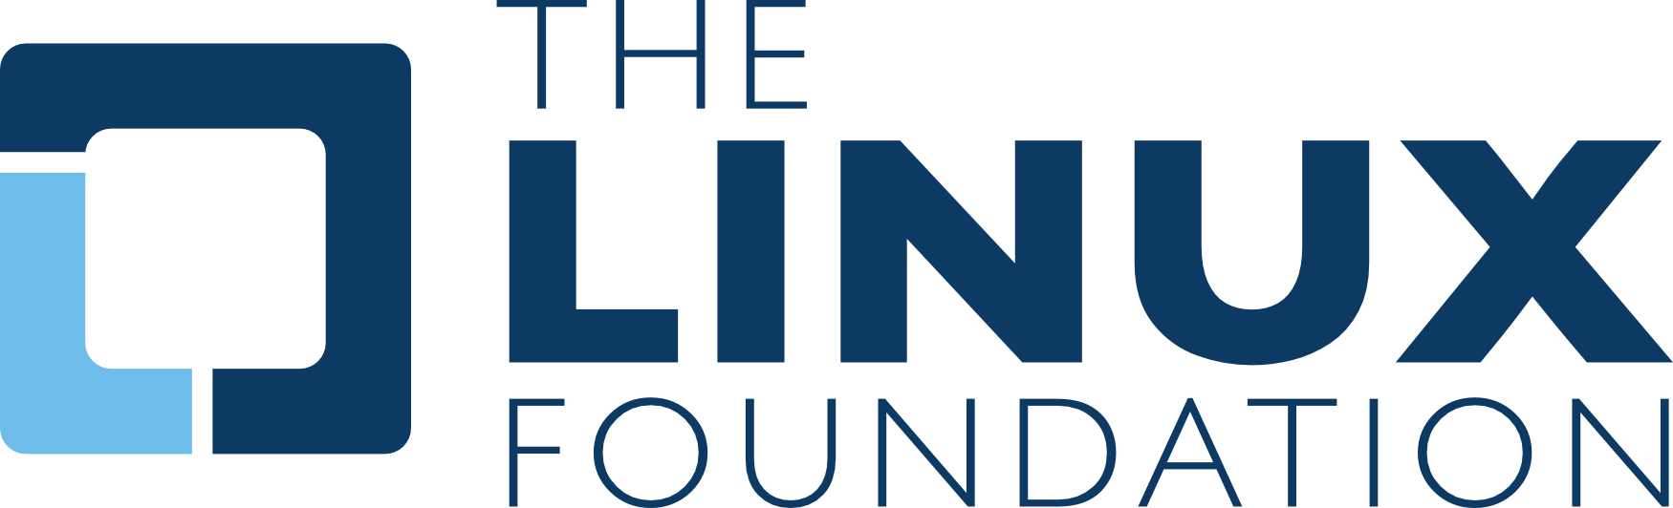
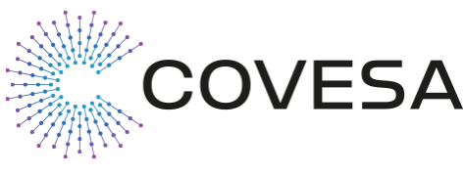
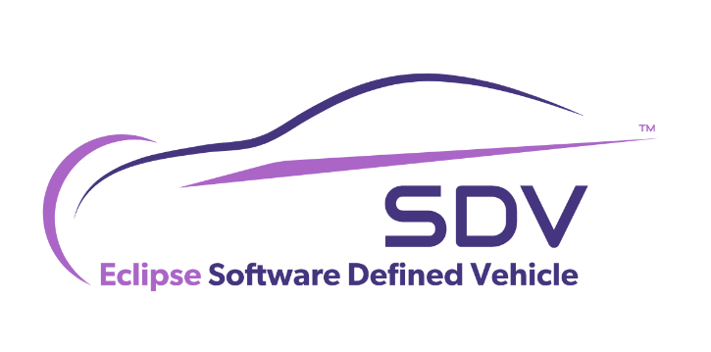


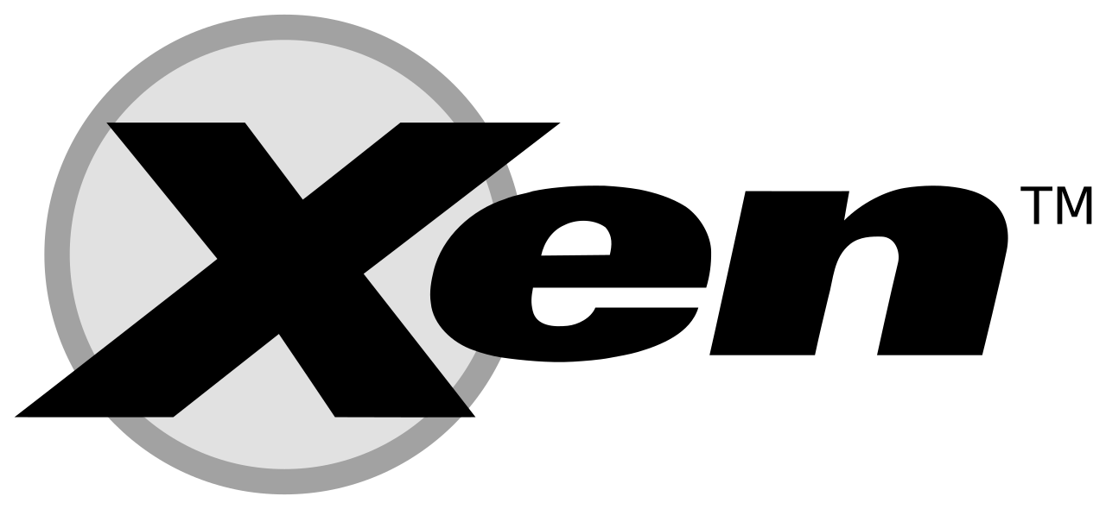
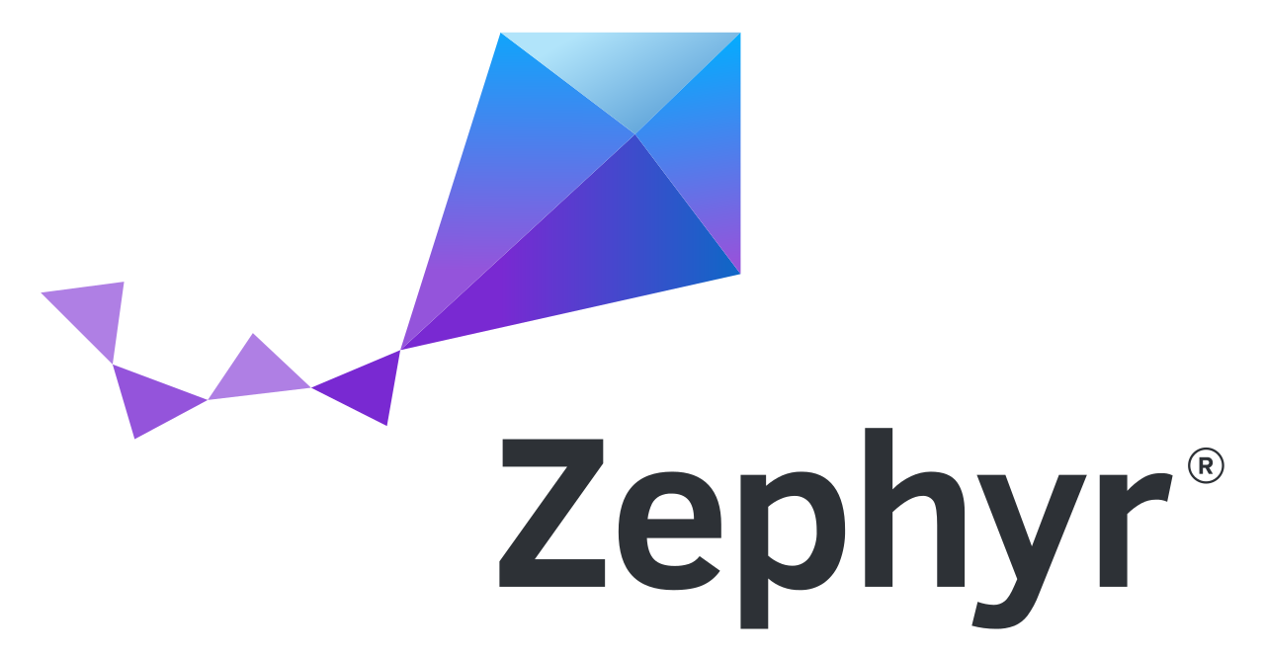
Convergence
What it looks like – shared interfaces and a proven baseline
1
Common semantic API
2
Reference integration
What it means
Applications target one shared, meaning-based interface instead of platform-specific calls.
Why it matters
Software written once runs across vehicle platforms and car lines without costly rewrites.
What it means
A canonical, working build showing how the open components fit together end to end.
Why it matters
Teams validate against a proven baseline, cutting integration risk and guesswork.
1
2
SPANNING THE OPEN-SOURCE ECOSYSTEM

Slide 14


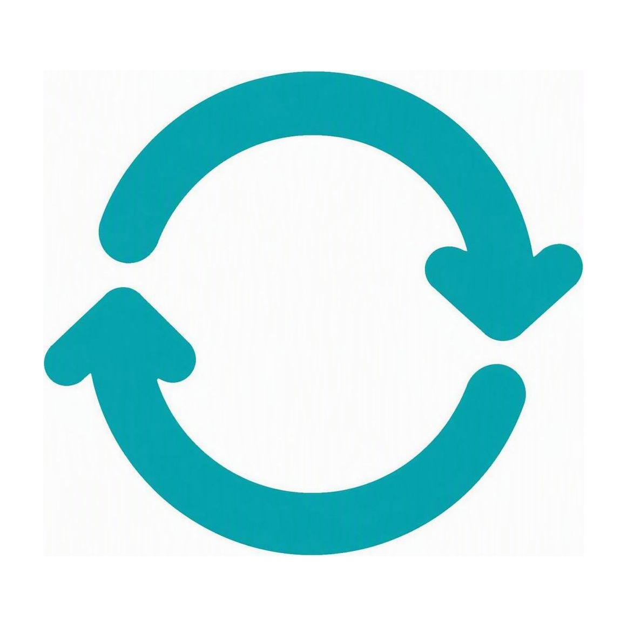
Convergence
What it looks like – coordinated projects and certified interoperability
3
Structured bridge between projects
4
Conformance profiles
What it means
Formal coordination links the separate open-source efforts such as AUTOSAR, Linux and COVESA.
Why it matters
Aligned roadmaps replace duplicated, divergent work and keep interfaces compatible.
3
What it means
Defined compliance levels that implementations can test and certify against.
Why it matters
Buyers and partners gain a clear, verifiable guarantee of interoperability.
4
5
Joint release trains and integration labs
What it means
A synchronized release cadence backed by shared facilities for continuous testing.
Why it matters
Predictable, jointly validated releases shorten time to a production-ready stack.
5

Slide 15
Business model convergence
Open source doesn’t eliminate business models – it shifts value from license control to integration, qualification, lifecycle and compliance.
OPEN CORE
COMMERCIAL VALUE
Reference architecture
Productized integration
API mappings
OEM-specific adaptation
Open CI tests
Qualification evidence
Community release
Long-term maintenance
Open conformance profile
Safety/security lifecycle service
Reference stack
Production-grade platform integration
“Open source creates the commons. The business is making the commons production-grade.”

Slide 16
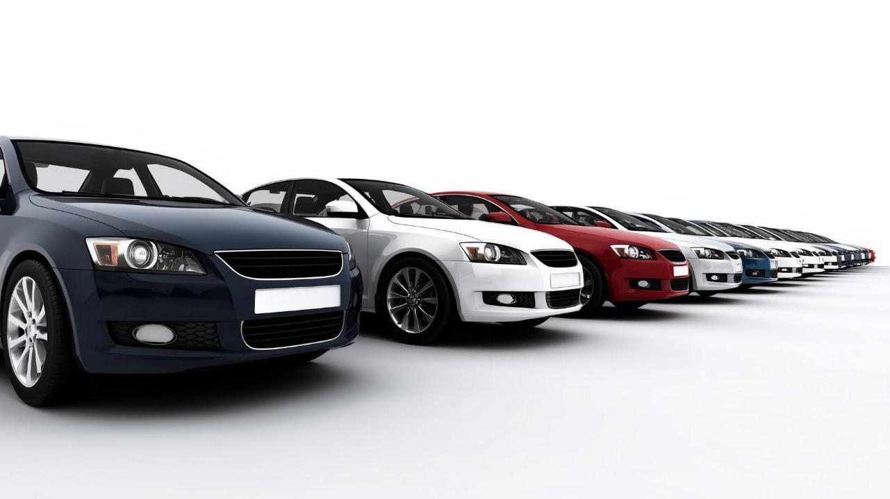
Will there be an open source Vehicle OS?
Notes:
The average modern vehicle's software contains already largely open source, by code volume ~70% originate from open source already (based on OSSRA report)
Yes, it looks that way and S-Core is a great example that bringts the industry together and helps it to move forward
There are challenges like Intellectual Property in Autosar but also there are activities launched to work on these challenges
AI as a new technology will also continue to impact automotive software and the traditional ways we integrate these components together

Slide 17
How Elektrobit drives the industry to open source
Three initiatives where we lead the industry toward open, safety-critical vehicle software
01
02
03
EB corbos Linux for Safety Applications
Eclipse S-CORE — an open Safe Vehicle Core
Eclipse Ankaios — open vehicle orchestration
The world’s first open-source OS assessed for automotive functional safety.
Co-developing an open, safety-aligned vehicle core with BMW, Mercedes-Benz and Qualcomm.
Our own Eclipse project orchestrating software workloads on in-vehicle high-performance computers.
ASIL B / SIL 2 certified
Founding member
Initiated & led by Elektrobit
CES 2025 Innovation Award
ISO 26262 aligned
Eclipse SDV project
Live in Mobileye Drive
Shared, reusable core
Automotive-grade, in Rust
We don’t just adopt open source – we lead it. 35 years in automotive, 630M+ vehicles powered.

Slide 18
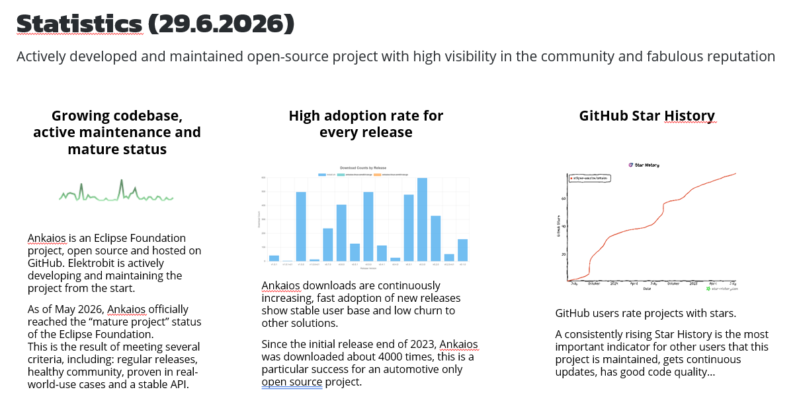
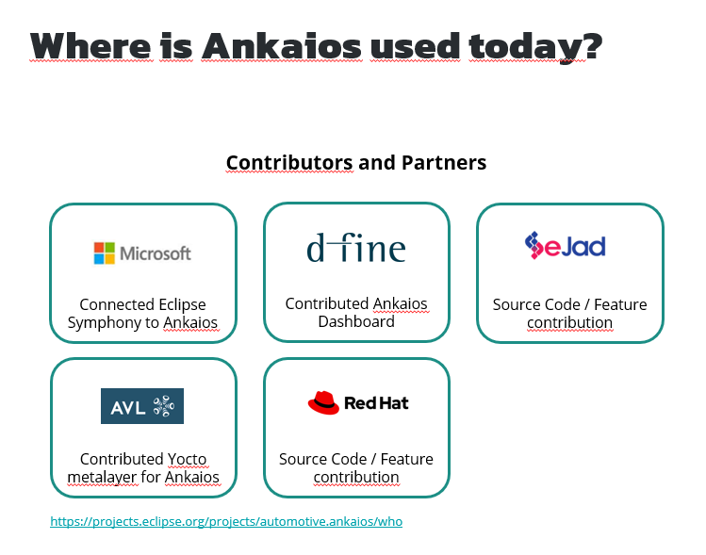
How Elektrobit drives the industry to open source
Three initiatives where we lead the industry toward open, safety-critical vehicle software
01
02
03
EB corbos Linux for Safety Applications
Eclipse S-CORE — an open Safe Vehicle Core
Eclipse Ankaios — open vehicle orchestration
The world’s first open-source OS assessed for automotive functional safety.
Co-developing an open, safety-aligned vehicle core with BMW, Mercedes-Benz and Qualcomm.
Our own Eclipse project orchestrating software workloads on in-vehicle high-performance computers.
ASIL B / SIL 2 certified
Founding member
Initiated & led by Elektrobit
CES 2025 Innovation Award
ISO 26262 aligned
Eclipse SDV project
Live in Mobileye Drive
Shared, reusable core
Automotive-grade, in Rust
We don’t just adopt open source – we lead it. 35 years in automotive, 630M+ vehicles powered.

Slide 19
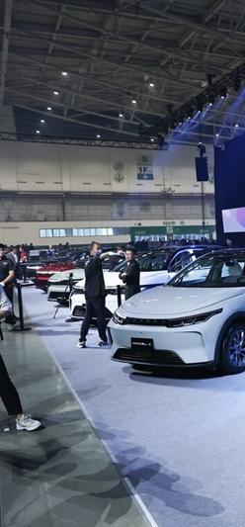

How can we help?
Smart SDV platform
Architecture review and consulting
Platform variants
SDV use-case definition
Development model
Right-sized SDV for global vehicle portfolios
Hands-on PoCs including vehicle functions
Identification of first use-case
PoC in-vehicle showcasing Smart SDV and existing E/E integration
Incremental adaption of E/E architecture
Staged rollout into staggered projects and platforms
Implementation of connectivity and applications
Integration into existing OTA backends or completely new setups
Typical in-car experience apps for a complete offering
© Elektrobit 2026 | Public
June 30, 2026

Slide 20
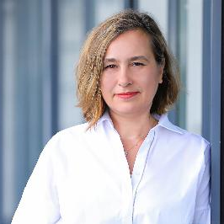


Thank you
Maria Anhalt
CEO
Elektrobit – Our software moves the world
maria.anhalt@elektrobit.com
elektrobit.com

