Slide 1
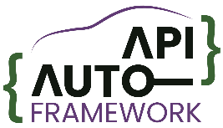
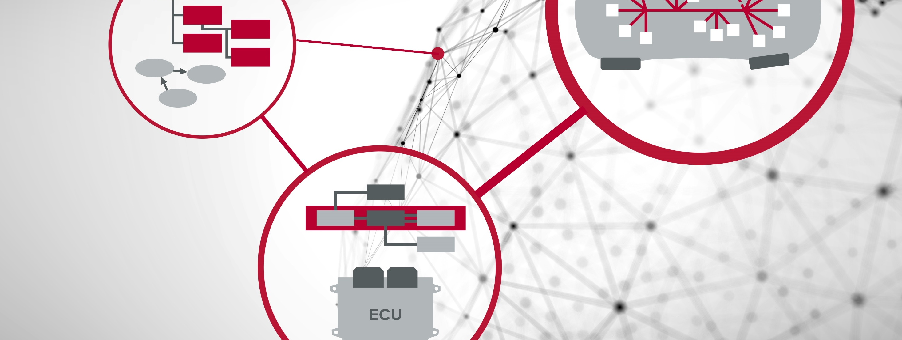
Eclipse.SDV blueprint around the Automotive API Framework project - Platform independent development for SDV projects in practice -

Slide 2
Agenda
About
Short introduction to the Eclipse Automotive API Framework project.
Blueprint project
Introduction to the scenario.
Signal catalogue and interface definition.
Application development and unit testing.
Executable integration and system-level testing.
Outlook
Next steps/milestones.

Slide 3

About
The Eclipse Automotive API Framework project
Partner alignment and kickoff meeting in July 2024.
Initial project presentation at Eclipse.SDV Community Days in Rotterdam.
Slides and recording.
Close afterwards, initial project contributions:
vss-gui-tool (ZF Group)
application-framework (Vector Informatik)
Migration to GitHub and Application Framework rc 0.6.0
Extended presentation with live demo at Eclipse.SDV Community Days in Gifhorn.
Slides and recording.
Interview about general motivation for this project.
Recording
Issue of Shifting Gears with SDV webinar with a detailed Application Framework tutorial.
Recording
Application Framework rc 0.7.0 with several improvements and new features.
Contribution of blueprint project and its variations.
Presentation at Eclipse.SDV Community Days in Bonn.
Q2/2024
Q1/2025
Q2/2025
Q4/2025
Q1/2026
Today

Slide 4
About
In a nutshell
The Application Framework is a compile-time solution for lower-layer independent design/implementation/test of distributed applications.
It is best described by a thin, modeled and generated layer in the µP stack but also the workflow and tool to configure it.
Text-based user experience through Configuration as Code and CLI tool. Ready for CI/CD and AI agentic workflows.
An application can consist of 1..N executables with 1..M app-modules each.
VSS is one possible input format. The VSS GUI tool allows to create custom signal catalogues.
Communication between app-modules is of central interest. API is identical for executable-internal and external communication.
Modularized application logic. App-modules facilitate work split and do not depend on lower layer middleware.
Application
Horizontal and vertical connection are identical from app-module perspective.
Executables
Wiring of app-modules and platform modules takes place via configuration at system compile-time.
App-module I
App-module II
App-module III
Control module covers runtime, execution, logging, error handling on executable-level.
Attachment at compile-time.
Imported interface design, derived from signal catalogue, or based on own definition.
Control module
Control module
Modeled and generated contract.
Middleware abstraction module (SIL Kit)
Middleware abstraction module (*)
Middleware abstraction module (*)
VAF can be used to realize a platform gateway, i.e., to realize a stable contract.
SIL Kit API
Middleware API
Lower-layer API gets abstracted by dedicated middleware modules. This facilitates an easy exchange.
SIL Kit registry
IPC channel / shared memory
Fast prototyping of distributed applications within minutes.
Pre-integration and SIL tests via SIL Kit. Production system based on qualified communication middleware.

Slide 5

About
API details
The Vehicle Application Framework (VAF) covers four functional aspects that are provided to programmers in dedicated groups of Application Programming Interfaces (APIs).
Plan is to support the following 4 pillars that are considered essential for the realization of most distributed applications in automotive.
In general, the VAF API is typed (basetypes and custom complex datatypes).
Communication – vaf::com
Key element for the realization of distributed applications.
Data elements for get/set end event-driven mode.
Operations for remote procedure calls.
Interfaces to group above elements.
Persistency – vaf::per
Persistent storage of data elements.
Based on key-value storages.
VAF API
Diagnostics – vaf::diag
Support for selected diagnostic use cases. For example, access to diagnostic IDs (DIDs).
Based on data elements.
+
Control – vaf::ctrl
Main function, interaction with OS, and other boilerplate.
Realization of the programming model, threading etc.
Executable controller for module instantiation, wiring, and operation.
Executable life cycle with state machine + user hooks.
Available
+
Planned

Slide 6
Blueprint project
Introduction to the scenario
The scenario as provided by colleagues from the ZF Group is a speed hazard detection application that consists of two parts.
Both parts of this application collect data from the vehicle network.
Vehicle Speed Calculation provides pre-calculated information to the Speed Hazard Detection.
Speed Hazard Detection triggers the hazard lights in case of a detected situation.
Project start
Vehicle Speed Calculation
Data from vehicle network
Speed Hazard Detection
Request hazard lights

Slide 7
Blueprint project
Signal catalogue
The Vehicle Signal Specification (VSS) format is used to describe the signals that get exchanged.
The public VSS catalogue from the COVESA open source project serves as base. See existing VSS signals as marked in gray.
On top, the vss-gui-tool is used to extend the catalogue with custom signals as marked in blue/purple.
The sample catalogue for this example is available in two flavors: VSS and IFEX.
Project start
Signal catalogue
Vehicle.Acceleration.Longitudinal
Vehicle Speed Calculation
Existing VSS signal
Vehicle.Chassis.Axle.Row1.Wheel.Left.Speed
New VSS signal (sensor/actuator)
New VSS signal (attribute)
Vehicle.Chassis.Axle.Row1.Wheel.Right.Speed
Vehicle.Chassis.Axle.Row2.Wheel.Left.Speed
Vehicle.DriveDirection
Speed Hazard Detection
Vehicle.Chassis.Axle.Row2.Wheel.Right.Speed
Vehicle.Speed
Vehicle.Powertrain.Transmission.DriveType
Vehicle.Body.Lights.Hazard.Request
Vehicle.Body.Lights.Hazard.IsSignaling
Vehicle.Chassis.SpeedHazardForward
Vehicle.Body.SpeedHazardReverse

Slide 8

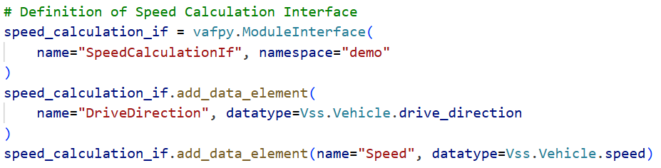
Blueprint project
Interface definition
From here, the application-framework takes over for the next steps as follows:
Creation of an Interface Project.
Import of the VSS catalogue. Or in exchange the catalogue in IFEX format.
Definition of VAF Module Interfaces using Configuration as Code in Python.
Project start
Signal catalogue
Vehicle.Acceleration.Longitudinal
Vehicle.DriveDirection
Vehicle.Body.Lights.Hazard.IsSignaling
Vehicle.Body.Lights.Hazard.Request
Interface definition
Vehicle.Chassis.Axle.Row1.Wheel.Left.Speed
Vehicle.Speed
Vehicle.Chassis.SpeedHazardForward
Vehicle.Chassis.Axle.Row1.Wheel.Right.Speed
Vehicle.Body.SpeedHazardReverse
Vehicle.Chassis.Axle.Row2.Wheel.Left.Speed
Vehicle.Chassis.Axle.Row2.Wheel.Right.Speed
SpeedCalculationIf
HazardIf
HazardDetectionIf
Vehicle.Powertrain.Transmission.DriveType
SpeedIf

Slide 9
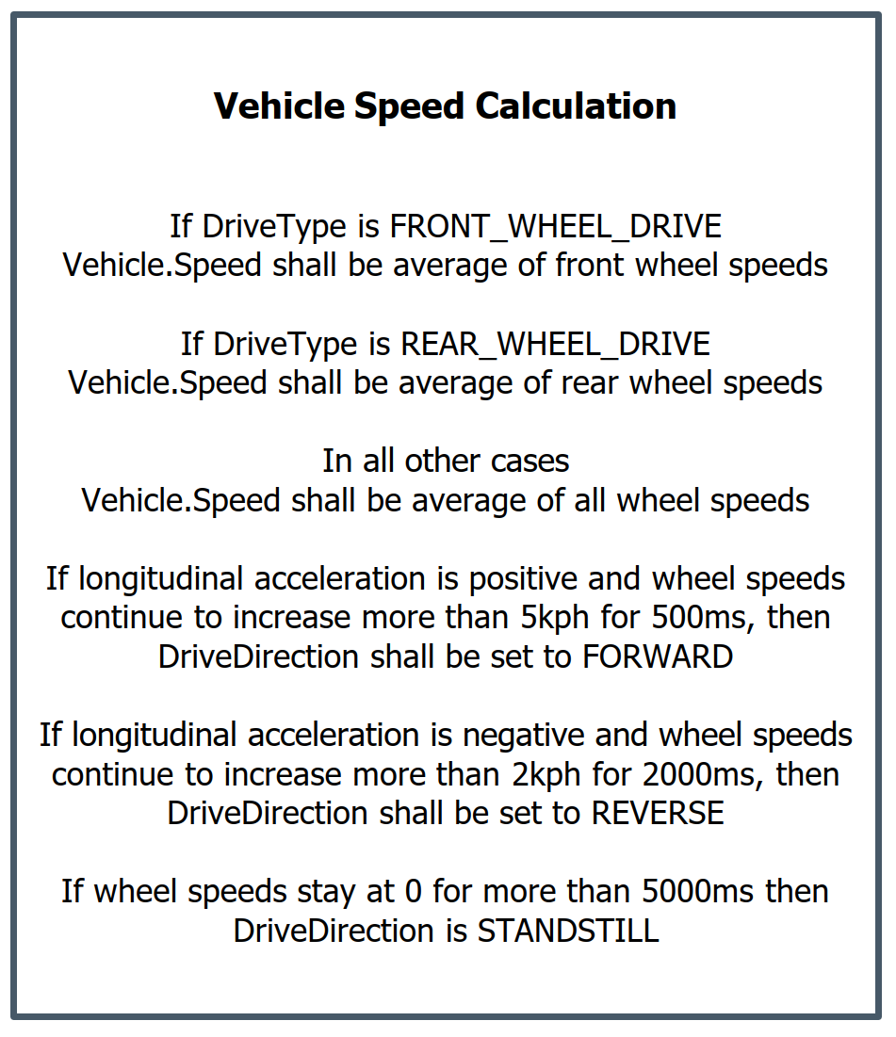
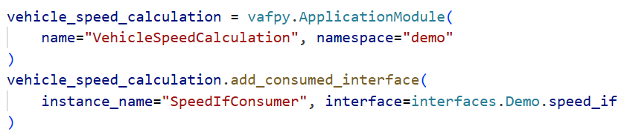
Blueprint project
Application development
Next step is the development of application modules. They hold the actual business logic.
Creation of app-module projects.
Import of the interface project result.
Definition of app-module details, i.e., consumed/provided interfaces and periodic tasks.
Generation of the project and implementation stubs.
Implementation work.
Project start
Signal catalogue
Interface definition
Vehicle Speed Calculation
Application development
Speed Hazard Detection
SpeedIf
SpeedCalculationIf
HazardIf
HazardDetectionIf

Slide 10
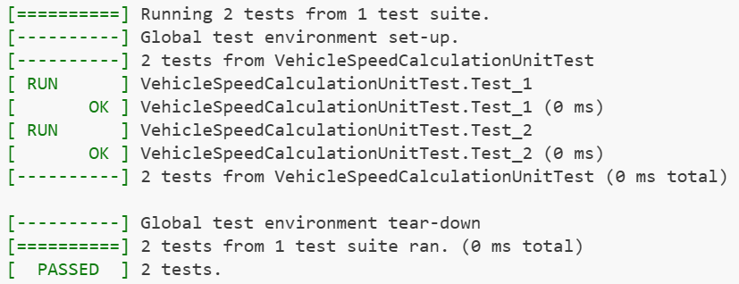
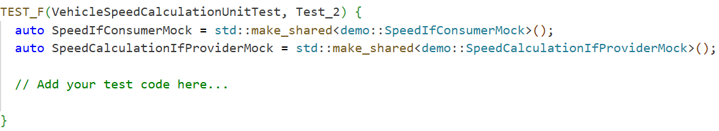
Blueprint project
Unit testing
For each app-module, unit testing is directly supported by the framework.
Googletest mocks and test stubs get generated automatically.
Helps to ensure the correct functionality of each module.
Project start
Signal catalogue
Interface mock
Vehicle Speed Calculation
Interface definition
Application development
SpeedIf
SpeedCalculationIf
Unit testing
Test stub

Slide 11
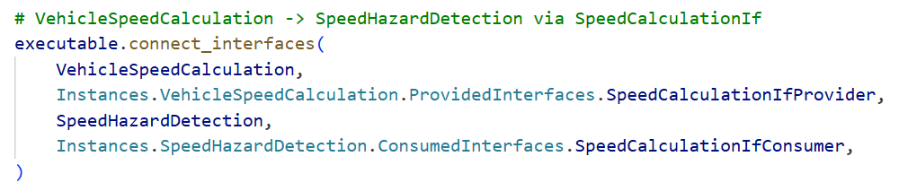
Blueprint project
Executable integration
Finally, the application modules need to be integrated on executable-level. This includes the following steps:
Creation of an integration project.
Definition of executables.
Instantiation of application modules and mapping to executables.
Finally, wiring of application modules.
Project start
Signal catalogue
Interface definition
Application development
Unit testing
Executable integration

Slide 12
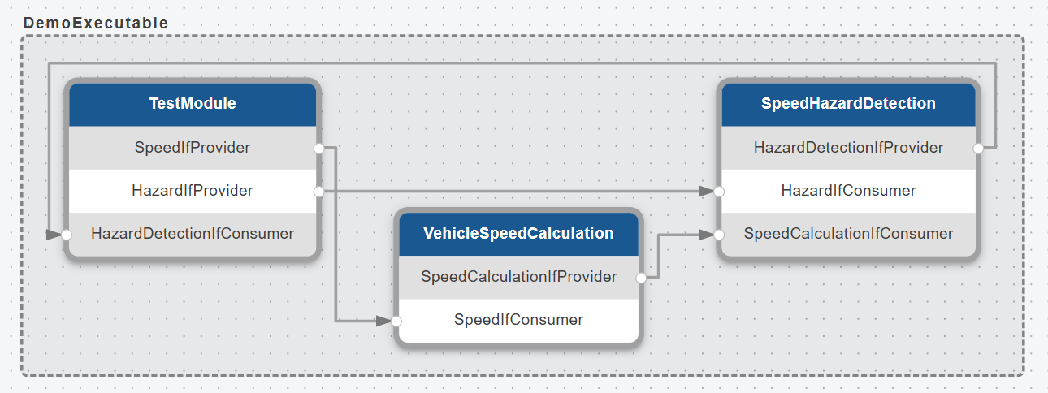
Blueprint project
System-level testing (1/3)
Different intermediate steps for system-level testing are possible. The first and simplest case:
One executable for the integration of all app-modules, including one additional “TestModule”.
Can be directly executed and allows the combined test of all involved modules.
Project start
Signal catalogue
Interface definition
Application development
Unit testing
Executable integration
System-level testing
L1

Slide 13
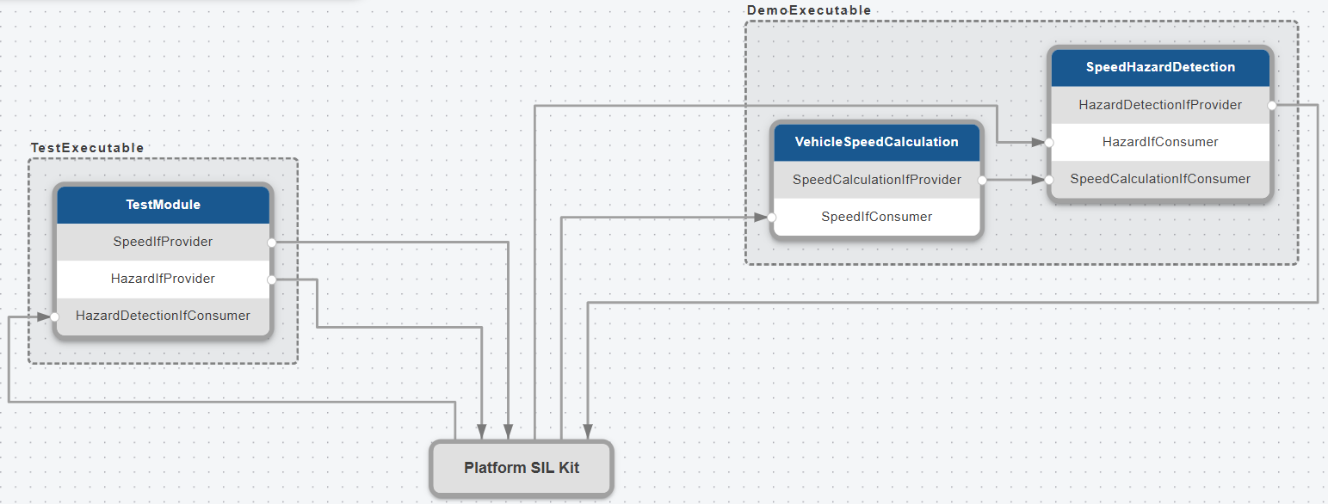
Blueprint project
System-level testing (2/3)
Different intermediate steps for system-level testing are possible. The next iteration level:
Multiple executables for the integration of all app-modules, including one additional “TestModule”.
Protobuf serialization and SIL Kit as protocol and transport layer in between.
Project start
Signal catalogue
Interface definition
Application development
Unit testing
Executable integration
System-level testing
L1
L2

Slide 14
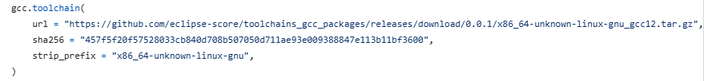
Blueprint project
System-level testing (3/3)
Different intermediate steps for system-level testing are possible. The last evolution stage:
Switch from prototyping setup with SIL Kit to a production middleware.
For the IPC connection we looked into S-CORE communication with the following outcome:
Note: This investigation was already done around Q3/2025 and with that before release of S-CORE v0.5.
VAF projects are CMake-based. S-CORE uses Bazel plus fixed toolchain with patched sysroot.
For that reason, we created forks of nlohmann_json, baselibs, and communication. We added CMake support for that projects. Contributing this addition via PR#33 and PR#77 got rejected → no interest in two build environments, which is understandable.
Nevertheless, we have implemented a VAF middleware abstraction module for S-CORE com (LoLa). It works.
Conclusion: Contribution of this part to the Eclipse project is postponed. We wait for upcoming releases including SOME/IP support (gatewayd and somipd) and will discuss Bazel for the Application Framework.
Project start
Signal catalogue
Vehicle Speed Calculation
IPC
Speed Hazard Detection
Interface definition
from someipd
to someipd
Application development
Unit testing
Executable integration
System-level testing
L1
L2
L3

Slide 15

Outlook
Next steps/milestones
Modularization of the Application Framework
Today, all building blocks (model, Configuration as Code, importers, generators, and CLI) are integrated in one Python project.
Plan is to separate the “core” parts from the platform abstraction parts.
This leads to a modularized system with multiple Python packages.
In sum, it gets easier to contribute platform support.
Once this change is rolled out, we will target again S-CORE communication (LoLa). This time as separate module.
Extend the framework with support for selected use cases from the diagnostics domain.
application-framework
extends
vaf-core
vaf-silkit

