Slide 1
Shift Down
How Developer Autonomy in Open Source
Delivers for Your Customers
Automotive Open Source Summit 2026
Stormy Peters
Notes:
Welcome everyone. I’m Stormy, and I lead open source strategy at AWS.
I’ve spend over 20+ years helping companies and communities work together.
Sometimes I think I’m a computer scientist. Other times I think I’m an anthropologist, figuring out how these cultures work. And sometimes I’m a negotiator, getting everyone to work together well.
I'm not here to talk about cloud services. I'm here because in my role, I've watched companies learn the same lesson over and over: the ones who empower their engineers to become maintainers end up steering the projects they depend on. Everyone else is a passenger.
This talk is about how to not be a passenger.

Slide 2

You downshift when you need power.
Notes:
As all of you know: you downshift when you need power — when you're climbing, when you're pulling, when the road demands it. Not when you're cruising on the highway.

Slide 3
In Open Source …
Shift decisions down the org — to the engineers closest to the code and the community
Less top-end control, more actual pulling power
Notes:
The SDV transition is not cruising. It's the steepest climb this industry has faced in decades. And the move I'm going to argue for today is a downshift — moving decision authority down the organization, to the engineers closest to the code and the community.
Less top-end control. (Although still top end steering) More actual pulling power.

Slide 4

For years, we have all been operating under a myth.
Notes:
When open source first got started, people were passionate about a cause.

Slide 5

Passion
Free software rights
Software to help your kids speak

Slide 6

More and more … it’s work first.
And passion grows.
Notes:
Put slide afte this one about where data comes from.
The pipeline runs backwards from what everyone assumes. The myth says passion comes first. The current data says employment comes first. People are hired, given freedom to work upstream, they grow into maintainers through consistency and trust — and THEN they become passionate advocates.
This is good news: it means you control the front of the pipeline. Your next maintainer already works for you.

Slide 7
Note on the data
June 2026 study of 29 Open Source Maintainers
Experience with companies
Personal anecdotes
Notes:
Note on the research: Findings from the June 2026 contributor-perception study (29 OSS contributors/maintainers, qualitative interviews) are woven in below, paraphrased — no direct quotes per your constraint. Decide how you want to attribute it on stage: "a recent qualitative study of 29 maintainers and contributors
[Study] When experienced maintainers were asked what the clearest signal of corporate alignment is, the top answer was employing the maintainers of projects you depend on: the maintainer keeps doing the work they already do, with financial stability, and the company's incentives align with the project's health.
[Study] How developers choose projects: Contributors choose projects based on purpose, community, and career value in roughly that order. If vehicle manufacturers want to attract top talent to solve real problems, they must give engineers the autonomy to work upstream on impactful shared infrastructure.
[Study] The maintenance gap: open source participation is growing, but unevenly — driven by AI tooling and lower barriers to entry, the user base is expanding much faster than the maintenance layer, creating structural strain. Automotive is about to become one of the biggest user bases of shared stacks in the world. The question for this room: will it also grow the maintenance layer, or just add weight to it?
[Study] Health ≠ visibility: experienced maintainers judge project health by sustained, quality engagement over time — not stars, downloads, or member counts. Joining a working group makes a project look active; staffing maintainers makes it be active.
[Study] The foundation point (flatters your hosts): maintainers view foundation governance positively when control genuinely transfers — multi-company governance with real distributed authority is the standard they apply. And community-governed projects survive a major corporate contributor walking away; single-company projects usually don't. The SDV's structure is the right one — now it needs the people.
Story slot (corporate-side): From your OSPO work — a company that thought "we joined the foundation, we paid our dues, we're done" vs. one that staffed real maintainers and shaped the project's direction. Board seat comes with money and gets a vote but the real decisions happen in the technical committee and people trust the people that are doing the work.
[Study] Trust is attributed, never claimed — and it's earned by individuals first. Maintainers consistently described liking and trusting individual corporate engineers while remaining skeptical of their employers. The community trusts Maria, not Maria's employer. But the inverse matters too: individual goodwill doesn't automatically transfer to the institution — it has to be reinforced by structural commitments (governance participation, sustained presence, investment in maintainers). Tell my story about going to Microsoft. People trusted me and my judgement enough to believe that maybe Microsoft had changed.
[Study] The single most consistent trust signal across every interview: showing up when there's nothing to announce. Maintainers draw a hard line between embedded participation (in the issue tracker on a random Tuesday, doing unglamorous work, reachable when things break) and performative participation (visible mainly around launches and press moments). They also notice when a company's engineers become less visible — trust erodes quietly even when nothing bad happens, because institutional trust is built through repeated low-stakes interactions.

Slide 8
Work path to maintainer: Madelyn Olson
Joined AWS
Manager said: "Go upstream our changes so we don't have to maintain them."
Five years later: one of five Redis maintainers in the world
Notes:
MADELYN OLSON STORY
Tell this as a narrative, not bullet points:
"Let me tell you about Madelyn Olson. In 2015 she graduated university and joined AWS as an engineer. Redis was just her assignment. Her manager said 'go upstream our changes so we don't have to maintain them ourselves.' She wasn't a believer — she was an employee with a practical problem."
"Five years of small fixes later, she was one of five Redis maintainers in the world. She didn't start with passion — passion was the output."
Key detail: Her manager allocated 25% of her time to upstream Redis contributions after the project lead responded positively to her TLS work. This wasn't a grand gesture — it was a practical business decision that happened to create a world-class maintainer.
Quote you can paraphrase: "There was no pathway to me becoming a maintainer. I was not expecting it. I was just trying to be helpful and that ended up paying off."
Alternative story slots if you prefer: Grant Grundler, Karthik Prabhakar, John Marvin.

Slide 9
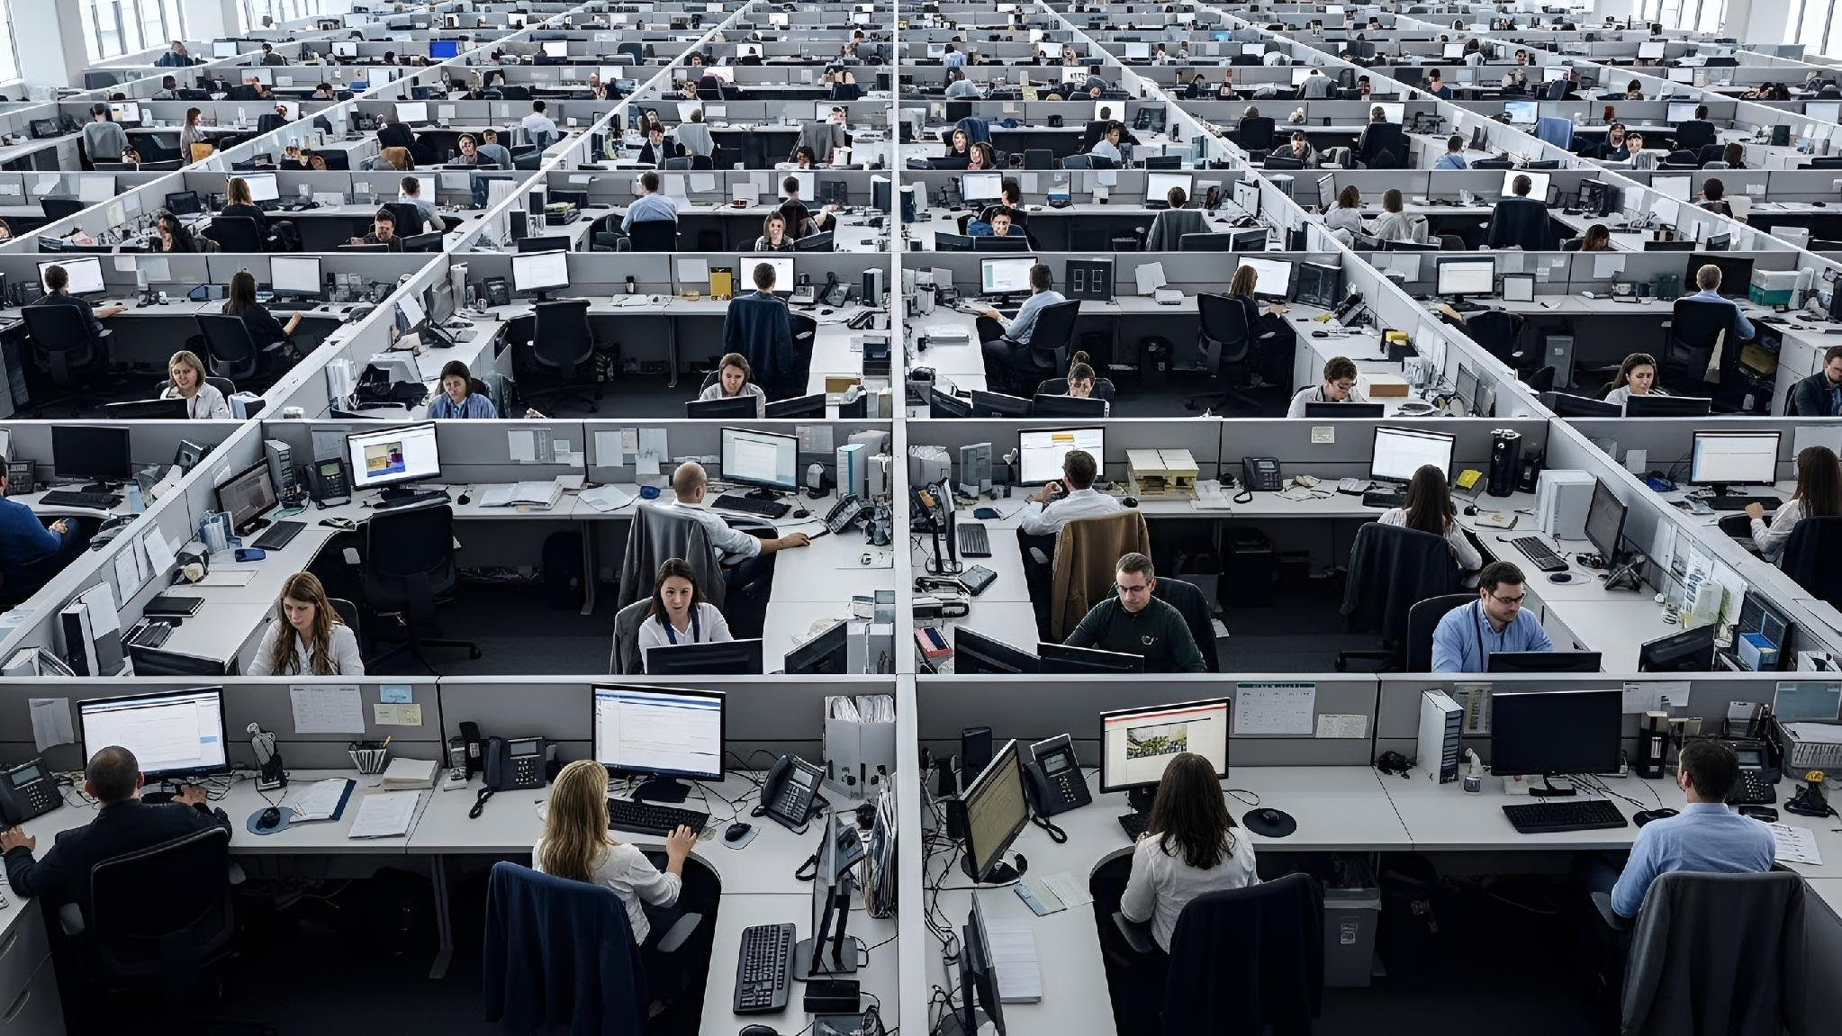
People are employed, given freedom, grow into maintainers -
and then become believers.
Notes:
People don't become maintainers because they love open source.
They're employed, given freedom, grow into maintainers —
and then become believers.
Your next maintainer already works for you. If you are brave enough to grow them.

Slide 10
Your next maintainer already works for you.
If you are brave enough to grow them.
Notes:
"Every driver in this room knows you downshift when you need power, not when you're cruising. The SDV transition is not cruising. It's time to shift decisions down."

Slide 11
The Myth vs. The Data
Notes:
Dismantle the "passionate hobbyist" myth with hard numbers.

Slide 12
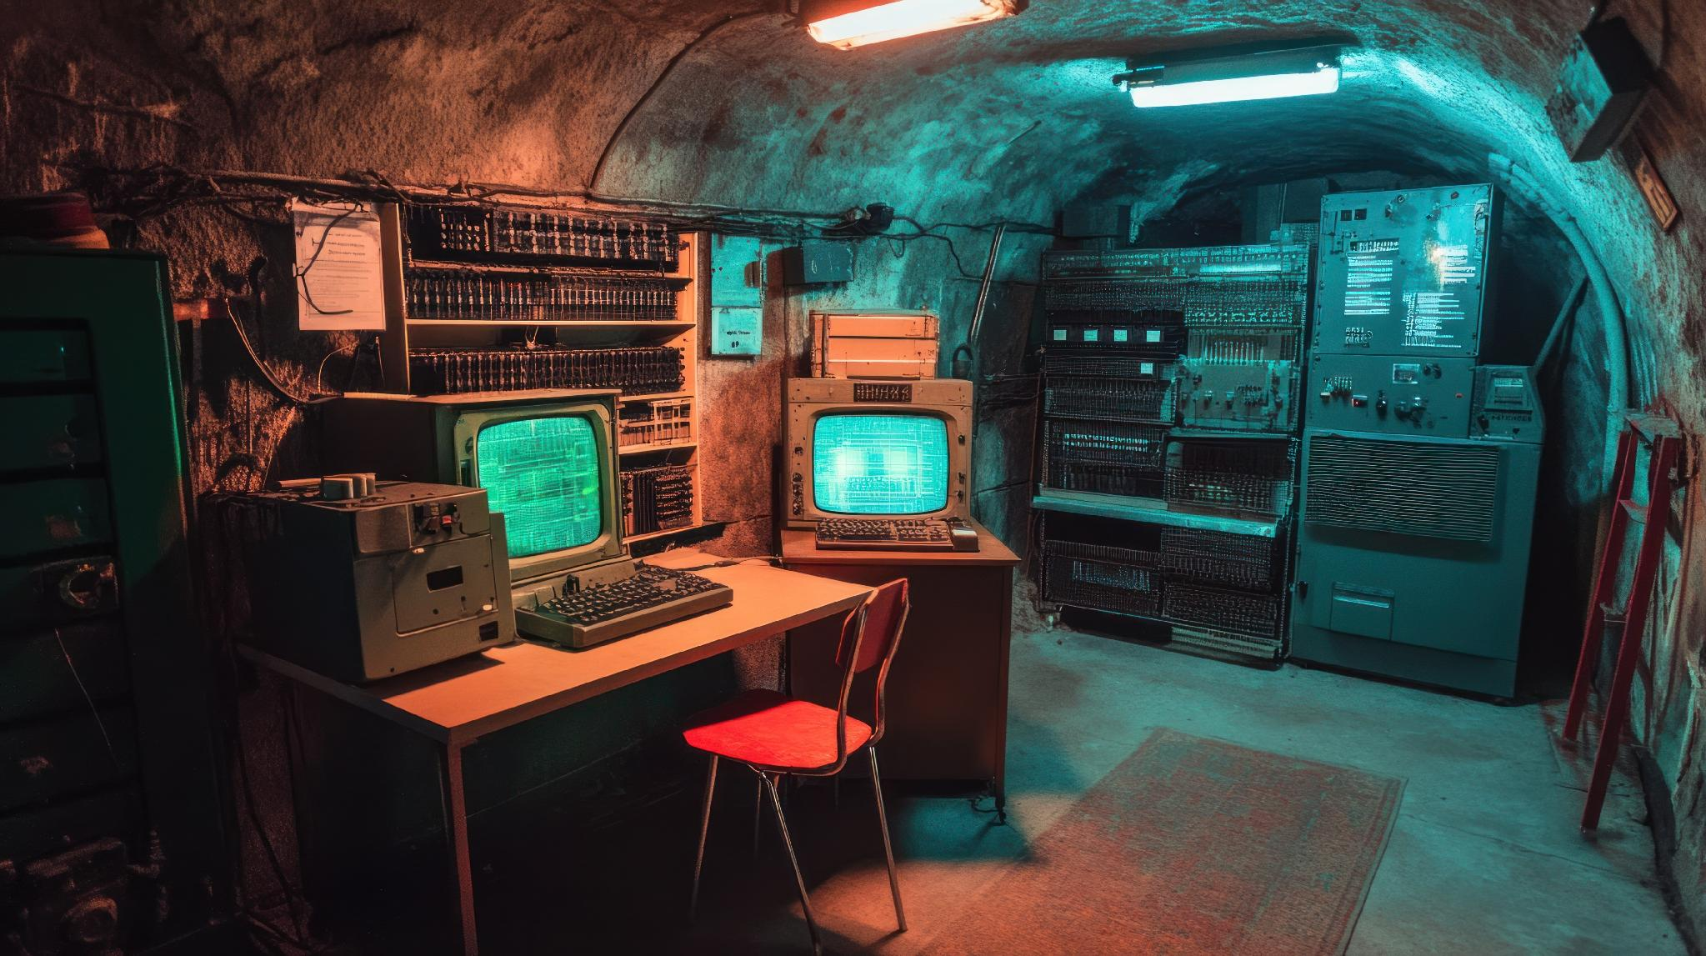
The Myth
Passionate hobbyist
→ Contributes nights and weekends
→ Becomes a maintainer
→ Maybe gets hired
Notes:
"what most people in this room probably assume." it's a reasonable assumption based on open source's origin story.
"Here's the story we all grew up with: some brilliant person falls in love with a problem, hacks on it in their garage, builds a community of fellow enthusiasts, and eventually — if they're lucky — gets hired to do it full time."
"It's a great story. It's also increasingly not how it works."
"Let me show you what the data actually says."

Slide 13
The Reality
48.7%
84%
1,780+
of FOSS contributors
paid by employer
of Linux kernel code
written developers employed by corporations
organizations
contributing to Linux
Notes:
48.7%: Nearly half of all FOSS contributors are paid by their employer to contribute. Source: Linux Foundation / Harvard 2020 FOSS Contributor Survey. This is not a niche finding — it's the largest survey of open source contributors ever conducted.
84%: In the Linux kernel — the closest analog to safety-critical, industrial open source — corporate developers write more than 84% of every line of code. Source: 2026 analysis across Intel, Google, Red Hat, Oracle, Huawei, and ~1,780 other organizations.
1,780+ organizations: This isn't a few big tech companies. It's a massive, diverse ecosystem of corporate participation.
"Open source isn't a hobby that sometimes gets corporate support. It's a corporate activity that sometimes attracts hobbyists."

Slide 14
Did they all start as passion projects and then get hired?

Slide 15
The Real Pipeline
EMPLOYED
GIVEN FREEDOM
MAINTAINER
SUPPORTER
Hired as engineer.
Project is assignment.
→
Time allocated for
upstream work.
→
Trust built through
consistency.
→
Passion is the
output, not input.
Notes:
There’s a pipeline.
EMPLOYED: "Someone joins your company as an engineer. They're assigned to a project that uses open source. They're not a necessarily believer — they're doing their job."
GIVEN FREEDOM: "Their manager says: you can spend time contributing upstream. Maybe it's 25% like Madelyn's manager. Maybe it's one day a week. The key is it's real time with freedom about what to do.
MAINTAINER: "Over months and years of consistent, small contributions — not grand gestures — they build trust with the community. They earn commit rights. They become someone whose judgment the project relies on."
SUPPORTER: "And then something interesting happens. They become passionate. They advocate. They recruit others. Passion was the output of the process, not the input."
From the study: When experienced maintainers were asked what the clearest signal of corporate alignment is, the top answer was employing the maintainers of projects you depend on.

Slide 16
It’s not HIRING maintainers,
it’s EMPLOYING maintainers.

Slide 17
Why This Is Good News for This Room

Slide 18
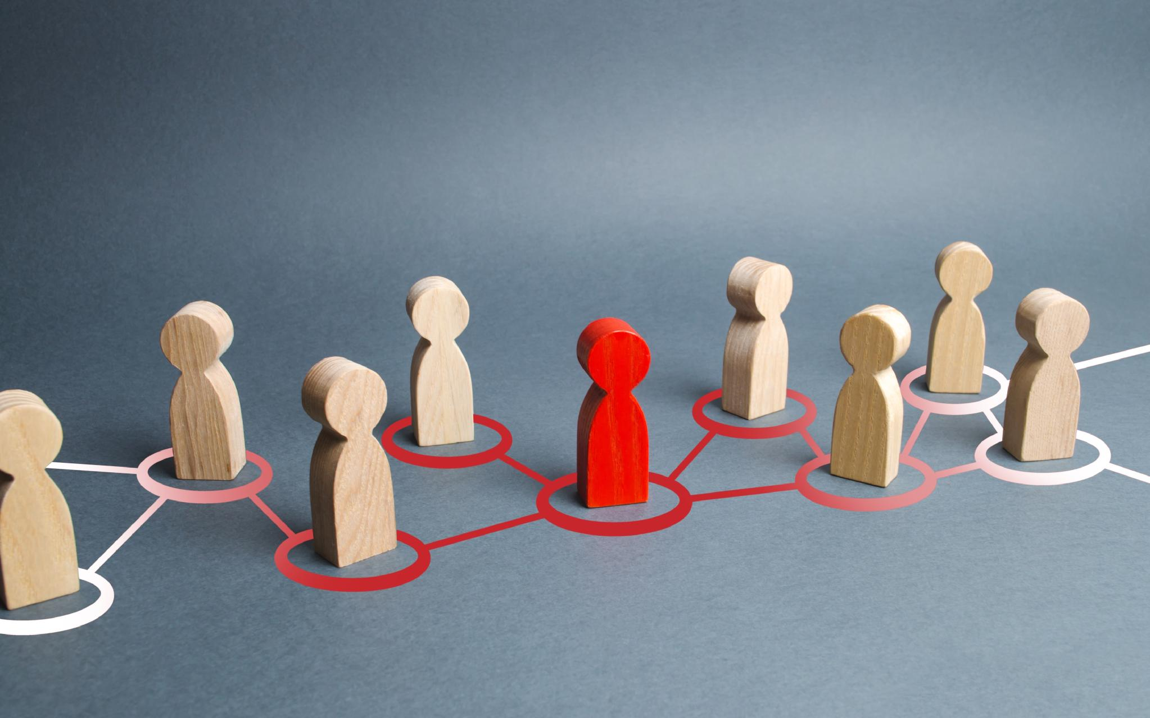
Maintainers are key for upstream influence
Every engineer you have is a potential maintainer
Notes:
"If passion came first, you'd be stuck recruiting from a tiny pool of believers. But since employment comes first, you control the front of the pipeline."
"Every engineer you have who touches open source is a potential maintainer. Whether they become one is decided by one thing: how much room you give them."
You control the front of the pipeline
Freedom is the growing condition
Every engineer you have is a potential maintainer
Whether they become one = how much room you give them

Slide 19
How do contributors choose projects
Purpose
Community
Career Value
Notes:
From the study: Contributors choose projects based on purpose, community, and career value — in roughly that order. If vehicle manufacturers want to attract top talent to solve real problems, they must give engineers the autonomy to work upstream on impactful shared infrastructure.

Slide 20
Why is this important to Automotive?
Notes:
You’re sitting in the window where choices about the SDV stack are being made. The S-CORE momentum is real — but structure without people is just paperwork.
"You already know the industry is moving. Some of you are signatories. The question here is: who are the people? Who will actually maintain it?" And who will be influencing the decisiosn they make. Who will be driving them?

Slide 21
S-CORE: The Industry Is Moving
32
40%
30%
companies signed
(expanded from 12
in 6 months)
less effort on
non-differentiating
software
faster
time-to-market
Notes:
32 companies: Started with VW, BMW, Mercedes-Benz, Bosch, Continental and 6 others in June 2025. By January 2026, expanded to 32 — adding Stellantis, Traton, Infineon, Qualcomm, LG Electronics, Red Hat, Cummins, and others. That's extraordinary momentum.
40% less effort: The promise is 40% less effort for non-differentiating software development. That's real money.
30% faster time-to-market: This is what shared infrastructure delivers when it works.
Source: VDA press releases (June 2025, January 2026).

Slide 22
An agreement gives you a seat.
Maintainers give you a voice.
Notes:
"The structure is right. Eclipse S-CORE is the right model. Now it needs the people. A signed MOU gives you a seat. Sustained maintainers give you a voice."
the companies — many audience members work for them. This creates identification.
Bosch/ETAS: They didn't just join — they INITIATED the Eclipse SDV Working Group. ETAS represents Bosch as a strategic member. They're developing Eclipse openDuT (test automation framework) with VW/CARIAD and Mercedes-Benz Tech Innovation.
"You can see who's serious by who's staffing engineers into the working groups — not just signing the MOU."
"A signed MOU gives you a seat. Sustained maintainers give you a voice."
VW Group · BMW · Mercedes-Benz · Stellantis · Traton
Bosch · Continental · Infineon · Qualcomm · LG Electronics
Red Hat · Cummins · and more...

Slide 23

What Happens When You Don't Invest
The Valkey/Redis Cautionary Tale
Notes:
THE VALKEY/REDIS CAUTIONARY TALE
This is the "what happens when you DON'T invest" story.
"In March 2024, after 15 years under the BSD license, Redis Inc. switched to restrictive dual licensing. Overnight, every company that depended on Redis had to make a choice."
"The community response was swift— but only because there were people ready to respond. Valkey emerged as a Linux Foundation-backed fork within weeks. AWS, Google, Oracle, Alibaba, Tencent, Ericsson — the companies that had invested in maintainers COULD respond. Everyone else was just passengers."
Now connect to automotive: "The SDV stack is being built right now. Whoever has maintainers in that stack when the next crisis comes — a license change, a security event, a governance dispute — will steer the response. Everyone else will read about it afterward."
"Your next fork moment is coming. Will your engineers be the ones to help you steer?
March 2024: Redis changed its license after 15 years of BSD
Companies with maintainers → led the fork response within weeks
Everyone else → passengers
Valkey: Linux Foundation-backed, 50+ companies, 100M+ Docker pulls
"Your next fork moment is coming.
Will your engineers be steering, or just passengers?"

Slide 24
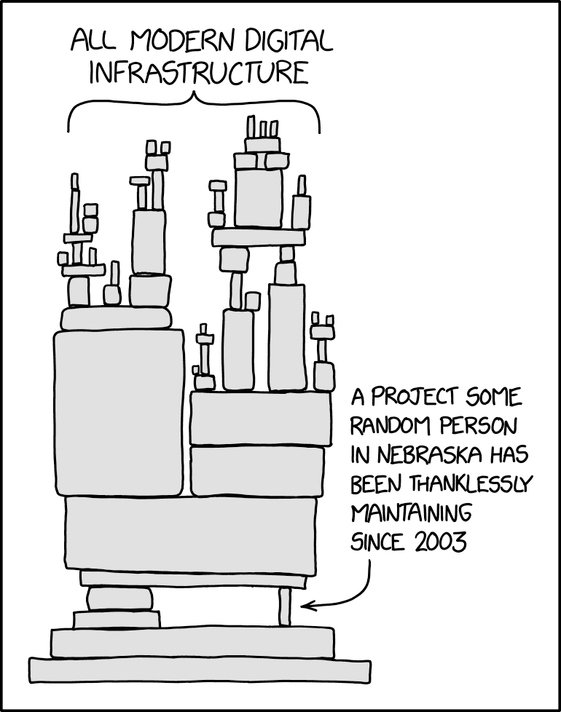
The Maintenance Gap
User base growing faster than maintenance layer
Code without maintainers is inventory, not infrastructure
Notes:
Image: xkcd https://xkcd.com/2347/
THE MAINTENANCE GAP
From the study: Open source participation is growing, but unevenly — driven by AI tooling and lower barriers to entry, the user base is expanding much faster than the maintenance layer, creating structural strain.
"Automotive is about to become one of the biggest user bases of shared stacks in the world. The question for this room: will it also grow the maintenance layer, or just add weight to it?"
Also from the study: Experienced maintainers judge project health by sustained, quality engagement over time — not stars, downloads, or member counts. Joining a working group makes a project LOOK active; staffing maintainers makes it BE active.
"Code without maintainers is inventory, not infrastructure."
From the study on foundations: Maintainers view foundation governance positively when control genuinely transfers — multi-company governance with real distributed authority is the standard they apply. Community-governed projects survive a major corporate contributor walking away; single-company projects usually don't. The SDV's structure is the right one — now it needs the people.

Slide 25
How do you earn the communities’ trust and grow maintainers?
Notes:
We did a study …
… "what the best companies have learned," not an indictment.
The key insight from the study: trust is attributed to individuals, never claimed by institutions. But individual goodwill doesn't automatically transfer — it has to be reinforced by structural commitments.
A test of Oracle's determination to live by its commitment would come when the community wants to make changes to the database that Oracle might consider detrimental to its commercial interests. "Would those be accepted?" Zaitsev asked.

Slide 26

Trust Is Earned by Individuals
Notes:
TRUST IS EARNED BY INDIVIDUALS
From the study: Maintainers consistently described liking and trusting individual corporate engineers while remaining skeptical of their employers. "The community trusts Maria, not Maria's employer."
But the inverse matters too: individual goodwill doesn't automatically transfer to the institution — it has to be reinforced by structural commitments (governance participation, sustained presence, investment in maintainers).
Personal story option: My story about going to Microsoft. People trusted you and your judgment enough to believe that maybe Microsoft had changed. Individual trust bridged institutional skepticism.
The #1 trust signal: "Showing up when there's nothing to announce." This was the single most consistent finding across every interview in the study. Maintainers draw a hard line between embedded participation and performative participation.

Slide 27
Two Kinds of Participation
Embedded
Performative
Notes:
EMBEDDED: "Your engineer is in the issue tracker on a random Tuesday. They're doing unglamorous work — triaging bugs, reviewing PRs that aren't their own, answering questions. They're reachable when things break at 2am. They know the project's quirks because they live with them."
PERFORMATIVE: "Your engineer shows up around launches and press moments. They give talks at conferences. They write blog posts. Then they disappear until the next announcement."
"Communities can tell the difference. And they route around messengers."
From the study: Maintainers also notice when a company's engineers become LESS visible — trust erodes quietly even when nothing bad happens, because institutional trust is built through repeated low-stakes interactions.
Personal anecdote: "In our role as AWS open source strategists, we often hear from internal teams 'they didn't take my PR.' The first thing we do is go look at the public mailing lists. Did they talk about the PR? Did they give feedback on other people's PRs? Did they post at all? The answer is usually no. Because if they had — even if their PR hadn't been accepted — they wouldn't have come to us."

Slide 28

When every upstream decision routes through management,
your engineer becomes a messenger instead of a maintainer.
Notes:
when decisions require internal approval chains, your engineer is on internal time, not community time. They can't merge a PR on Saturday. They can't say "yes" to a feature direction without checking. They become a bottleneck the community learns to work around.
From the study: The strain is real and growing — maintainer burnout predates AI (unclear contribution paths, shifting objectives, lack of recognition) — but AI-generated contributions have made review queues dramatically noisier. Maintainers need institutional backing now more than at any point in open source history.

Slide 29

Autonomy Unlocks Authority
Notes:
WHAT AUTONOMY UNLOCKS — VALKEY PROOF
This is a concrete, recent example of what happens when you give contributors real decision authority:
From The Register interview (May 2025), Madelyn Olson described features that were explicitly BLOCKED by the old Redis steering committee: "Another thing that was explicitly blocked by the old steering committee was an observability feature we built in 8.0 for slot statistics... And that got blocked before, but that was one of the first things that got built in 8.0 because it was like, 'well, new group, new folks, let's build a thing!'"
On avoiding burnout through distributed authority: "I really did not want this to be a single vendor project. We wanted to make sure that we weren't having this private little group that controlled everything. So we were trying to be more inclusive, adding more maintainers, adding more people to the Technical Steering Committee... And I think that's the best way to avoid burnout: making sure that everyone in the community is working on it, and also everyone feels empowered that they're making a difference."
Story slot: Jeremy Allison's test for new Samba maintainers — he wouldn't accept them until they contributed something that was against their company's best interests. This proved their judgment hadn't been compromised. "Your employees DO work for you and they ARE invested in your plans. Open source projects just want to make sure their morals haven't been compromised by you!"

Slide 30

An engineer who routes decisions through management can't be part of the conversation
Notes:
Move this up to after the autonomy slide.
TIE BACK TO THESIS — THE IMMUNE SYSTEM
This connects the AI urgency back to the core argument about autonomy:
"The AI flood is exactly why autonomy matters NOW. Triaging a flood requires judgment calls by the hour. Not by the quarter. Not after a steering committee meeting. By the hour."
"An engineer who has to route every decision through management can't be part of the immune system. They're too slow. The flood doesn't wait for your approval chain."
"And the immune system is understaffed."
Pause. Let the urgency land. Then transition: "So what do you actually DO about this? Let me give you a playbook."

Slide 31
The Investment Playbook
Notes:
SECTION 6: THE INVESTMENT PLAYBOOK (8-10 minutes)
Purpose: This is the practical core — the longest section. The audience should leave with concrete actions they can take Monday morning.
Each of the six moves gets its own slide. Keep each one tight: the principle, why it matters, and one concrete example or study finding.
Tone: Prescriptive but not preachy. "Here's what works" not "here's what you should do."

Slide 32
Seven Moves
Make it a role, not a hobby
Make sure everyone understands the customer problem
Delegate decision authority
Contribute to projects you don't control
Reward work
Be transparent about the hard parts
Plan in years, not quarters
Notes:
SIX MOVES — OVERVIEW
Present these as a menu, not a sequential checklist. Different companies will start at different points.
"What does 'invest in maintainership' actually look like? I've distilled it into six concrete moves. Some of you are already doing one or two of these. The question is whether you're doing them systematically — as strategy — or accidentally."
Let them see the full list, then dive into each one.
Make it a role, not a hobby. Upstream maintainership in the job description, with real time allocation — not "20% time" that evaporates every deadline. [Study] Employing/funding maintainers of projects you depend on was the #1 action maintainers named when asked what companies should do — direct, verifiable, aligns incentives without bureaucratic overhead.
Delegate decision authority. Define the box (license boundaries, security, strategic red lines) and let maintainers decide freely inside it. [Study] Maintainers said corporate involvement is healthy when it's legible — they can work within almost any structure if they understand who decides what. An engineer who must phone home for every decision is illegible to the community.
Contribute to projects you don't control. [Study] Maintainers give far more credit for sustained engineering in neutral, foundation-governed projects than for contributions to a company's own repos — it's harder to fake and reads as community commitment rather than product strategy. For this room: the Eclipse SDV projects are that neutral ground.
Count it in careers. Promotion criteria that value community trust, adoption, and project health — not just internal deliverables. [Study] Lack of recognition is one of the original drivers of maintainer burnout. If maintainership stalls a career, you only ever get reluctant maintainers. Many times we hear that managers aren’t supportive of open source work, but when we ask the managers or the executives in charge of the group, they are very supportive. I think it often comes down to what is perceived as important. A manager may say I don’t have travel funding for this event. The developer, who knows meeting other developers at this event is very important for growing credibility, hears “I don’t think open source is important.”
Be transparent about the hard parts. [Study] The companies maintainers trust most are the ones willing to document when commercial and community interests conflicted and how they resolved it. Polished announcements don't register; specific, verifiable accounts do. Tell the community when it was hard. This is especially true in the AI age when all stories sound a bit fabricated.

Slide 33

Make It a Role, Not a Hobby
Notes:
1. MAKE IT A ROLE, NOT A HOBBY
From the study: This was the #1 action maintainers named when asked "what should companies do?" — employing/funding maintainers of projects you depend on. Direct, verifiable, aligns incentives without bureaucratic overhead.
"Not '20% time' that evaporates every deadline. Real time allocation. In the job description. Measured and protected."
Madelyn Olson example: Her manager allocated 25% of her time to upstream Redis contributions. It was in her job scope. That's what made it real.
AWS explicitly describes this approach: "We hire maintainers or develop engineers to become experts and leaders in the open source projects that we operate."
For this audience: "If you depend on Eclipse SDV projects for your vehicle software, the most aligned investment you can make is employing the people who maintain those projects."
Upstream maintainership in the job description
Real time allocation — not "20% time" that evaporates every deadline
#1 action maintainers named when asked what companies should do
Direct. Verifiable. Aligns incentives without bureaucratic overhead.

Slide 34
Delegate Decision Authority
Notes:
2. DELEGATE DECISION AUTHORITY
"Define the box — license boundaries, security policies, strategic red lines — and then let your maintainers decide freely inside it."
From the study: Corporate involvement is healthy when it's LEGIBLE — maintainers can work within almost any structure if they understand who decides what. An engineer who must phone home for every decision is illegible to the community.
Amazon's two-pizza team analogy maps perfectly: "The key to going faster, being more innovative, and utilizing new advanced technologies is to establish teams that have clear lines of accountability and empower them to do so."
"Amazon built one of the world's largest tech companies on the principle that decisions should be made by the people closest to the problem. It turns out that principle works just as well when the problem lives in a shared open source repository."
Valkey proof: After the fork, pent-up features shipped immediately because contributors finally COULD decide.
Define the box: license boundaries, security, strategic red lines
Let maintainers decide freely inside it
Corporate involvement is healthy when it's legible
An engineer who phones home for every decision is illegible to the community

Slide 35
Make sure everyone knows the customer problem
Notes:
2. DELEGATE DECISION AUTHORITY
"Define the box — license boundaries, security policies, strategic red lines — and then let your maintainers decide freely inside it."
From the study: Corporate involvement is healthy when it's LEGIBLE — maintainers can work within almost any structure if they understand who decides what. An engineer who must phone home for every decision is illegible to the community.
Amazon's two-pizza team analogy maps perfectly: "The key to going faster, being more innovative, and utilizing new advanced technologies is to establish teams that have clear lines of accountability and empower them to do so."
"Amazon built one of the world's largest tech companies on the principle that decisions should be made by the people closest to the problem. It turns out that principle works just as well when the problem lives in a shared open source repository."
Valkey proof: After the fork, pent-up features shipped immediately because contributors finally COULD decide.
Define the box: license boundaries, security, strategic red lines
Let maintainers decide freely inside it
Corporate involvement is healthy when it's legible
An engineer who phones home for every decision is illegible to the community

Slide 36

Contribute to Projects You Don't Control
Notes:
3. CONTRIBUTE TO PROJECTS YOU DON'T CONTROL
From the study: Maintainers give far more credit for sustained engineering in neutral, foundation-governed projects than for contributions to a company's own repos. It's harder to fake and reads as community commitment rather than product strategy.
"For this room: the Eclipse SDV projects are that neutral ground. Contributing to Eclipse KUKSA, to S-CORE, to openDuT — that's where the community is watching."
Bosch/ETAS example: They didn't just join the Eclipse Foundation. They INITIATED the SDV Working Group. ETAS represents Bosch as a strategic member and is developing the open-source test automation framework with VW/CARIAD and Mercedes-Benz Tech Innovation. "You can see who's serious by who's staffing engineers into the working groups — not just signing the MOU."
Google/Kubernetes parallel: Google created Kubernetes internally, open-sourced it, then donated governance to the CNCF — giving up direct control to gain ecosystem adoption. Result: 82% production adoption rate. They still invest heavily but don't control it.
Far more credit for sustained work in neutral, foundation-governed projects
Harder to fake → reads as community commitment
Eclipse SDV projects = that neutral ground
Bosch/ETAS: didn't just join — initiated the Working Group and staffs engineers

Slide 37

Reward work
Notes:
4. COUNT IT IN CAREERS
From the study: Lack of recognition is one of the original drivers of maintainer burnout. If maintainership stalls a career, you only ever get reluctant maintainers.
"Promotion criteria that value community trust, adoption, and project health — not just internal deliverables."
The perception gap story: "Many times we hear that managers aren't supportive of open source work. But when we ask the managers or the executives in charge of the group, they ARE very supportive. I think it often comes down to what is perceived as important. A manager may say 'I don't have travel funding for this event.' The developer, who knows meeting other developers at this event is very important for growing credibility, hears 'I don't think open source is important.'"
Madelyn Olson is now a Principal Engineer at AWS — maintainership IS her career. That sends a signal to every engineer in the organization.
Promotion criteria that value community trust, adoption, project health
Lack of recognition = original driver of maintainer burnout
If maintainership stalls a career, you only get reluctant maintainers
Manager says: "No travel funding for that event"
Developer hears: "Open source isn't important"

Slide 38
Be Transparent About the Hard Parts
Notes:
5. BE TRANSPARENT ABOUT THE HARD PARTS
From the study: The companies maintainers trust most are the ones willing to document when commercial and community interests conflicted and how they resolved it. Polished announcements don't register; specific, verifiable accounts do.
"Tell the community when it was hard. This is especially true in the AI age when all stories sound a bit fabricated."
"Don't pretend there's never tension between your product roadmap and what the community needs. There is. Everyone knows there is. The companies that earn trust are the ones that say 'here's how we navigated that tension' — not the ones that pretend it doesn't exist."
This connects to the trust theme from Section 4: trust is built through honesty about trade-offs, not through perfect messaging.
Document when commercial + community interests conflicted
And how you resolved it
Polished announcements don't register
Specific, verifiable accounts do
Especially in the AI age — when all stories sound fabricated

Slide 39

Plan in Years, Not Quarters
Notes:
6. PLAN IN YEARS, NOT QUARTERS
"Trust compounds. The companies maintainers named as leaders earned it through multi-year ecosystem building BEFORE any commercial payoff. Budget maintainership like R&D, not like a sponsorship."
Madelyn Olson timeline — the nine-year investment:
- 2015: Student, graduates, joins AWS
- 2015-2020: Upstream contributor, small fixes, building trust
- 2020: Named Redis maintainer
- 2024: Led Valkey fork when Redis changed license
- 2026: Principal Engineer, leading a project with 100M Docker pulls and 50+ contributing companies
"That's a nine-year investment. AWS didn't know in 2015 that Redis would change its license in 2024. But because they'd invested in Madelyn as a maintainer — not just an employee — she was ready when the moment came."
"We track the path to maintainership in years and we measure milestones. A shortcut is to hire existing maintainers — but then you have to convince them they'll have the support and freedom to work on the project as they see fit. They'll only believe that if they've seen your other employees doing this."
Story slot: "We send out an internal email about all the projects we depend on, how many PRs we've made, how many maintainers, how many TSC members, decisions being made (where we had influence or not) and where people are in the path. And who has left that pipeline. To all leaders of projects that depend on open source software."
Trust compounds
Leaders earned it through multi-year ecosystem building
Budget maintainership like R&D, not sponsorship
Madelyn Olson: Student (2015) → Contributor → Maintainer (2020)
→ Fork Leader (2024) → Principal Engineer. Nine years.

Slide 40
What Your Maintainers Do for You
RECRUIT — Best engineers want to work where upstream work is real
RETAIN — Maintainers with autonomy stay
REPRESENT — Trusted maintainer > press release
DELIVER — Upstream fixes in days, not quarters
Notes:
WHAT YOUR MAINTAINERS DO FOR YOU
RECRUIT: "The best engineers want to work where upstream work is real. They check. They ask in interviews. They look at your GitHub org. If your engineers are visible upstream contributors, you attract the next generation of talent."
RETAIN: "Maintainers with autonomy stay. They have intrinsic motivation, community connection, and a sense of purpose that's hard to replicate with compensation alone."
REPRESENT: From the study — "blog posts and press releases barely move perception; impressions are formed through direct interaction with a company's engineers." Your most credible voice in the ecosystem is a trusted maintainer, not a press release.
DELIVER: "Autonomy means upstream fixes land in days instead of quarters. Your engineers shape the shared stack around your customers' actual needs. And the software in the vehicle is maintained by people empowered to fix what breaks. Decisions at community speed become quality at product speed."
developer autonomy in open source delivers for your CUSTOMERS.
[Study] maintainers said blog posts and press releases barely move perception; impressions are formed through direct interaction with a company's engineers. Your most credible voice in the ecosystem is a trusted maintainer, not a press release.
They deliver for customers autonomy means upstream fixes land in days instead of quarters, your engineers shape the shared stack around your customers' actual needs, and the software in the vehicle is maintained by people empowered to fix what breaks. Decisions at community speed become quality at product speed.

Slide 41

Notes:
[Study] The stakes: in open source communities, corporate reputation is either building or eroding — there is no stable middle. Companies in adjacent industries have learned this the hard way: consume heavily without contributing back and the community remembers it as the baseline against which everything you do later is measured, for years. The baseline perception for this is acting like an "Uber for open source"—meaning you build massive commercial scale on a system you depend on, while letting volunteer maintainers carry the cost. Automotive gets to choose its baseline right now.
THE STAKES
From the study: In open source communities, corporate reputation is either building or eroding — there is no stable middle. Companies in adjacent industries have learned this the hard way: consume heavily without contributing back and the community remembers it as the baseline against which everything you do later is measured, for years.
The baseline perception for this is acting like an "Uber for open source" — meaning you build massive commercial scale on a system you depend on, while letting volunteer maintainers carry the cost.
"Automotive gets to choose its baseline right now."
Keep this generic — no company names — and inspirational: "You're early enough to get this right from the start."
The flywheel works in both directions: positive reputation compounds (trusted companies attract more contributors, who build more trust), and negative reputation compounds (extractive companies lose contributors, which makes them more extractive).
In open source, corporate reputation is either building or eroding
There is no stable middle
Consume heavily without contributing → community remembers for years
Automotive gets to choose its baseline right now.
You're early enough to get this right from the start.

Slide 42
The Flywheel
EMPLOYED
FREEDOM
MAINTAINER
SUPPORTER
Engineer joins.
Project is assignment.
→
Time and authority
to work upstream.
→
Trust built.
Decisions made.
→
Recruits, retains,
represents, delivers.
Notes:
THE FLYWHEEL — VISUAL
Return to the pipeline one more time, but now as a CYCLE — the supporter your investment created mentors the next employed engineer.
Employed → Freedom → Maintainer → Supporter → (mentors next) → Employed...
"This is the virtuous cycle. The maintainer you invested in becomes the person who recruits and mentors the next generation. The flywheel speeds up over time because trust compounds and reputation builds."
Connect to AWS quote: "Over 90% of what we build is driven by customer demand." When maintainers have autonomy, they align upstream work with customer needs — not just internal roadmaps. Decisions at community speed become quality at product speed.
Google/Kubernetes parallel: Google gave up control → got an industry standard → everyone contributes → standard improves → Google benefits. Same pattern available to automotive right now with S-CORE.

Slide 43
The software-defined vehicle will be built by maintainers.
The only question is whether any of them work for you.
Notes:
"The software-defined vehicle will be built by maintainers. The only question is whether any of them work for you."
"So here's what I'm asking you to do."
One thing you can do this week:
"Identify the engineers already doing upstream work in the shadows — and make it their job. With real authority."
"You probably already have engineers contributing to Eclipse SDV projects, or to the Linux kernel, or to Rust, or to AUTOSAR adaptive. They're probably doing it in the margins — between sprints, after hours, without recognition. Find them. Make it their job. Give them real authority to make decisions in the community. And watch what happens."
This connects back to Madelyn: her manager made a single decision — "you can spend 25% of your time upstream" — and nine years later she led a fork that 50 companies depend on.

Slide 44

Pay attention to the humans
Notes:
This is from the study.
"Pay attention to the humans. It's not just your software stack. It's the named maintainers and the people who are triaging stuff at midnight. The companies and the AI systems and the foundations are all downstream from that."

Slide 45
Shift Down.
You don't downshift because you've lost control —
you downshift because you want power exactly where the road demands it.
Notes:
"You don't downshift because you've lost control — you downshift because you want power exactly where the road demands it."
"Shift down."
Thank the audience.
e"Madelyn Olson didn't become a Redis maintainer because she loved open source. She was an AWS engineer with a practical problem and a manager who said 'go upstream.' Nine years later, when the project needed someone to lead a fork that 50 companies and 100 million pulls now depend on — she was ready. Because AWS had invested in her as a maintainer, not just as an employee. Your engineers are writing code for the SDV stack right now. The question is whether you're investing in them as maintainers — or just as employees."

