Slide 1
How Non-Software Companies Get Value from Open Source
Emily Omier

Slide 2

About Me
Open Source Strategy Consultant
Host of The Business of Open Source podcast
Open Source Founders Summit co-organizer

Slide 3
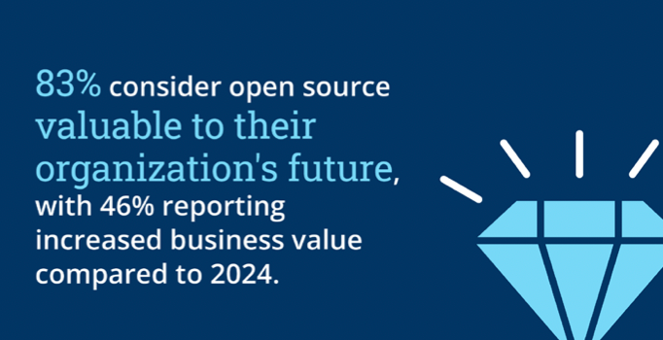
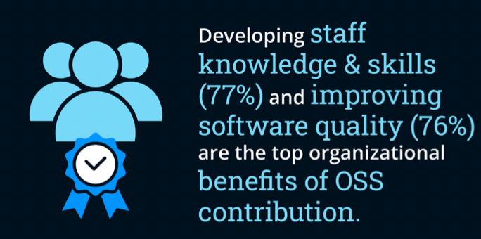


Linux Foundation State of Global Open Source, 2025

Slide 4

Ways to Interact with Open Source
Downloading and using open source projects anonymously
Contributing to existing open source projects
Publishing internal software as open source projects

Slide 5

Ways to Interact with Open Source
Downloading and using open source projects anonymously If you write software, you use open source. All of your competitors do too.
Contributing to existing open source projects
Publishing internal software as open source projects

Slide 6
How does contributing to open source projects and publishing open source
projects build competitive advantage?

Slide 7
Participation in community and/or creating your own community
Trust and brand loyalty
Innovation
Partnership opportunities
New revenue streams

Slide 8

Community
Code isn’t a moat, but community is
Human connection will always be important
It’s possible, but harder, to build community without open source

Slide 9

Trust and Brand Loyalty
Transparency: You can see what we’re doing
Co-creation: You are a part of the team and we are in this together

Slide 10

Innovation
Open source gives individuals and teams more exposure to unique use cases and perspectives
There are more opportunities for feedback when software is open source
Teams that are more involved in open source file more patents

Slide 11

Partnership Opportunities
Participating in open source ecosystems builds relationships between companies and between individuals
Working on open source is already a type of partnership, but can extend to joint business ventures, joint marketing campaigns, etc.

Slide 12
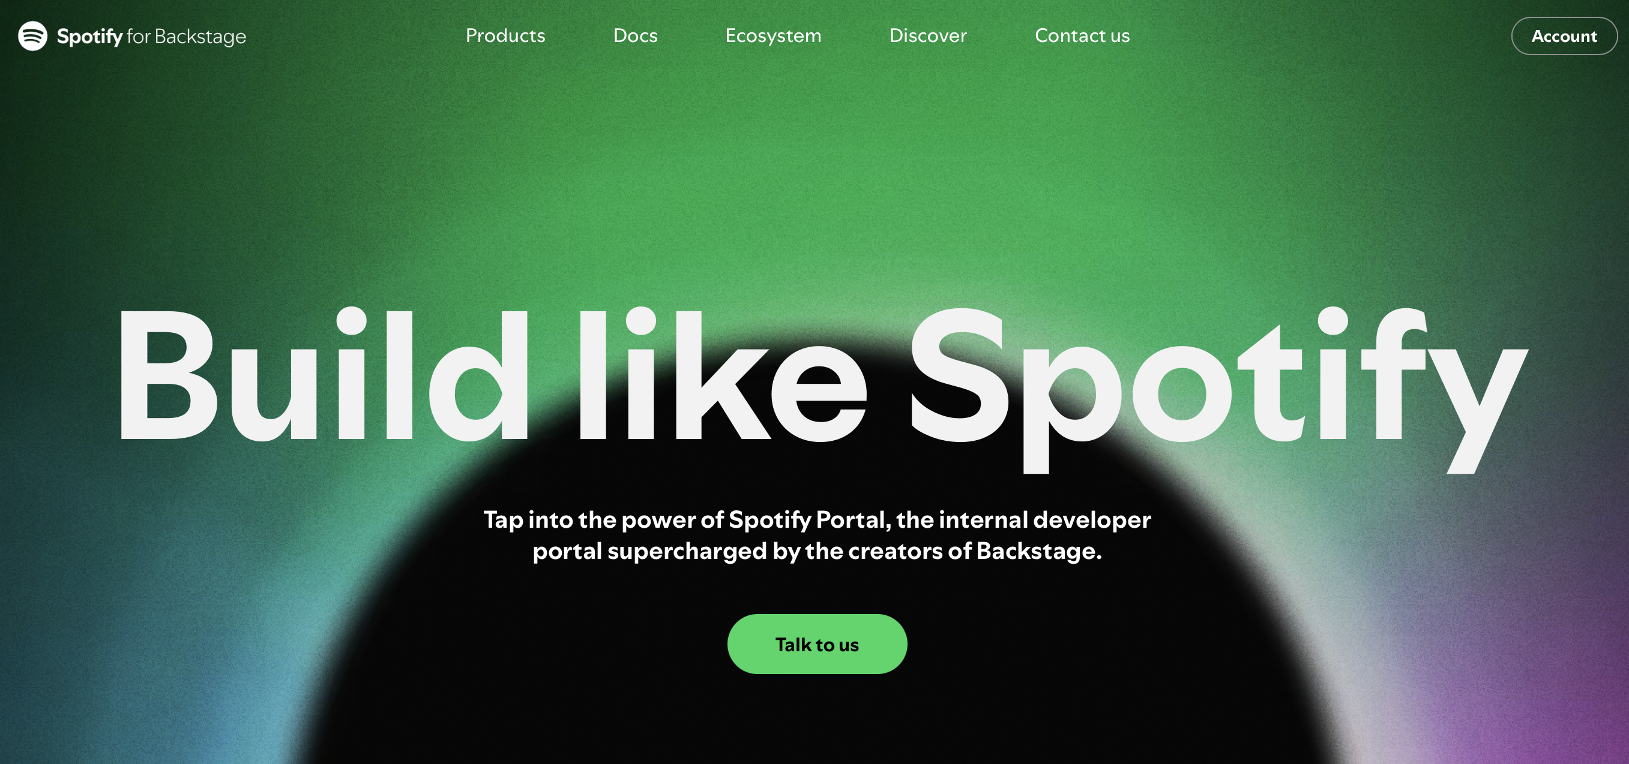
New revenue streams

Slide 13
What can you do
Establish an OSPO
Define goals from open source
Communicate throughout the organization
Develop an open source first mindset
Evaluate proposals for publishing OSS for strategic fit, strategic IP, code quality

Slide 14

The Business Value of Open Source: https://github.com/todogroup/ospology/tree/main/whitepapers/business-value/content/en
Podcast: The Business of Open Source
Open Source Founders Summit: www.05f5.com
Website: www.emilyomier.com
Email: emily@emilyomier.com
I’m a consultant! If you want help using your involvement in open source to build competitive advantage, reach out!

