Slide 1



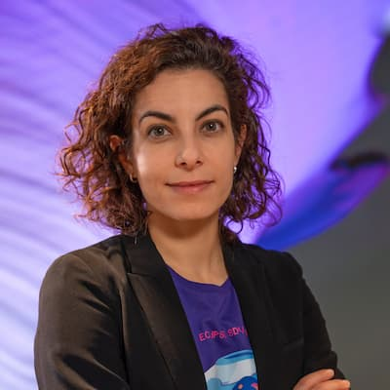
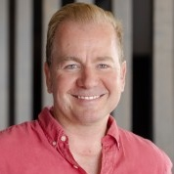
Eclipse SDV: open source, open collaboration and beyond
Dr Ing Sara Gallian, Senior Manager, SDV & Automotive Programs
Ansgar Lindwedel, Director SDV Ecosystem Development
Jun 30, 2026

Slide 2

Agenda
2025 vs. 2026: what happened since last AOSS?
Eclipse SDV vision for a way forward
Eclipse SDV: Did we finish the game?
Copyright© Eclipse Foundation AISBL and contributors. Made available under CC-BY-SA 4.0 International.

Slide 3
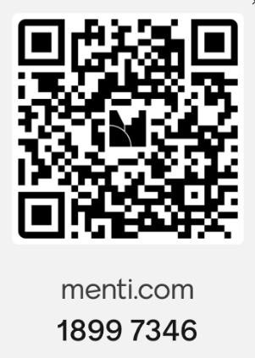

2025 vs 2026 - Pool time!
Your opinion: what have been the major advancements in Eclipse SDV since the last AOSS?

Slide 4
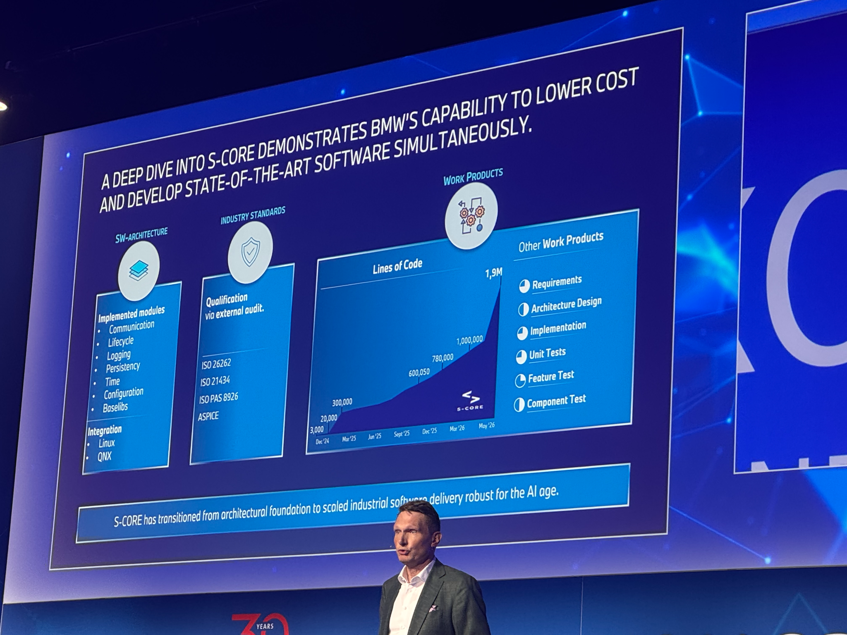
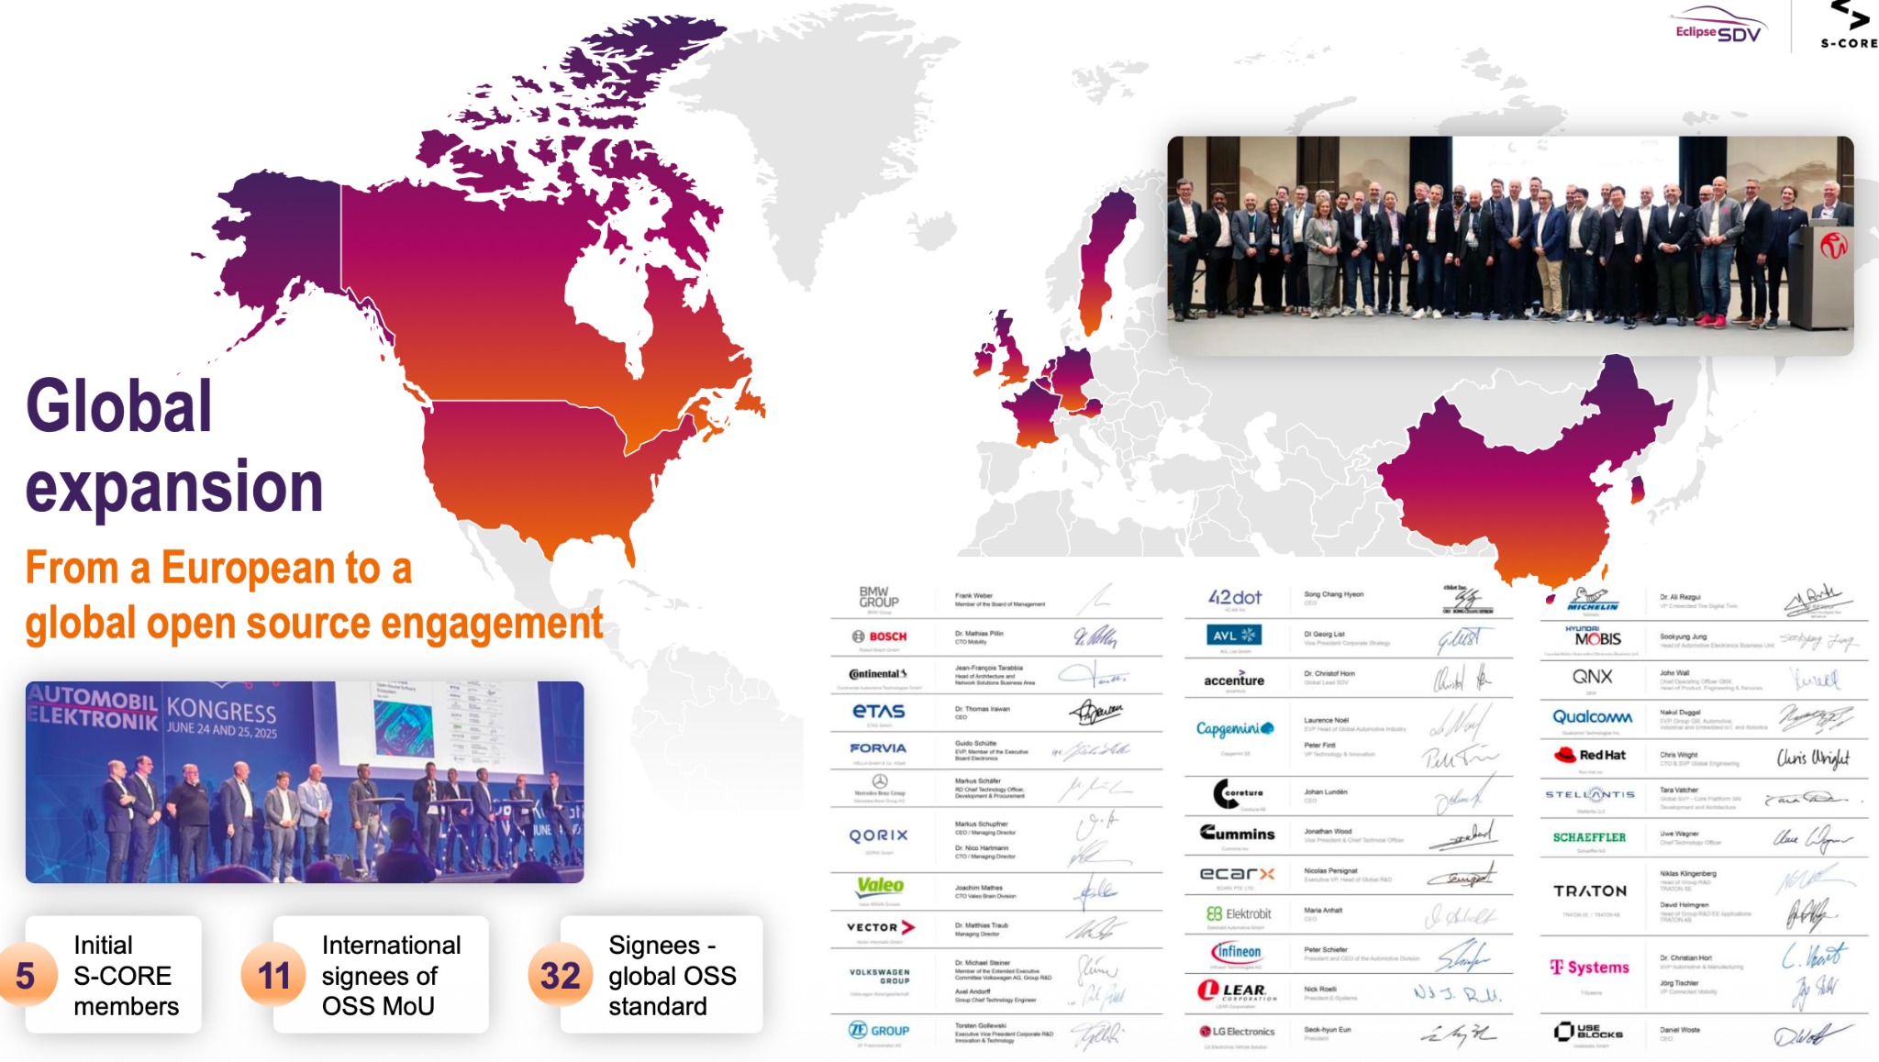
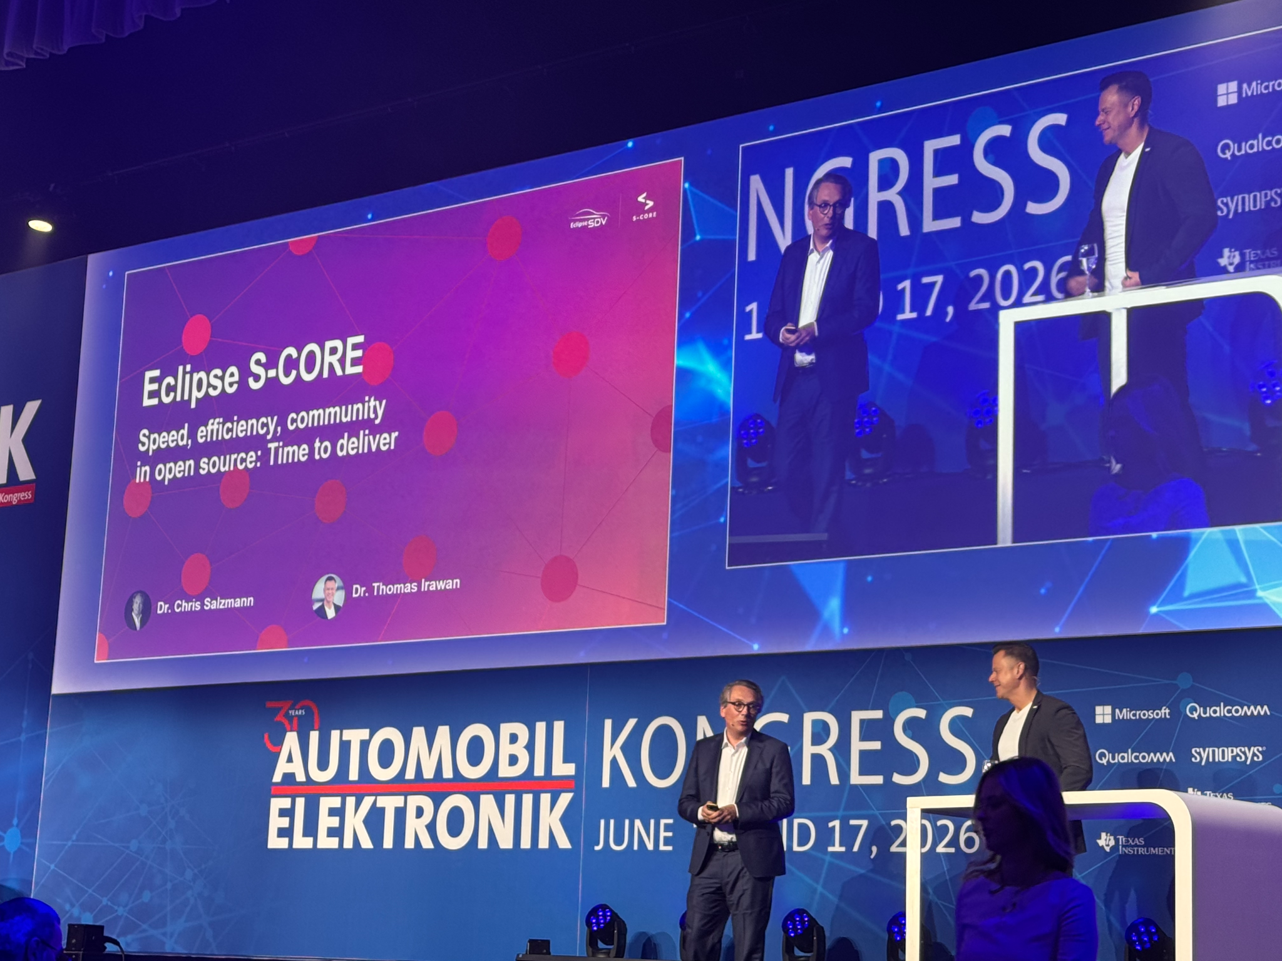
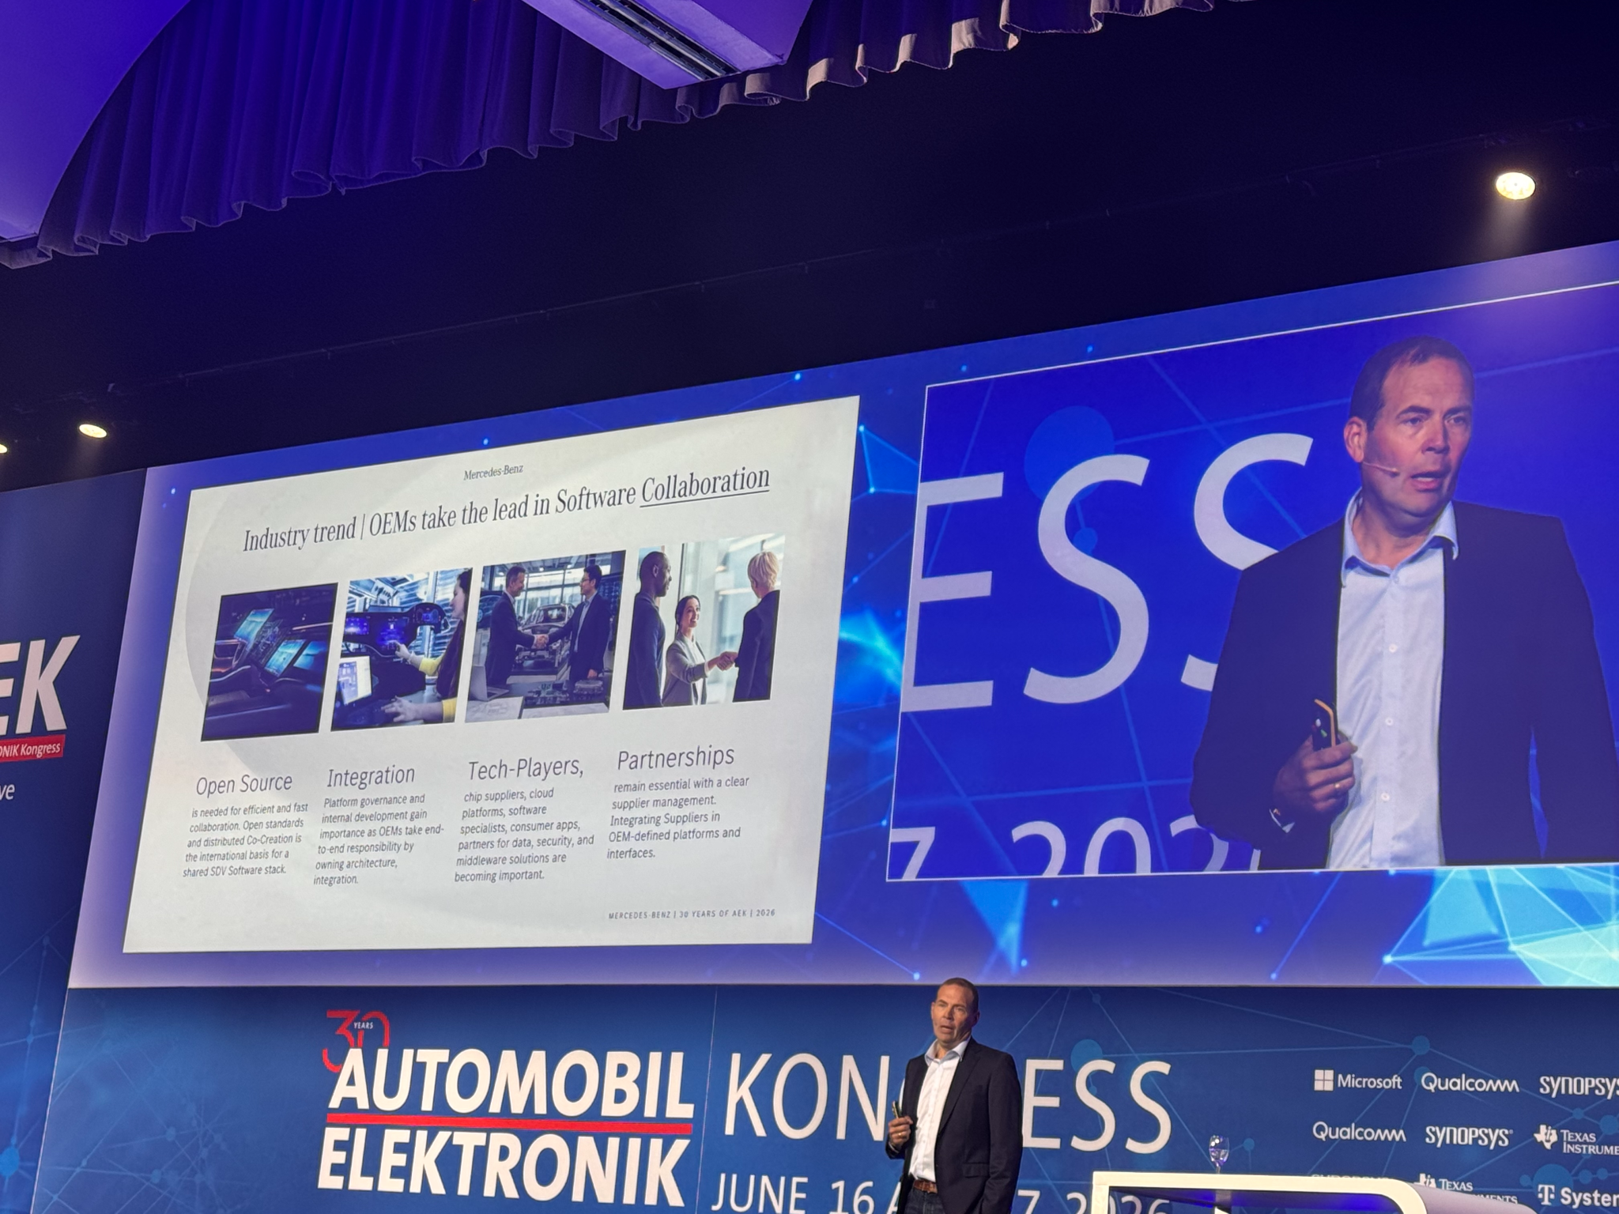
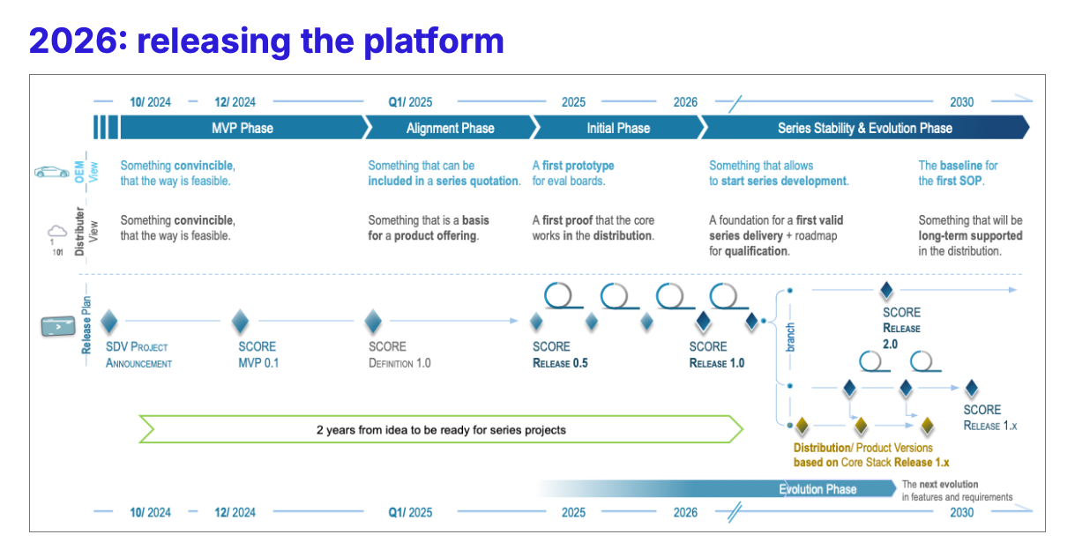
2025 vs 2026 Eclipse SCORE takes center stage

Slide 5
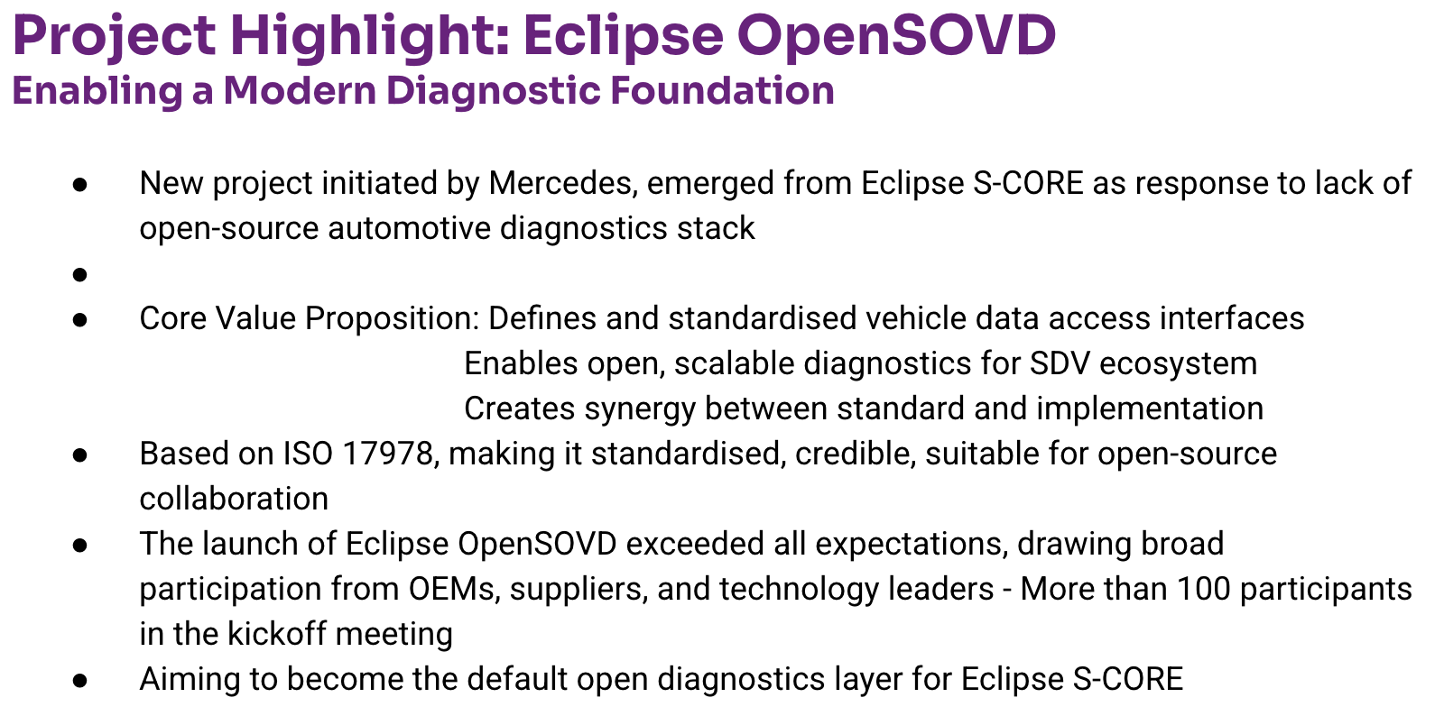
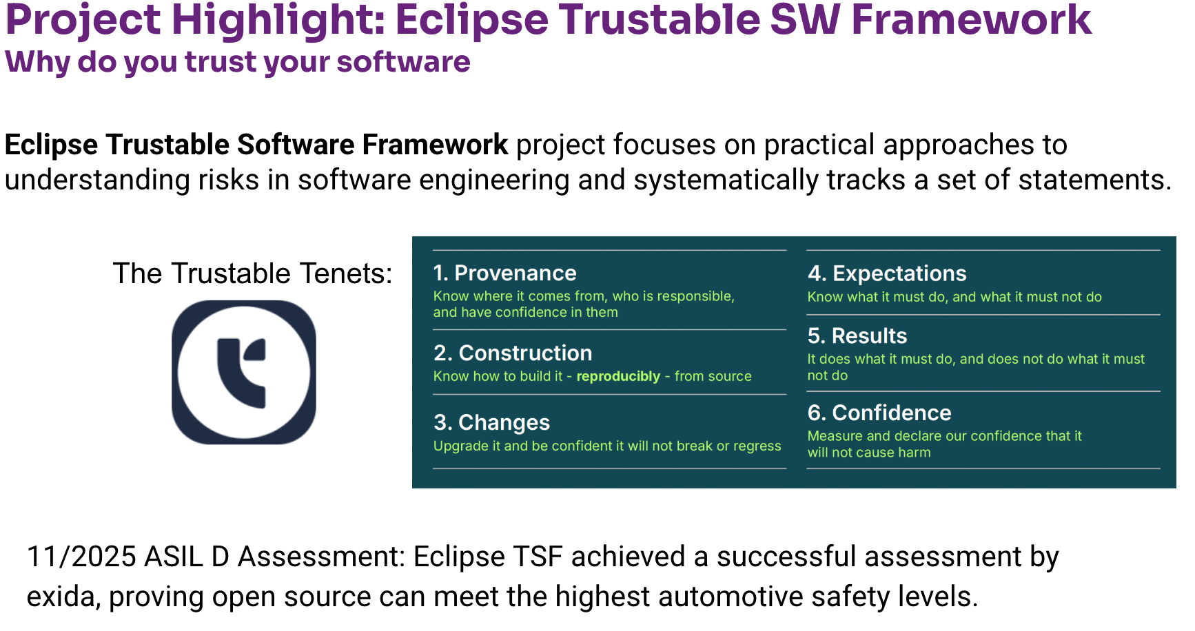
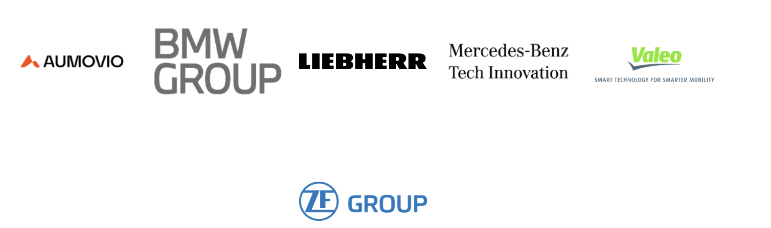
2025 vs. 2026: Highlight projects beyond Eclipse SCORE
Eclipse OpenSOVD and Eclipse TSF
NEW! Within the Eclipse Foundation Functional Safety Process Operations Guide, EMO has approved Eclipse TSF for use by Functional Safety Projects

Slide 6
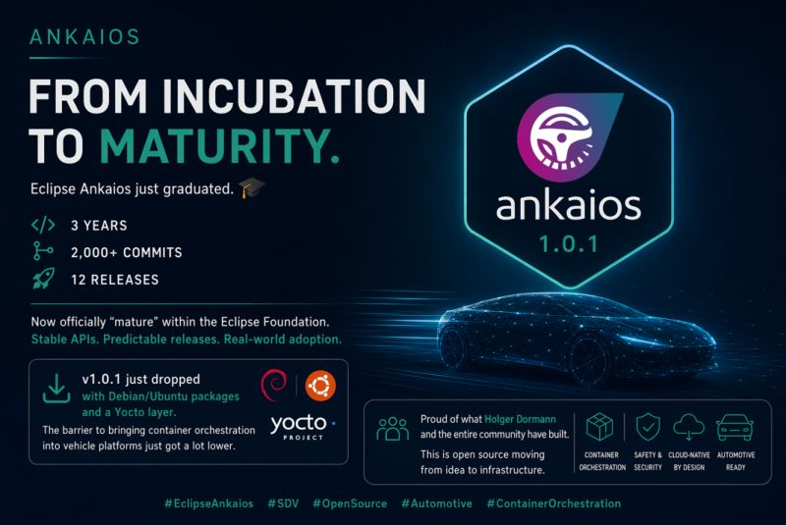
2025 vs. 2026: Highlight projects beyond Eclipse SCORE
Eclipse Ankaios reaches maturity

Slide 7
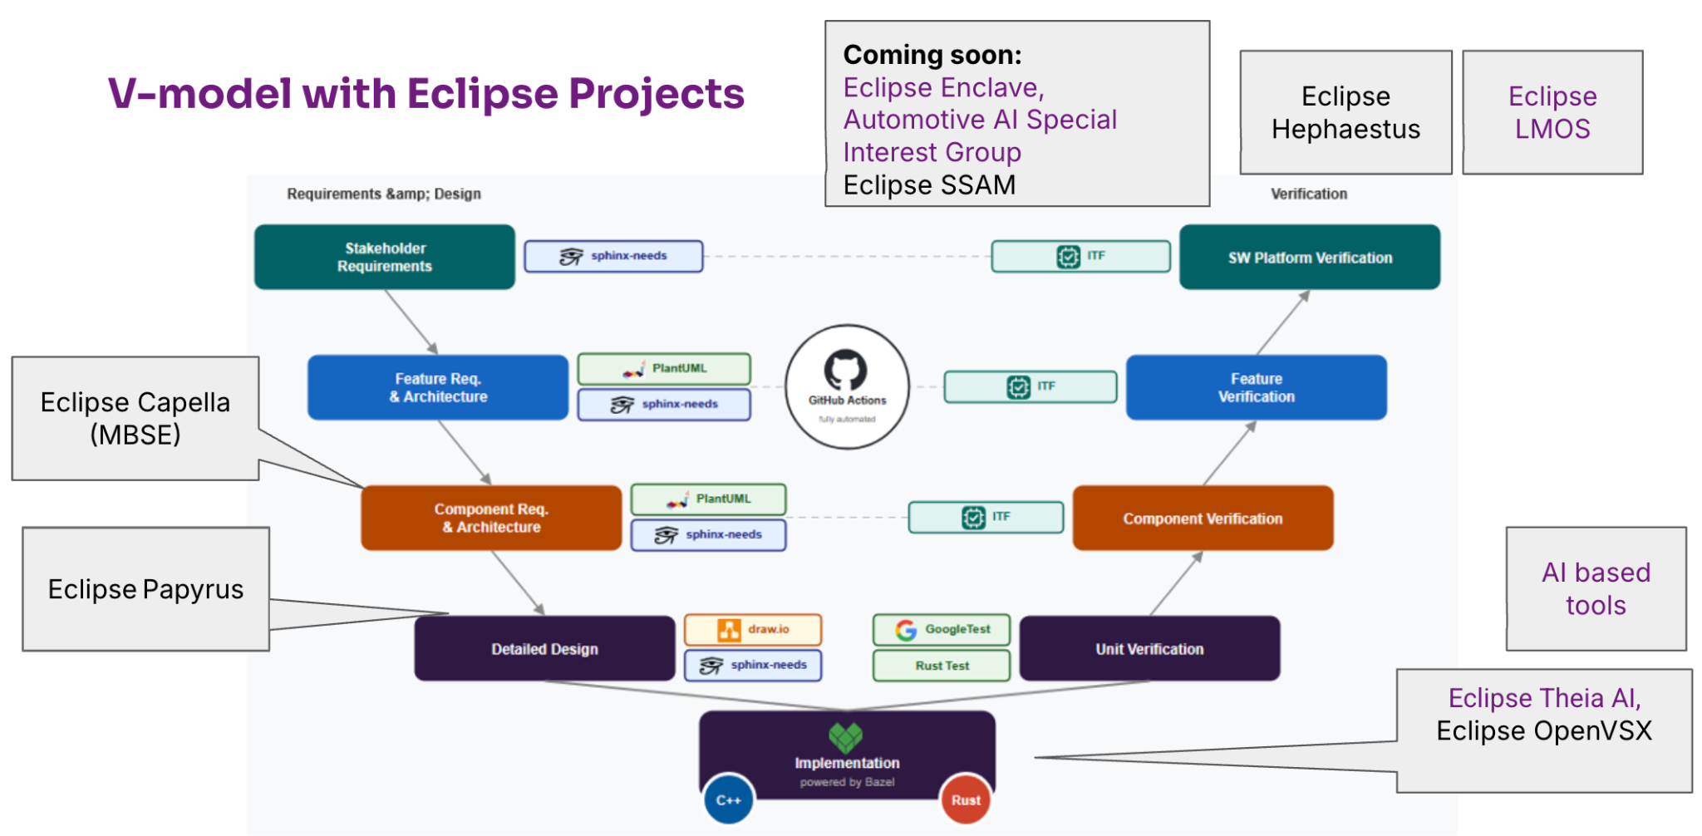
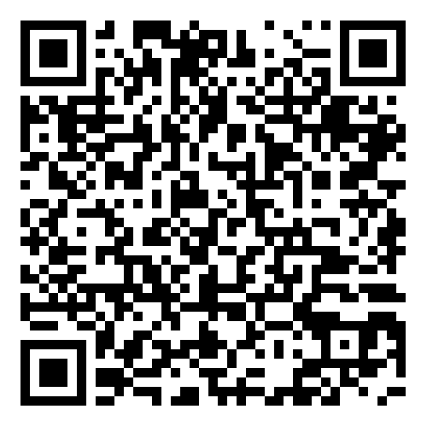
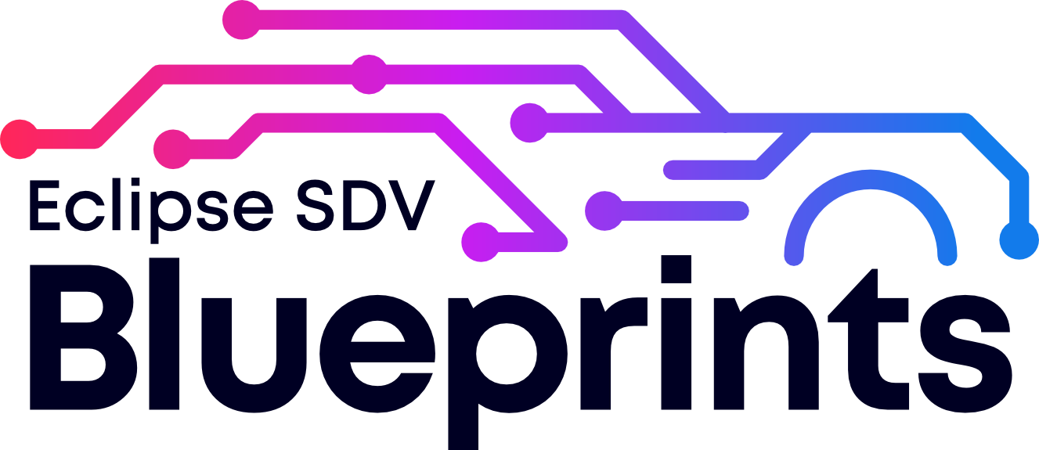
2025 vs. 2026: Notable initiatives
An AI supported toolchain and a commercial vehicle blueprint
AI supported DevOps Toolchain
  Automotive AI Special Interest group to be kicked off
  Exploiting synergies with Eclipse tool projects (eg Theia AI, Conclave)
  AI4SDV EU project funded
  Onboard Eclipse SDV Hephaestus
Commercial Vehicle Initiative
  Eclipse SDV Blueprint tailored to commercial vehicles applications

Slide 8
2025 vs. 2026: Notable initiatives
Introducing the Eclipse Functional Safety Process and Guidelines
It’s an addition to the Eclipse Development Process, dedicated for Functional Safety Projects
Setting up a Functional Safety committee
Supporting the Eclipse SCORE process to achieve assessment
Functional Safety Development Practices
Eclipse Foundation Functional Safety Process
Eclipse Project Development Practices
Eclipse Foundation Development Process
Eclipse Foundation Eclipse Intellectual Property Policy
Copyright© Eclipse Foundation AISBL and contributors. Made available under CC-BY-SA 4.0 International.

Slide 9
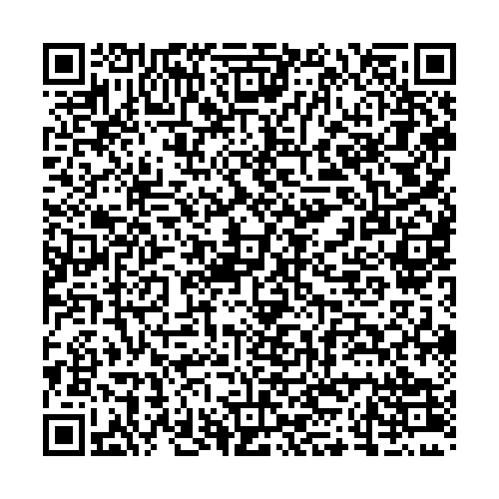
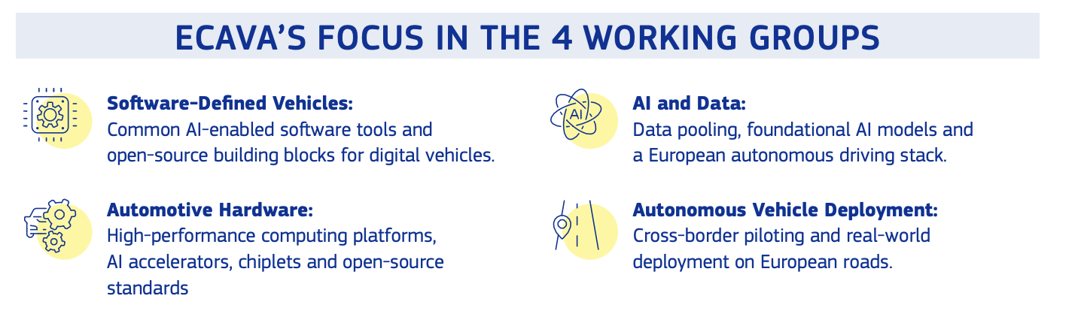
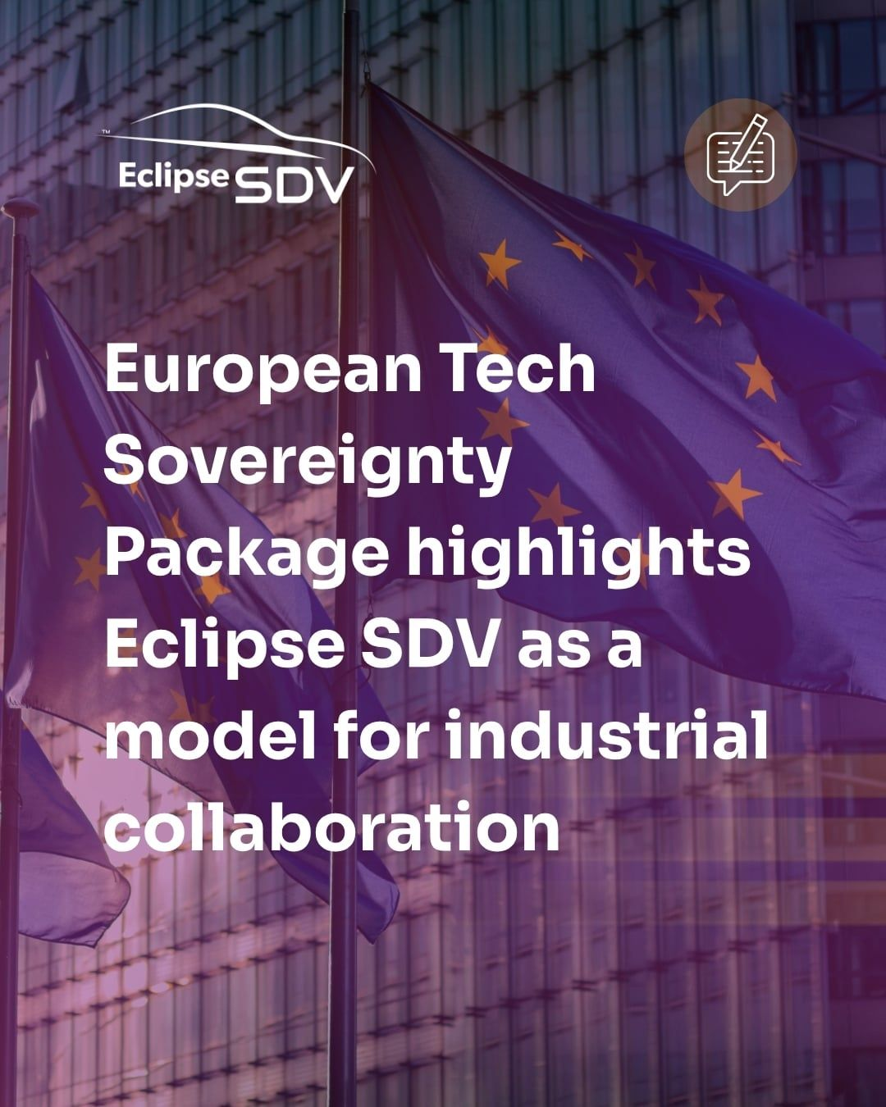
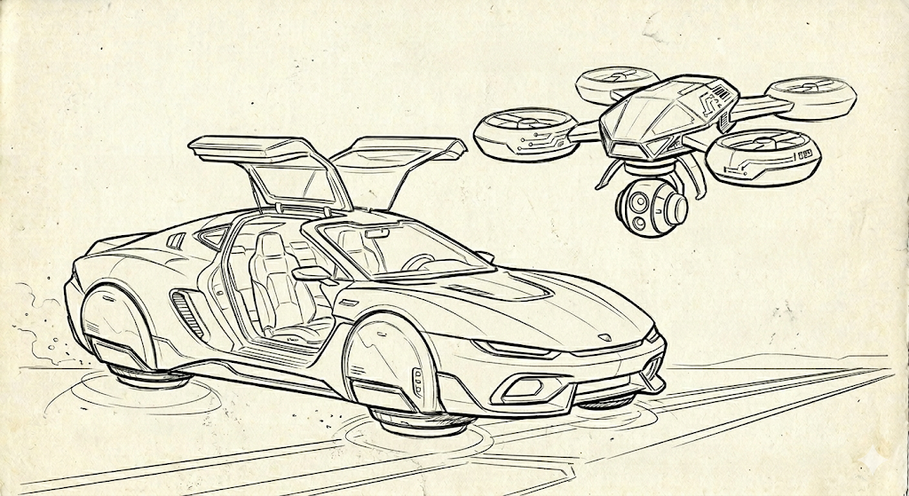
2025 vs. 2026: Notable initiatives
Strengthening the European roots
Engage with European Connected and Autonomous Vehicle Alliance (ECAVA)
Explore similar ecosystem such as UAVs to promote Eclipse SDV projects
Mention of Eclipse SDV in the EU OS strategy
Not so different after all

Slide 10
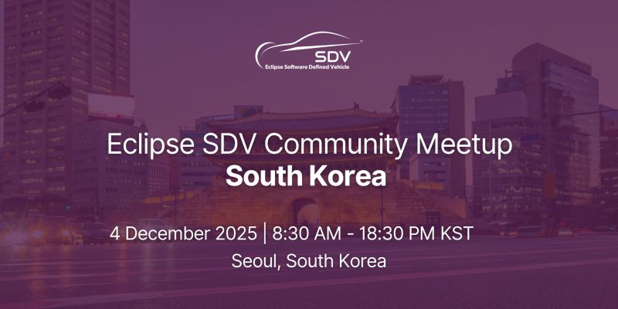
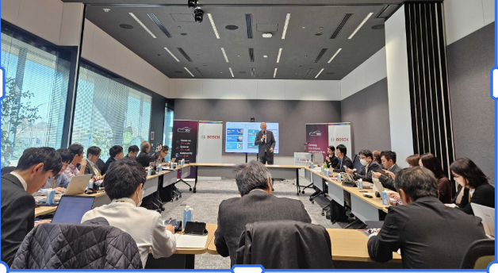
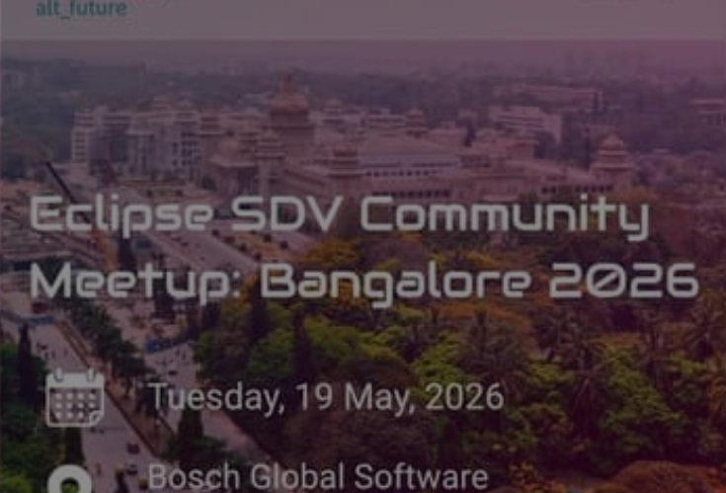
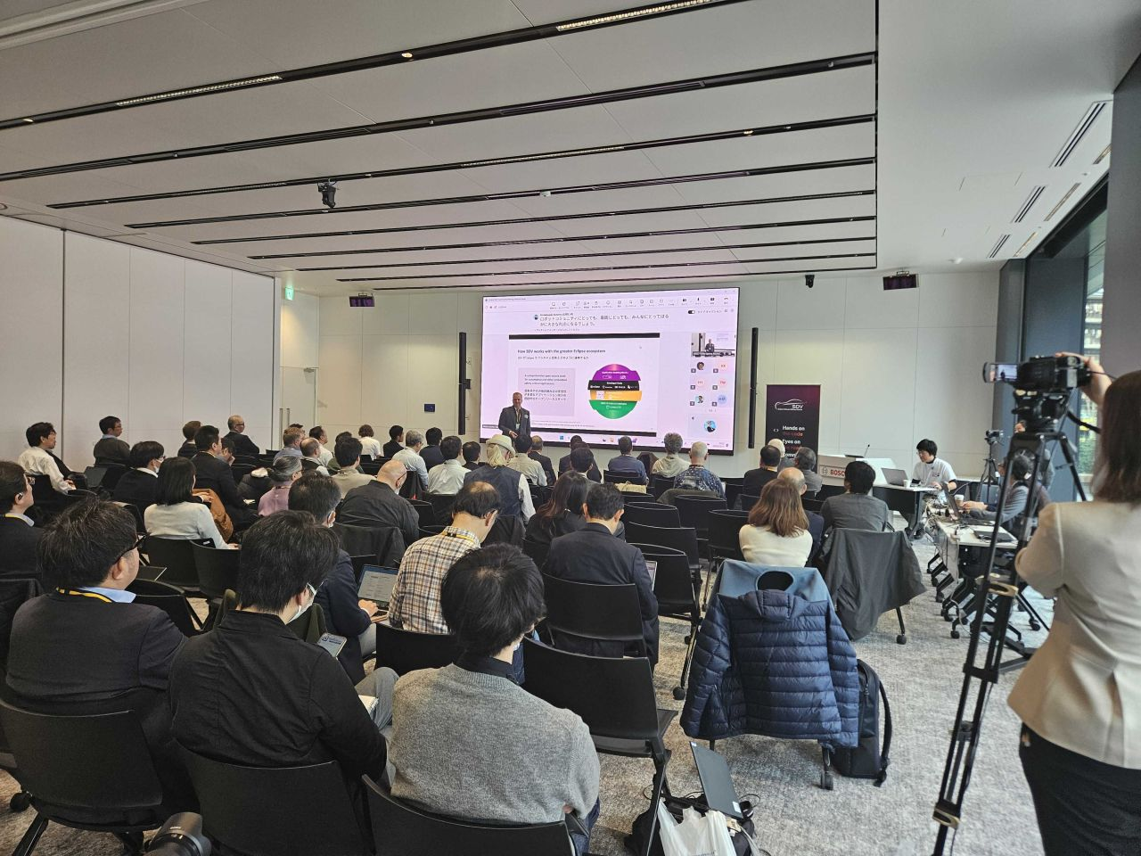
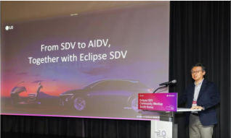
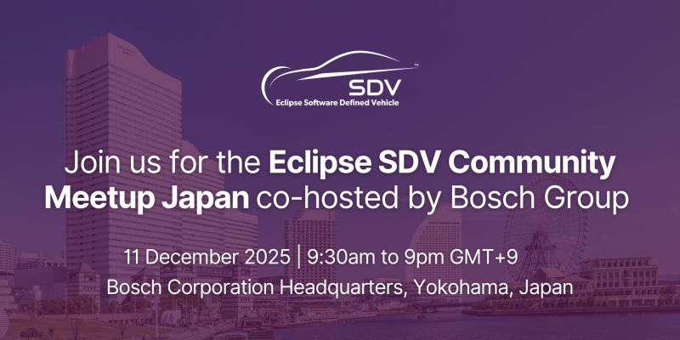
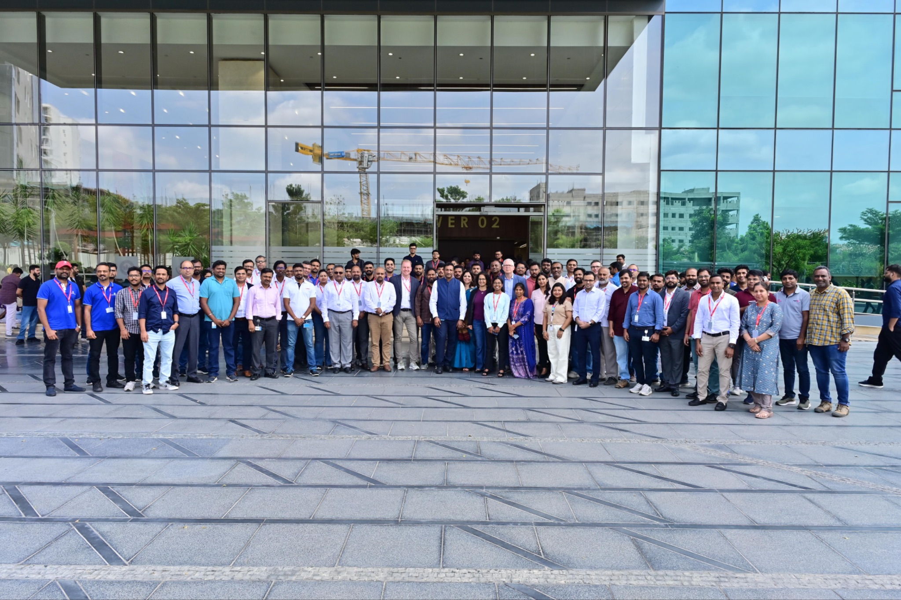
2025 vs. 2026: Eclipse SDV goes global
Shifting gears in Asia

Slide 11
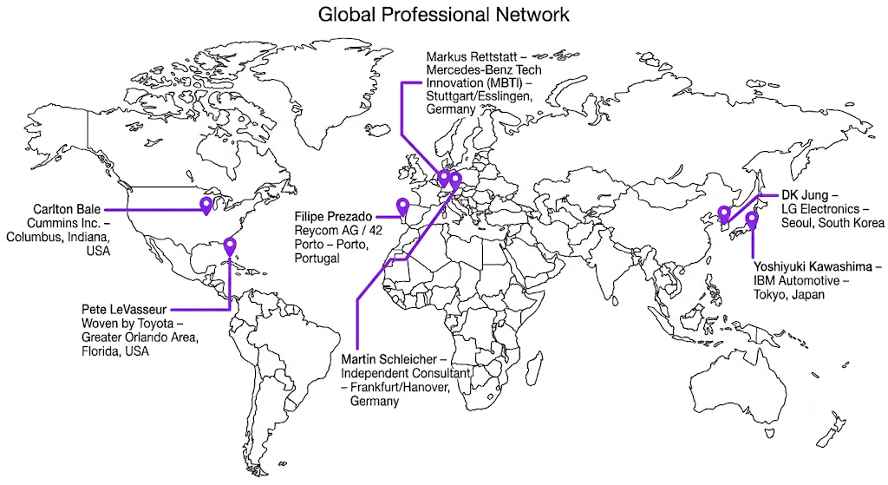
2025 vs. 2026: Eclipse SDV goes global
Global ambassadors

Slide 12
2026 and Beyond: Eclipse SDV vision for a way forward
Eclipse S-CORE v1.0 is a success with broad adoption
Leverage multiple building blocks: such as Eclipse OpenSOVD for diagnostic or Eclipse uProtocol as a service mesh
Passenger car and commercial vehicle OEMs work together for a heterogeneous and sustainable ecosystem
Global ecosystem involving non EU centric initiatives such as Jaspar
Open source modular cross project toolchain infrastructure delivers artifacts needed for project safety assessment (development in Eclipse Hephaestus, supported by AI4SDV)
Frameworks adopted to assess safety and security risk consistently and in a transparent manner (eg Eclipse TSF and Eclipse SCORE process), aligned with the Eclipse Functional Safety Process
Resilient and sovereign ecosystem with clear IP policy, shared by members and contributors
Notes:
Our = Eclipse SDV WG

Slide 13
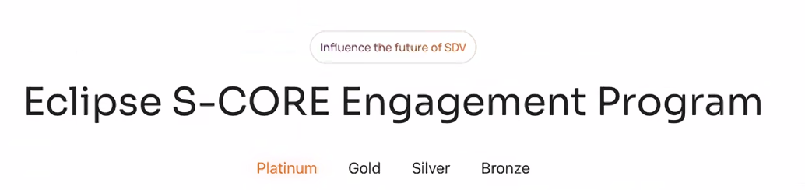

Eclipse SCORE levels of Engagements program - Claim your badge!

Slide 14
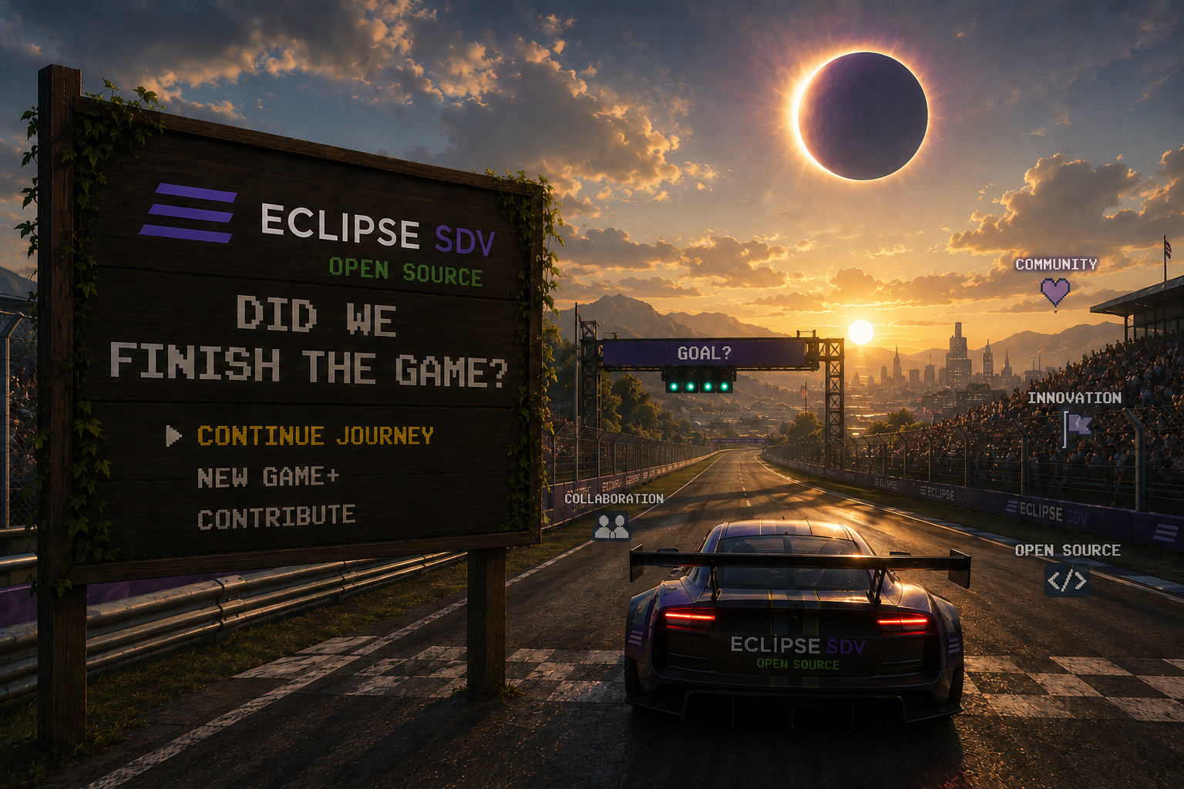
Notes:
Our = Eclipse SDV WG

Slide 15


Did we finish the game? Dimension 1
SDV.Ops Cloud based mobility solutions
SDV.Edge in-vehicle
SW Stack
SDV.Dev toolchains and workflows

Slide 16
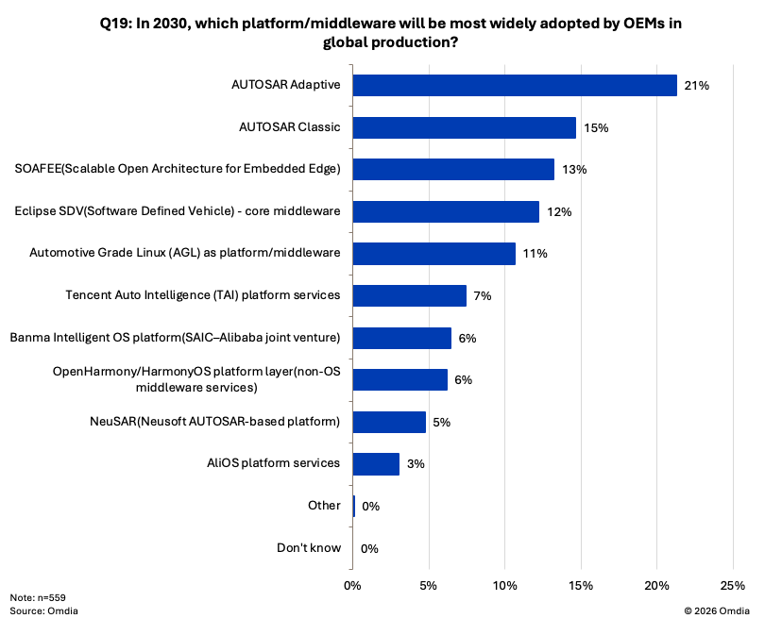
An open source projects ultimate goal: Adoption
Demographics:
559 automotive industry professionals across:
automakers (50%)
Tier 1 suppliers (31%)
Tier 2 suppliers (19%)
seven major markets
US, UK, Germany, France, Japan, China, and Canada)
deployed in March/April 2026

Slide 17
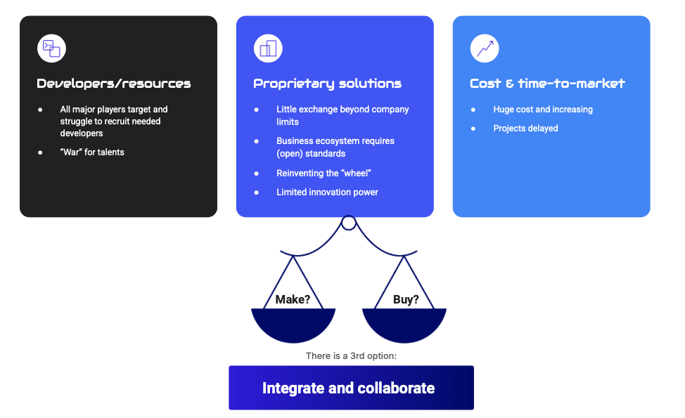
Did we finish the game? Dimension 2
Often history is a good teacher, let’s look back some years…

Slide 18
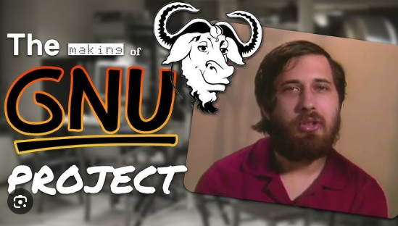
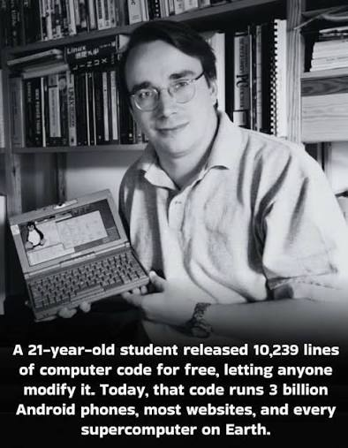
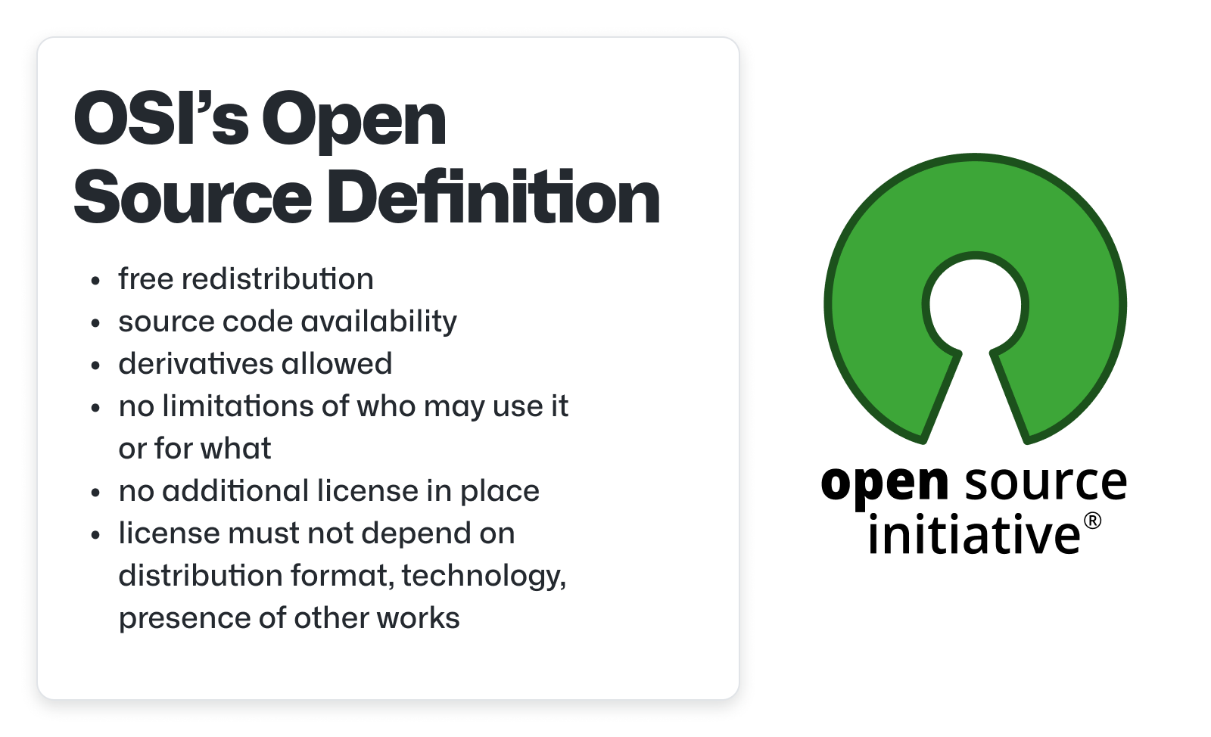
Throwback: Enterprise IT OSS experience
1983: Richard Stallmann starts GNU
1991: Linus Torvalds starts Linux
1998: OSI and the open source definition

Slide 19
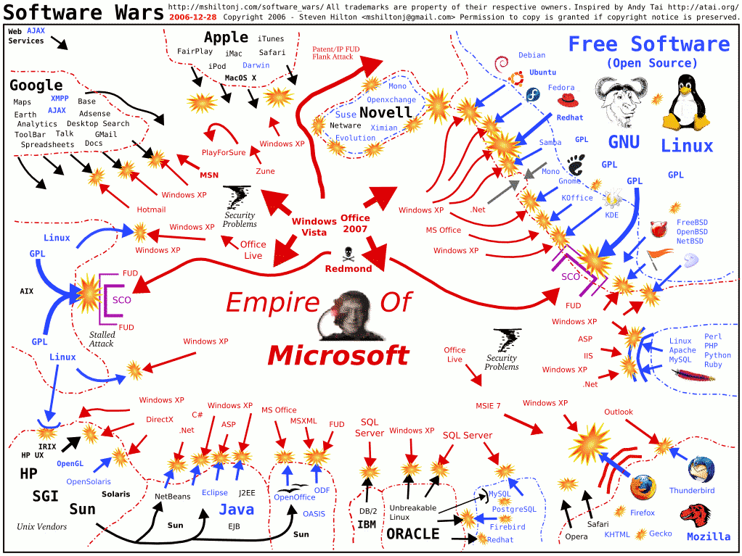
Meanwhile in Redmond

Slide 20
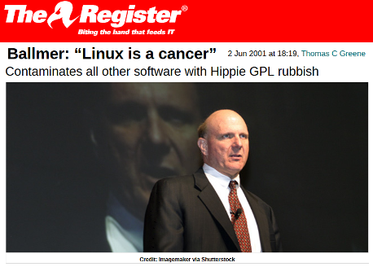
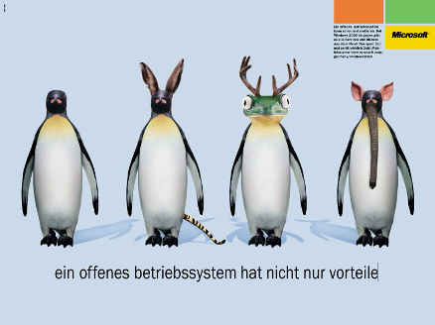
FUD as a typical answer to open source initiatives

Slide 21
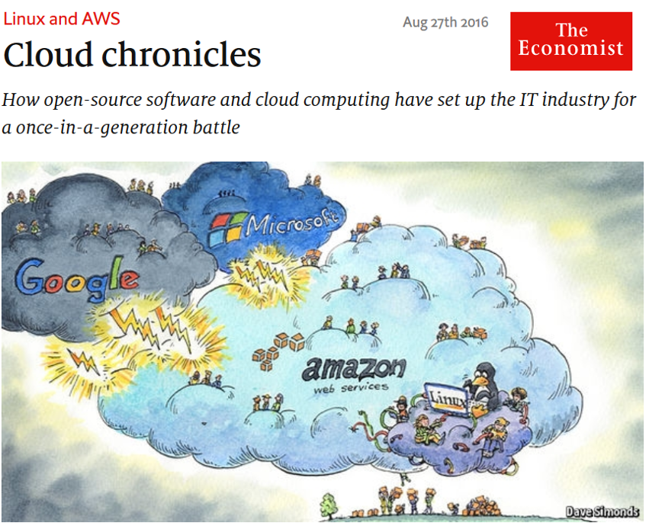
Then things changed and business went from license to service

Slide 22
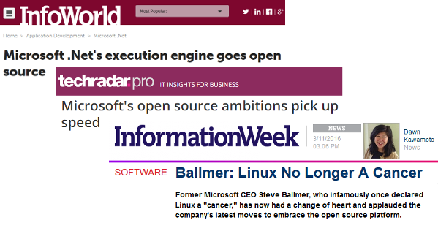
Today all IT companies use Open Source as a strategic tool

Slide 23
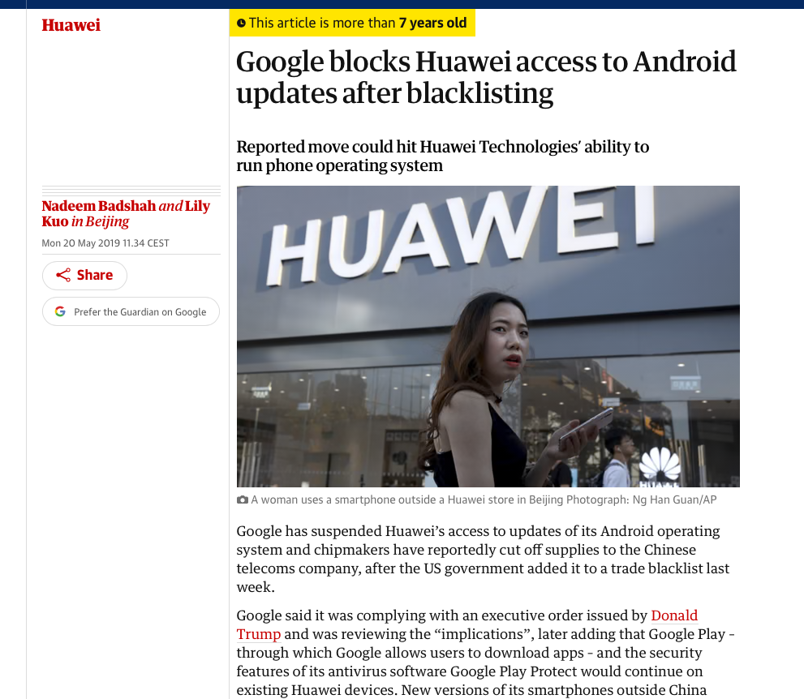
And governments explore the strategic impact of SW

Slide 24
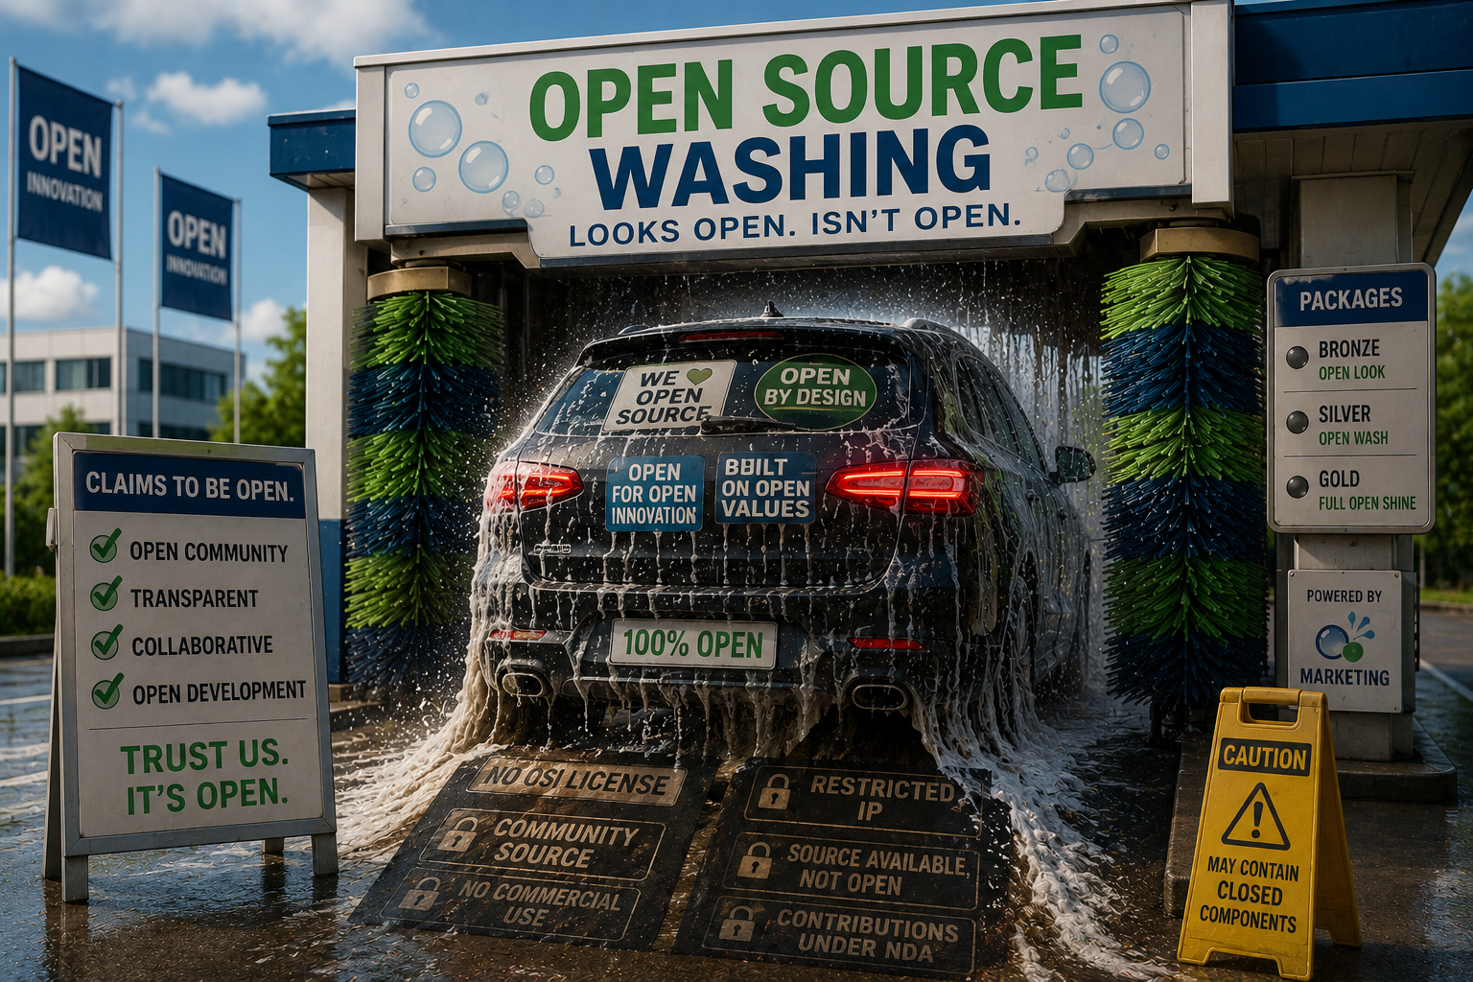
What’s new today: “open source washing”

Slide 25



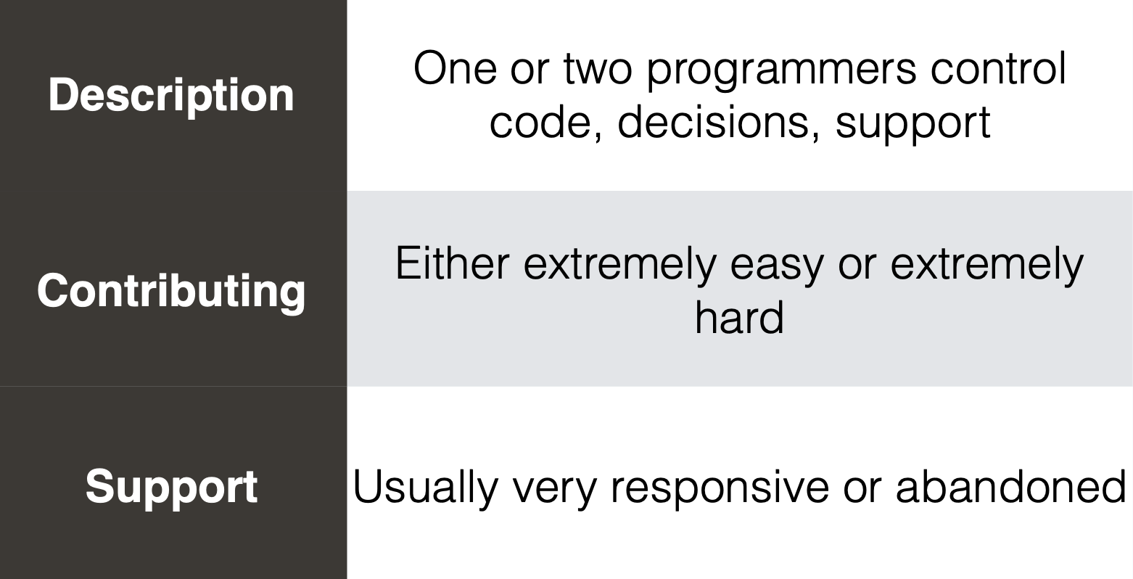
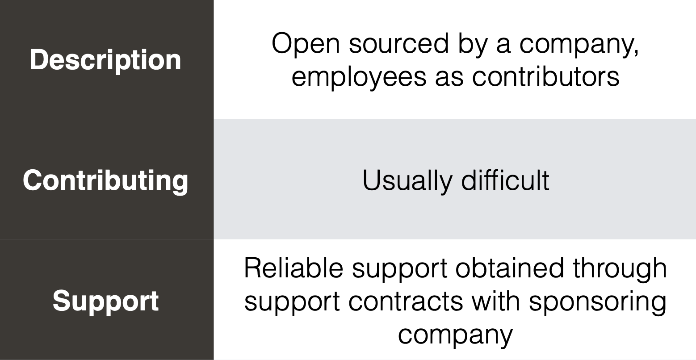
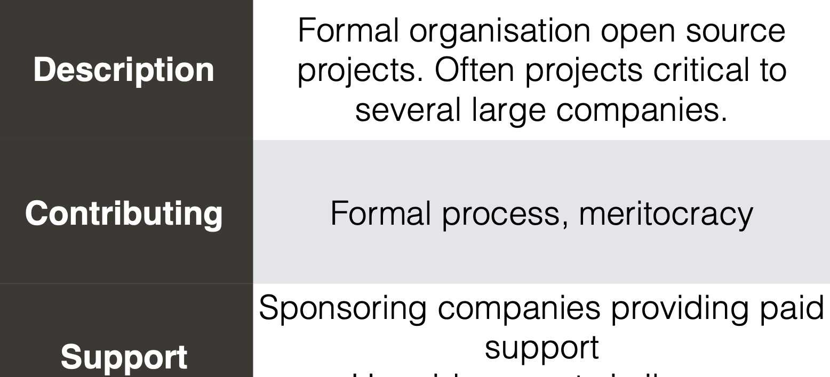
Open Source != Open Source
Solo
Single Vendor
Open Collaboration
And that’s why it was an educated decision to build Eclipse SDV in open collaboration!

Slide 26
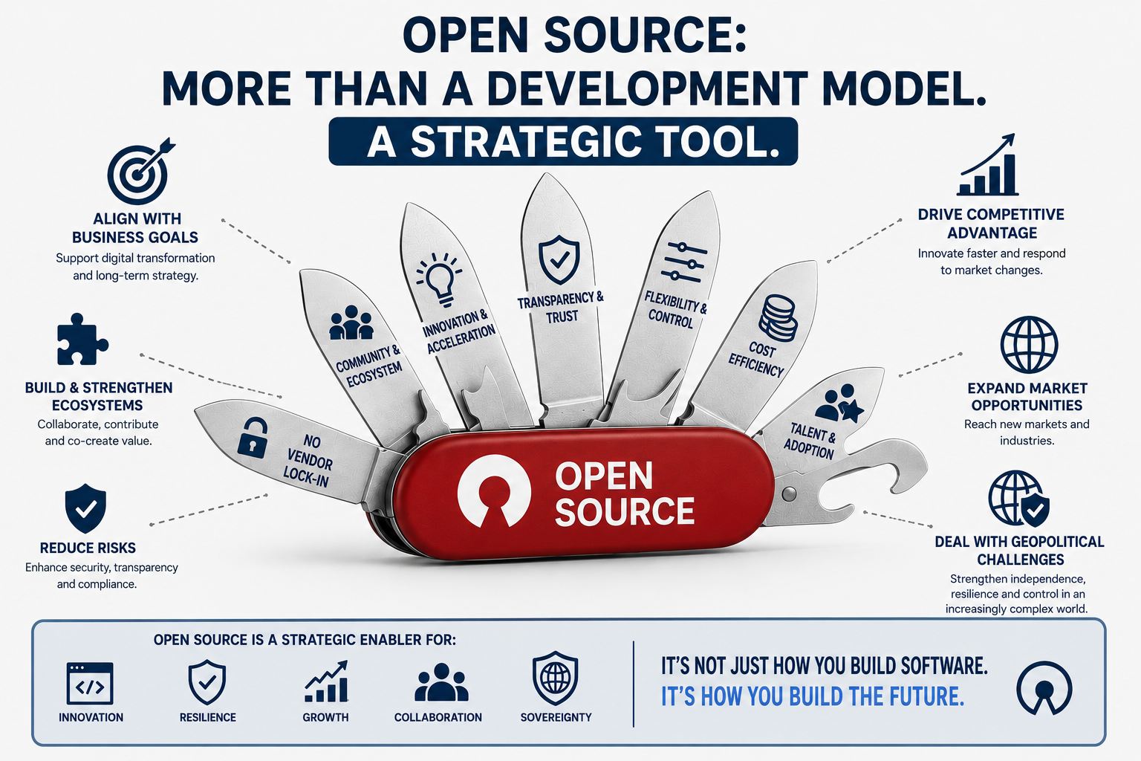
Take-away

Slide 27
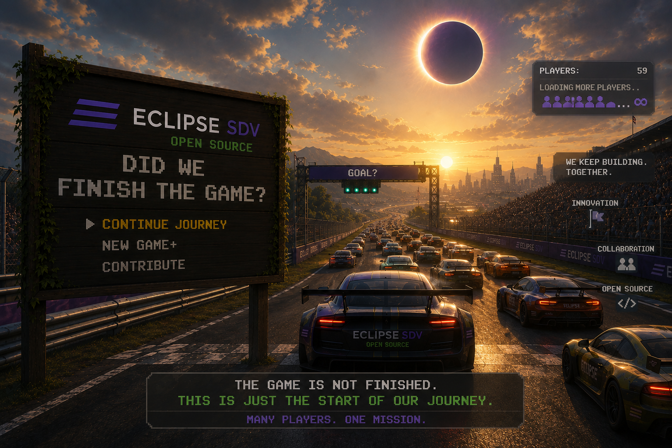

Slide 28
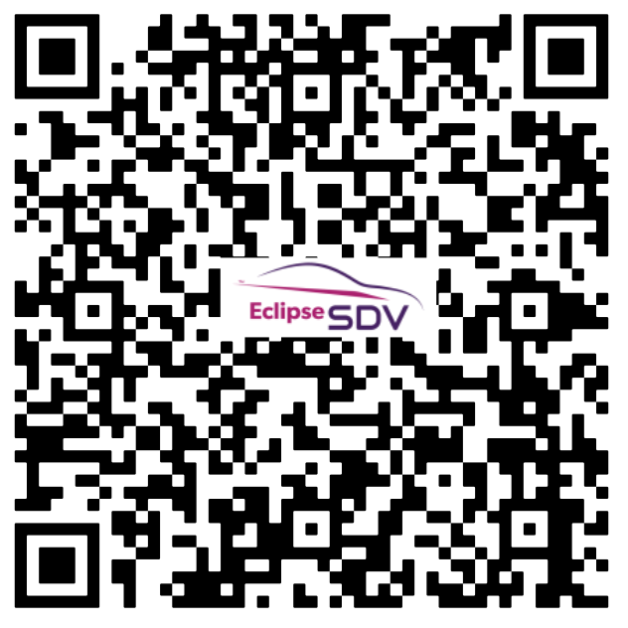
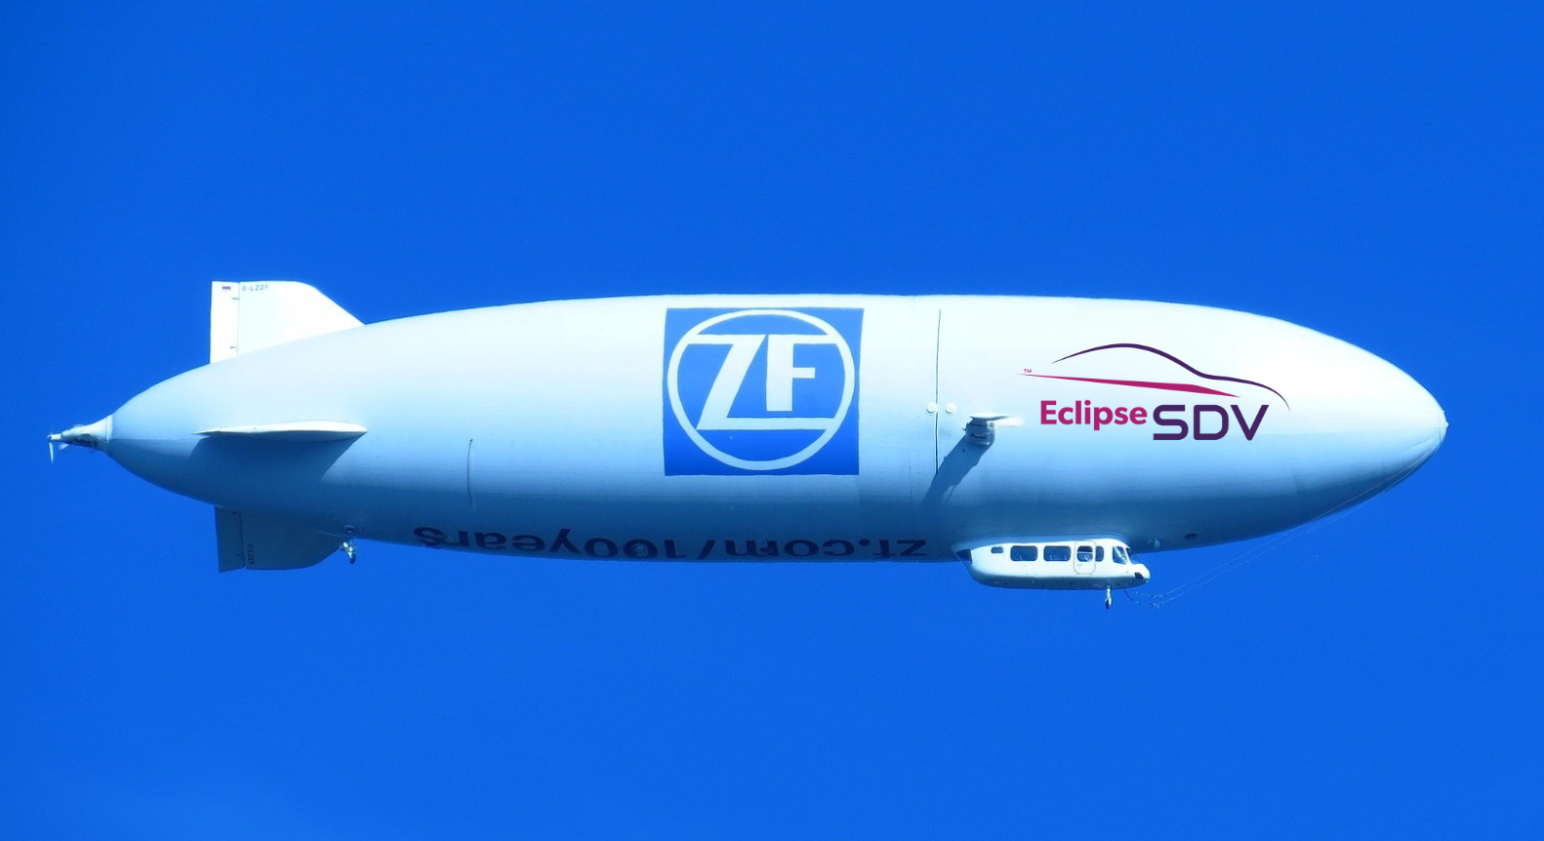
Eclipse SDV Hackathon - Chapter #4
October 6–8, 2026 | Friedrichshafen, Germany
Format: Dual-track competition featuring an Innovation Track (business case focus) and a Freestyle Track (project integration focus).
Team Structure: Form teams of up to 5 people (capacity is capped at 60 attendees total).
Ongoing weekly planning:
Hack Coaches meetings established focused on building the challenges and the evaluation systems
Jury formed
Planning sessions with the host
Internal planning (logistics, promotional activities, etc.)
Follow us on the refreshed website, Eclipse SDV LinkedIn page, Slack channels: Join the #hackathon2026 and #hackcoaches-2026
Copyright© Eclipse Foundation AISBL and contributors. Made available under CC-BY-SA 4.0 International.

