Slide 1

What role for chipmakers?
Automotive Open-Source Summit 2026 | Starnberg
frederic.ameye.vz@renesas.com

Slide 2

Do we want more Open-Source ?
(also applies to Open Standards)

Slide 3

Have we figured out how to deal with safety and cyber regulations?

Slide 4

We love reinventing the wheel.

Slide 5
Tech Industry figured it out early
Not only the benefits of open sourcing
But also energizing communities around a product
Being SW product-minded in general
Also technologies for mission-critical systems
  Hypervisor
  Containers
  Memory safety
  Distributed systems
  Confidential Computing
  …

Slide 6
Typical well-known example:
Who’s doing non-Android/AOSP infotainment nowadays?

Slide 7
Why?
Building around good developer experience, open ecosystems.

Slide 8
Also.
Never let one vendor own your stack.

Slide 9
Broadcom buys VMware.
Cloud vendors migrate to Xen.

Slide 10
That’s why we built Renesas Whitebox platform
Xen as reference hypervisor
  Including common work with AMD and EPAM on ASIL D qualification
  Upstreaming as default strategy (incl. Renesas HW-backed FuSa isolation)
Zephyr and TockOS as reference Cortex-R52 RTOS and Secure Enclave
  Including roadmaps for ASIL D qualification
  Based on OSS Long Term Support versions
  With standardised HW-crypto acceleration HALs

Slide 11
What sustainability model ?
Safety-qualified product shall be the same as the OpenSource product.
You only pay for the right to use it commercially and get the stamped paperwork.
Cf: Ferrocene

Slide 12
Oh, while we talk about Rust…

Slide 13
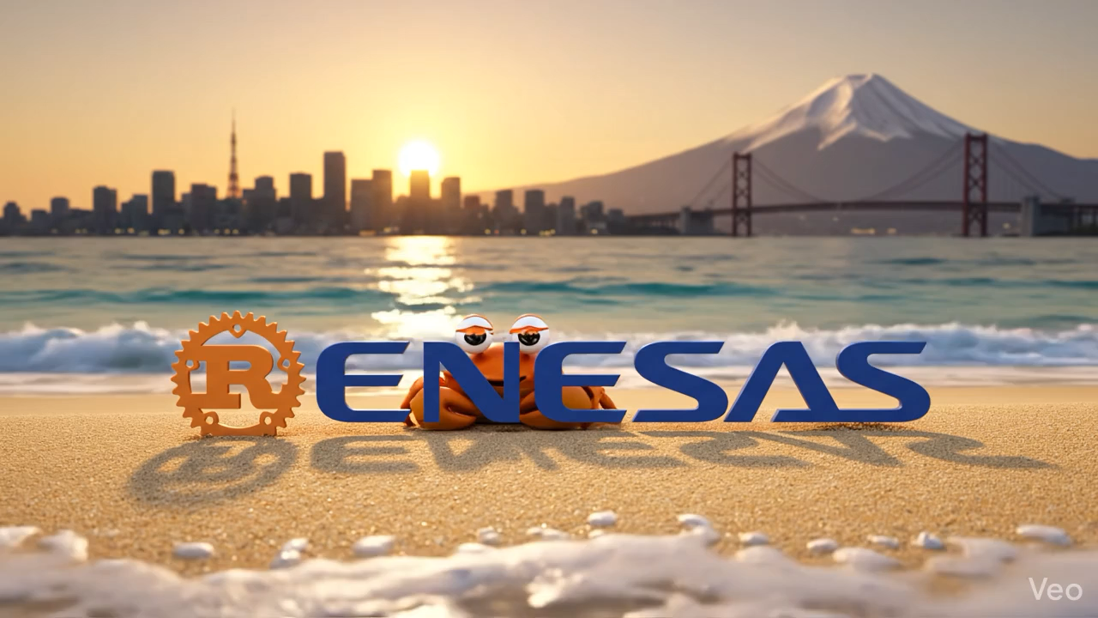
joins Rust Foundation as Silver member

Slide 14
Why joining Rust Foundation?
Someone has to fund volunteer work that powers our digital world
Notably when we start talking about supply chain security
FuSa Working Group
Embedded HAL contributions (eg. crypto, AI)
Better debugging (notably on Cortex-R52 cores with affordable probes)

Slide 15
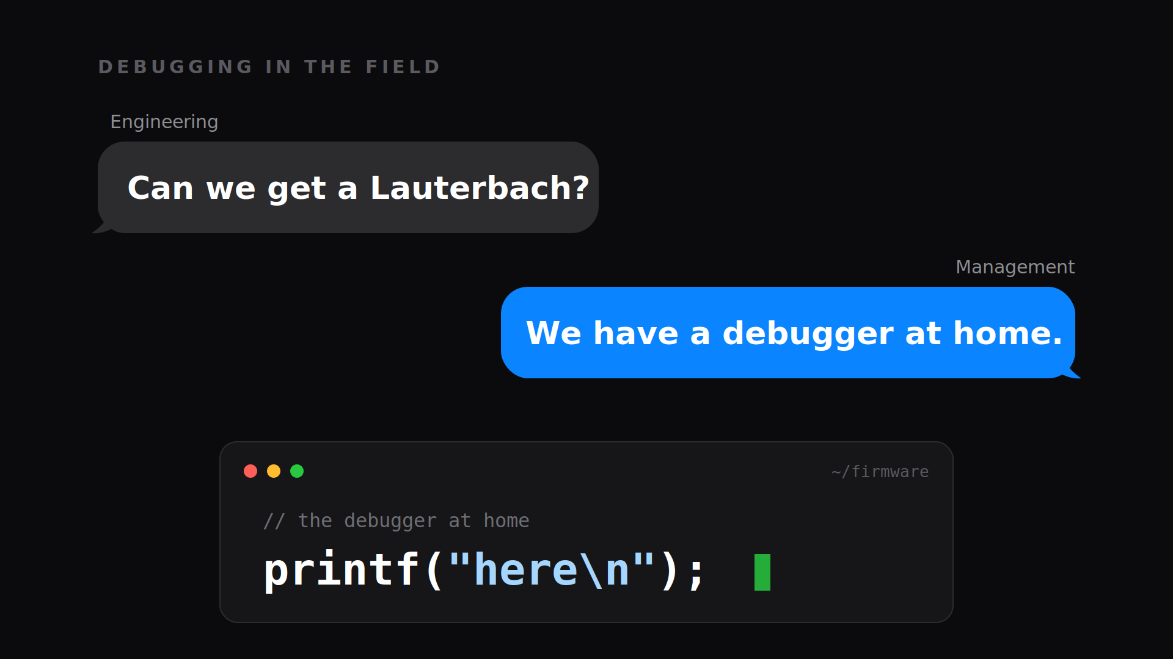

Slide 16
Why joining Rust Foundation?
Again, it’s about bridging worlds : Tech vs Legacy industry
  Somewhat it already started in infotainment
  So what’s next? ;-)
Bringing a « smart creative » culture where tech geeks wants to work in
Reliability and contract-based programming at scale + machine-enforceable

Slide 17
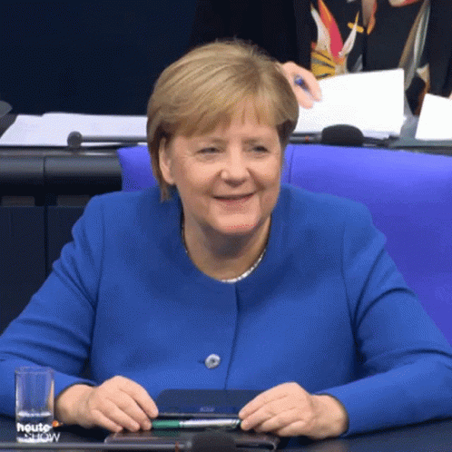
« That’s IoT stuff… will never land in a vehicle. Not Automotive-grade.
Das ist kein deutsche Wertarbeit. »
Someone, somewhere, in some committee

Slide 18
Stay tuned
AAOS SDV runtime integration in Zephyr
  With Zenoh and zerocopy backends, and SDV runtime compatibility
  While maintaining access control and Quality of Service using Renesas HW features for FFI (what if you had TSN-like capabilities for shm?)
An open standard for Level3+ cloud emulation containers, using Renesas Fast Simulator (based on QEMU, KVM and Arm64+GPU cloud instances)
  Emulate the full chip, interoperable with competitors for full E/E architecture emulation, ADAS resimulation, cockpit integration and 1-Click onboarding
  Based on interoperable Veecle ChipLab platform

Slide 19
Our devices should be as hackable as Arduinos.
Complexity is no excuse for opacity.

Slide 20
Thank you.
frederic.ameye.vz@renesas.com

