Slide 1
From Open Source to Market – Commercializing Eclipse S-CORE
Markus Schupfner
Qorix GmbH
AOSS 2026
Starnberg, Germany
June 30, 2026

Slide 2


01 The Industry Shift
02 Eclipse S-CORE & Qorix‘s Role
03 The Commercial Model
04 The Road Ahead
Agenda
© 2026 Qorix GmbH. All rights reserved.
Notes:
Today we move from the industry challenge to a working commercial model
SDV is no longer a vision, it is a delivery question
The goal: show how open source becomes a sustainable business

Slide 3
The Industry Shift

Slide 4
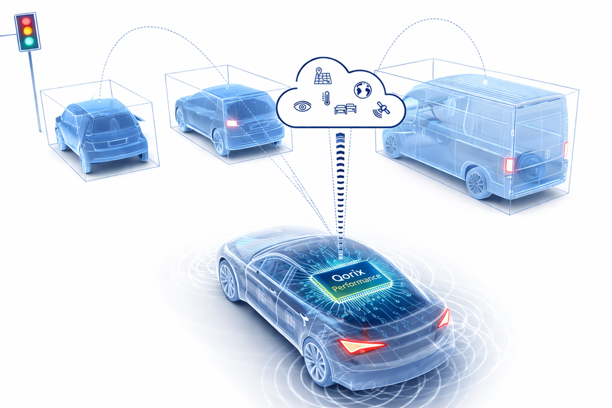
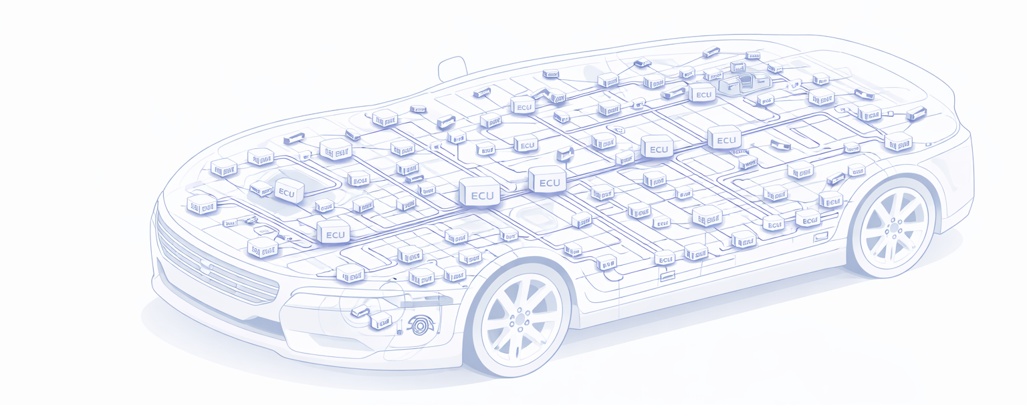
The Vehicle is Getting More Complex. Fast.
THE INDUSTRY SHIFT
Majority of today’s vehicles
Cars of the future with centralized middleware
  Vehicles with > 100 individual computing units
  Limited scalability and connectivity
  Inefficient resource utilization
  ≤5
  high-performance
  computing units
  Cross-domain consolidation and efficient communication
  Scalable open architecture enabling up-integration
High wiring and manufacturing costs
Lower wiring and manufacturing costs
1
2
3
Distributed ECU
(> 100 ECUs per vehicle)
Centralized Domain Controller
Centralized Computes with
Mixed Criticality
Complexity
The ever-increasing complexity of vehicles and the shift toward centralized computing require high-performance middleware solutions to ensure efficient communication between systems
1) The SAE (Society of Automotive Engineers) levels (L0-L5) define a standardized framework to classify the degree of vehicle automation
© 2026 Qorix GmbH. All rights reserved.
Notes:
From the past: more than 100 ECUs per vehicle, distributed architecture, high cable and manufacturing costs
Now: up to five high-performance computing units with mixed criticality. Complexity explodes.
This consolidation requires a completely new middleware generation
The old architecture is no longer competitive

Slide 5




Own the Platform. Not the Risk.
THE INDUSTRY SHIFT
The question is not whether to own the platform. The question is how to do it without carrying all the risk.
SW LIFECYCLE IN AUTOMOTIVE: ~30 YEARS
Project
Kick-Off
1st SOP
Last SOP
same platform
EOP last car
same platform
End of
Maintenance
Year “X”
"X" + >2y
"X" + >6y
"X" + ~12y
"X" + ~30y
RISK: Proprietary Lock-in
Development / industrialization
Usage of same platform
Maintenance
CHALLENGE: The 30-Year Burden
RISK: Proprietary Lock-In
Automotive SW lives for 20–30 years.
Maintenance often exceeds initial dev effort.
Safety & cybersecurity continue post-SOP.
OEMS become responsible for sustaining engineering over multiple product generations.
Reuse becomes dependent on a single supplier.
Supplier changes become expensive.
Platform evolution slows down.
Innovation is constrained by proprietary roadmaps.
Benefit of Open Source
Eclipse S-CORE
Qorix Performance
Build once, reuse across programs.
Reduce dependency on proprietary suppliers. Improve software quality through continuous evolution.
Create a common software foundation across brands and vehicle lines.
Open foundation.
Full SW ownership.
No supplier lock-in.
Ecosystem-driven.
Regulated co-development
Compliancy enabled
Commercial bridge.
Certification, LTS, liability
Production-ready
+
© 2026 Qorix GmbH. All rights reserved.
Notes:
Platform ownership is the strategic answer of every OEM to SDV
But ownership comes with two burdens: proprietary lock-in and 30 years of sustaining engineering
Eclipse S-CORE solves the lock-in problem with an open, ecosystem-driven foundation
Qorix Performance closes the gap to series production: certification, LTS, liability

Slide 6
Eclipse S-CORE & Qorix’s Role

Slide 7



Specifications Define Goals. S-CORE Delivers Working Code.
ECLIPSE S-CORE & QORIX’S ROLE
Code first - Code is the standard.
Eclipse S-CORE delivers an 'implemented standard‘, not a paper one.
Code-first removes ambiguity. No room for interpretation.
No duplicated work. No incompatible variants.
Founding members:
Lines of code committed
to Eclipse S-CORE
in 2025/2026
>20
Active member companies
contributing to the code base
in the last quarter.
>120
Individual contributors committing code in the last quarter.
Source: Eclipse Foundation
© 2026 Qorix GmbH. All rights reserved.
Notes:
Automotive standards have been document-driven for decades
S-CORE breaks the pattern: code first, specification follows
The numbers show the momentum: over 20 active members, over 120 contributors, significant code output in 2025/2026 summing up to 1.900.000 lines of code!
No more paper standard. An implemented one.

Slide 8



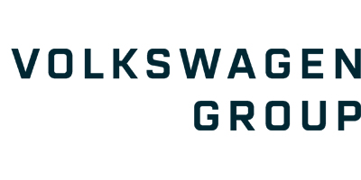

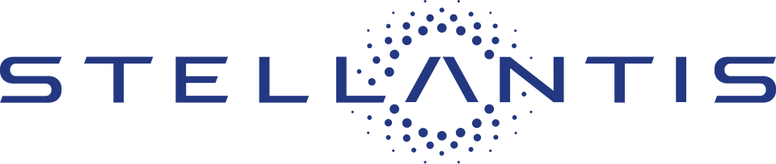



Contributing to S-CORE Opens Doors
ECLIPSE S-CORE & QORIX’S ROLE
Race to SDV ready middleware
AUTOSAR-locked middleware providers
SDV challengers well behind
Broad long tail of middleware providers lacking SDV positioning
Still stuck in AUTOSAR-centric legacy architectures
Few challengers with limited open-source-focused offerings
Providers lack clear open-source focus
>10 other contributors with smaller shares
Distribution as
Qorix Performance as
part of the Eclipse environment enables direct access to relevant OEM/ Tier-1s
3rd largest contributor and architecture lead in Eclipse S-CORE
Contribution as of 06/2026
1
*
2
3
* Exemplary selection — the S-CORE community continues to grow.
© 2026 Qorix GmbH. All rights reserved.
Notes:
Qorix is the third largest contributor and architecture lead in the project
The broad mass of middleware providers is still stuck in AUTOSAR-centric legacy architectures
Whoever shapes the code sits at the table where the future is decided
Distribution as Qorix Performance turns that position into commercial access to OEMs and Tier-1 suppliers
5 key messages
1. The market is shifting to open-source SDV middleware
Traditional AUTOSAR middleware providers are still focused on legacy architectures.
Few competitors have a strong open-source strategy.
2. Qorix has established a leading position in Eclipse S-CORE
Qorix is one of the largest contributors and an architecture lead.
This provides influence over the evolution of the platform.
3. Contribution creates competitive advantage
Early access to new technology.
Ability to shape APIs and architecture.
Strong technical credibility within the ecosystem.
4. Qorix commercializes S-CORE
Qorix Performance becomes the production-ready distribution built on S-CORE.
This transforms open-source innovation into a commercial product.
5. Contribution opens customer doors
Active participation in Eclipse creates visibility and trust with leading OEMs and Tier-1s.
This positions Qorix for strategic partnerships and future RFQs.
Executive Takeaway
Contributing to Eclipse S-CORE is not only a technology investment—it is a strategic business investment that enables Qorix to influence the future SDV platform, build a commercial middleware product, and gain direct access to leading automotive customers.

Slide 9
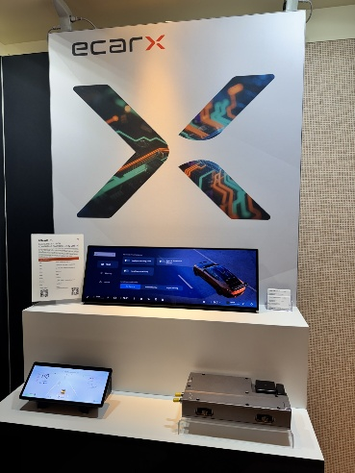
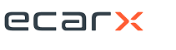

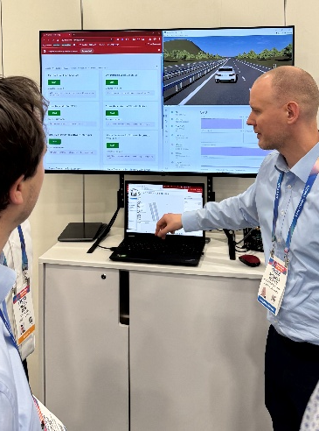
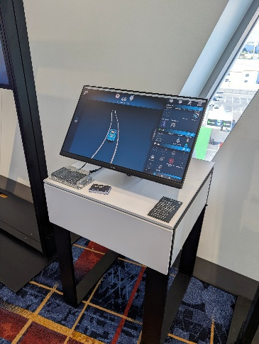
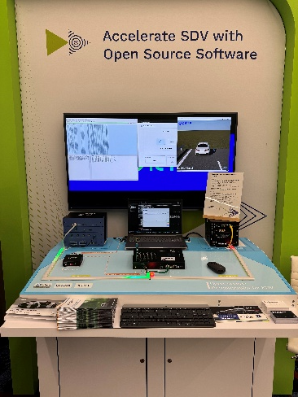
4 Partners. 4 Platforms. 4 Use Cases.
ECLIPSE S-CORE & QORIX’S ROLE
Technical Set-Up of Demonstrator
  SoC: Qualcomm Snapdragon SA8797P​
  ECU: ECARX ref. platform (dual-domain set-up)
  OS: Android + QNX 8.0 (Dual-OS scenario)
  Middleware: Qorix Performance
  Applications:
  Cockpit domain: Android-based UI and
  ADAS domain: Real-time driving function
Cockpit and ADAS, united on one ECU.
With Qorix Performance, real-time driving functions and infotainment run smoothly together on Qualcomm’s next-generation platform – showing how future SDV architectures will operate.
Technical Set-Up of Demonstrator
  SoC: Qualcomm Snapdragon SA8775
  OS: Red Hat In-Vehicle OS (RHIVOS)
  Middleware: Qorix Performance
  Applications: Adaptive Cruise Control
Mixed-criticality on Linux — enabled by Qorix Performance + Red Hat RHIVOS.
A fully open-source-based SDV platform that demonstrates deterministic orchestration, functional separation and a developer-friendly Linux workflow for OEM SDV programs.
Technical Set-Up of Demonstrator
  SoC: Qualcomm Snapdragon Ride™ SA8775
  OS: Red Hat AutoSD
  Middleware: Qorix Performance
  Application: KPIT Adaptive Cruise Control ​
  Switch: Technica’s FLYNC configuration tool (2 HPCs, 1 board)
  ​
Two hardware platforms, one consistent middleware.
KPIT’s ACC orchestrated by Qorix Performance –predictable, portable, and ready for real ADAS workloads.
Technical Set-Up of Demonstrator
  Hardware: ZF Parking ECU with
  TI TDA4 SoC
  OS: Red Hat In-Vehicle OS (RHIVOS)
  Middleware: Qorix Adaptive + Qorix Performance Orchestrator
  Applications: ZF Adaptive Cruise Control
Mixed-criticality on a safety-informed SDV platform – orchestrated by Qorix Performance.
Predictable, safety-aligned runtime execution on automotive-grade hardware.
Qorix Performance turns Eclipse S‑CORE concepts into real, automotive‑grade middleware – ready for OEM programs with full lifecycle support.
Notes:
Production-readiness is not a slide. It is hardware that runs.
Four demonstrators, four partners, four platforms, four use cases
All demonstrators powered by Qorix Performance
This is what "ready for OEM programs" looks like in practice

Slide 10
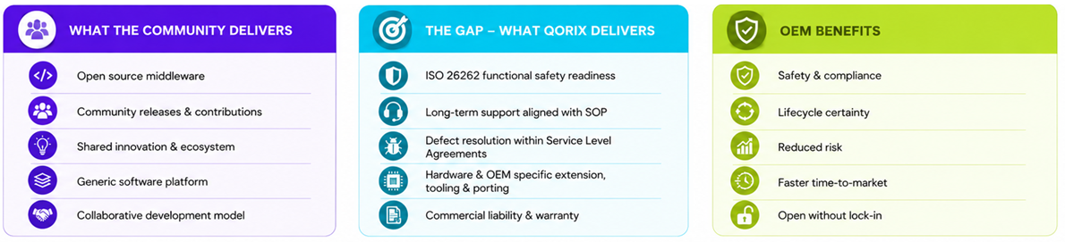
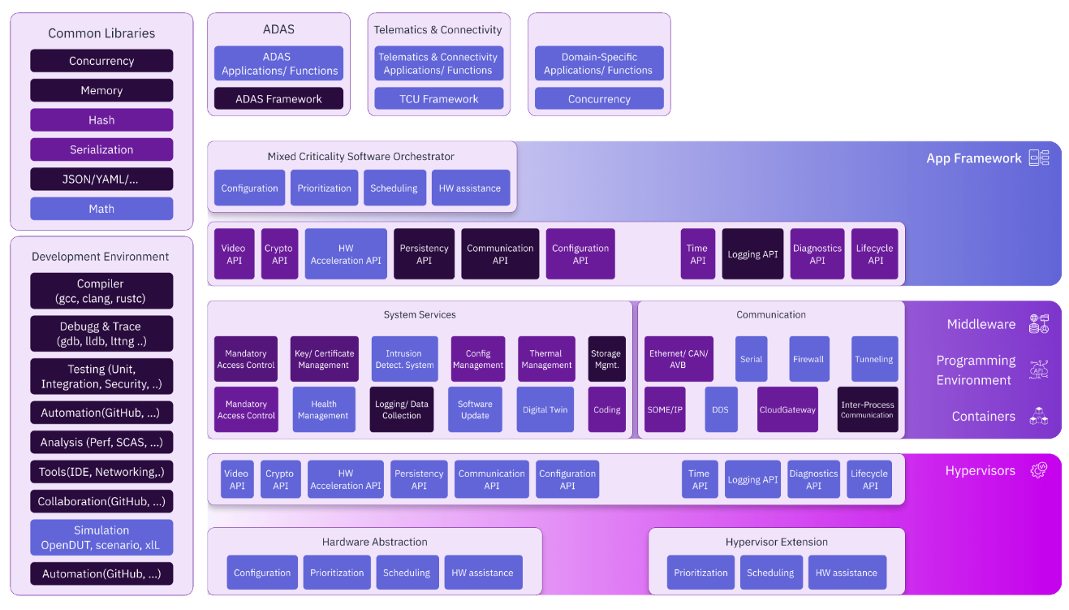
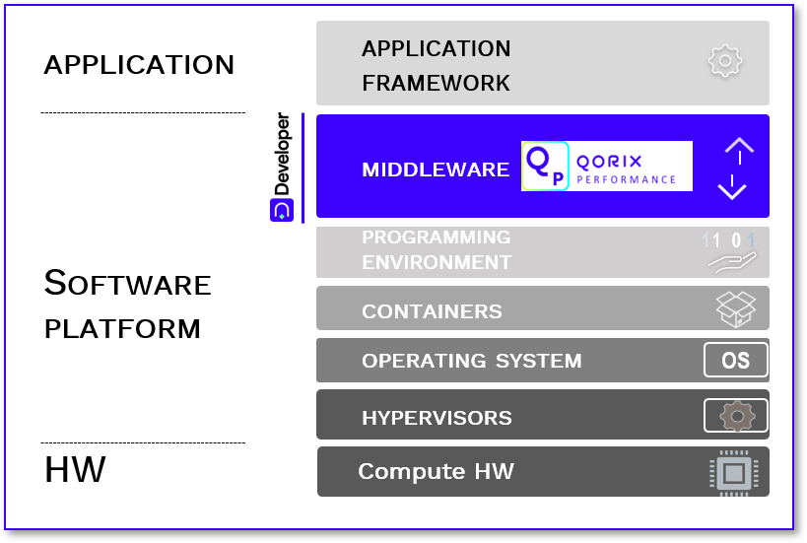
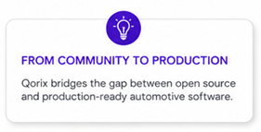
Open Source Does Not Ship Cars
ECLIPSE S-CORE & QORIX’S ROLE
What the community delivers – and what OEMs still need on top of that
OPEN-SOURCE ECOSYSTEM
PRODUCTION-READY SW PLATFORM
OPEN SOURCE
CLOSED
SOURCE
© 2026 Qorix GmbH. All rights reserved.
Notes:
The community delivers the foundation, but not the production platform
What is missing: certification, long-term support, liability, OEM-specific integration
The community delivers what can be shared. Qorix delivers what cannot.
This is exactly where the commercial model starts
OEMs benefit with aspects, such as faster time-to-market and reduced risk
The 5 key messages
The community delivers innovation
Open-source middleware
Shared development
Continuous innovation
Generic software platform
OEMs need more than open source
Functional safety
Long-term support
Hardware enablement
OEM-specific integration
Commercial liability and warranty
Qorix closes the gap
Qorix transforms S-CORE into Qorix Performance, a production-ready middleware platform with validation, safety, cybersecurity, lifecycle management, and commercial support.
OEMs benefit from lower risk
Faster time-to-market
Safety and compliance
Long-term lifecycle support
Reduced engineering effort
Freedom from vendor lock-in
From community to production
The value of Qorix is not replacing open source—it is industrializing it into a software product that is ready for SOP and long-term deployment.
Executive Takeaway
Eclipse S-CORE creates the open-source middleware foundation. Qorix adds the engineering, validation, safety, support, and commercial services required to turn that foundation into a production-ready software platform for Software-Defined Vehicles.

Slide 11





QORIX DEVELOPER
What Qorix Developer Delivers
Ship Faster.
Configure Smarter.
AI-Assisted Configuration
Deterministic & Safe Output
Natural language → validated configuration drafts across Bootloader, Classic, Classic Lite, Adaptive & Performance
AI assists; final configurations remain user-approved, deterministic, and aligned with safety-critical workflows.
Plug & Play Integration
One Tool for the Full Stack
VSCode extensions, Designer-based, Git-native collaboration, and CI/CD-ready artifacts.
Single environment for the entire Qorix middleware portfolio – zero toolchain fragmentation.
AI-powered tooling for the full SDV middleware stack – in VS Code and the cloud.
Our Differentiators
→ Explainable AI recommendations – the tool tells you why, not just what
→ Cross-stack alignment: Classic ↔ Adaptive ↔ Performance – automated, real-time
→ Automated conflict detection, cyclic dependencies, invalid scheduling patterns
→ OEM-scale variant support with full change traceability for CI pipelines
5
AI
0
Stacks
Unified
Natural
Language
Toolchain
Fragmentation
© 2026 Qorix GmbH. All rights reserved.
Notes:
Configuration is the silent cost driver in automotive software development
Qorix Developer changes that: AI-powered tooling across the full middleware stack
Natural language translates into validated, deterministic configuration drafts
One environment for Classic, Classic Lite, Adaptive and Performance. Zero toolchain fragmentation.

Slide 12
The Commercial Model

Slide 13
Addressable Market of Automotive Middleware
THE COMMERCIAL MODEL
Automotive middleware
2025
2030
2035
CAGR 2025-2035
$2bn
$3.1bn
$4.8bn
9.3%
Connectivity, Aps & OTA
Automotive connectivity market
Global in-vehicle apps market
OTA & FOTA (inkl. telematics)
Lessons Learned from Automotive Middleware
Middleware is a strategic asset:
It has become a key control point between applications, operating systems, and semiconductors.
Open ecosystems outperform proprietary solutions: OEMs want flexibility, portability, and reduced vendor lock-in.
Lifecycle matters more than development:
Long-term support, updates, cybersecurity, and maintenance are critical for 15–30 year vehicle lifecycles.
Hardware independence is essential:
Middleware must run across multiple SoCs and compute platforms.
Safety, determinism, and scalability are mandatory: Future SDVs require middleware that combines real-time performance, functional safety, and centralized HPC architectures.
OEMs want to own the software platform, but not the complexity of building and maintaining it themselves.
2025
$55bn
2030
$89bn
2035
$132bn
CAGR 2025-2035
9.1%
2025
$71bn
2030
$106bn
2035
$161bn
CAGR 2025-2035
8.5%
2025
$5.8bn
2030
$14bn
2035
$33bn
CAGR 2025-2035
19%
Infotainment, Digital Cockpit & Vehicle OS
Automotive OS market
Automotive middleware
Infotainment OS market
2025
$12bn
2030
$21bn
2035
$39bn
CAGR 2025-2035
12.8%
2025
$2bn
2030
$3.1bn
2035
$4.8bn
CAGR 2025-2035
9.3%
2025
$0.6bn
2030
$0.9bn
2035
$1.4bn
CAGR 2025-2035
8.6%
ADAS Solutions
Global ADAS market
ADAS sensor market
ADAS software market
2025
$37bn
2030
$80bn
2035
$175bn
CAGR 2025-2035
16.5%
2025
$29bn
2030
$49bn
2035
$82bn
CAGR 2025-2035
14.1%
2025
$2.2bn
2030
$3.9bn
2035
$7.1bn
CAGR 2025-2035
13%
E/E Architecture
E/E architecture market
Global automotive semiconductors
ADAS domain controller market
2025
$74bn
2030
$107bn
2035
$155bn
CAGR 2025-2035
7.6%
2025
$70bn
2030
$90bn
2035
$120bn
CAGR 2025-2035
5.7%
2025
$2.8bn
2030
$7.9bn
2035
$26bn
CAGR 2025-2035
25.1%
Suppliers should select their strategy bets for sustainable value generation.
Relevant control points for SDVs and AI-enabled vehicles need to be known and owned.
Source: MHP, 2026 (SDV: Today and the vision for the future)
© 2026 Qorix GmbH. All rights reserved.
Notes:
Automotive middleware market: 2bn USD today, growing to 4.8bn USD by 2035, CAGR 9.3 percent
The bigger story: middleware becomes the strategic control point between apps, OS and semiconductors
OEMs want flexibility and portability, not lock-in
A market that rewards open ecosystems over proprietary stacks

Slide 14


How Open Source Creates Commercial Value
THE COMMERCIAL MODEL
Open-source software is collaboratively developed with publicly accessible code and is generally not monetized through traditional licensing models
Closed-source software is proprietary and vendor-controlled, allowing Qorix to monetize a middleware stack for OEMs through extensions and integration on top of an open-source foundation.
Contribute
Maintain
Distribute
OEMs/ Semiconductors
Automotive
Contributor
Maintainer
Distributor
Semiconductors
The Eclipse foundation stewards the Eclipse open-source community, where contributors collaboratively develop the S-CORE middleware platform
Creates and maintains middleware on reference HW
Enables a certification of stack & tools
Enables long term availability
Up-streams changes to community
Enables Distribution
Enriches stack with specific components
Customizes on target HW
Safety guarantee with certification of full stack
Adds liability & warranty
Delivers customized solution towards OEM
Community middleware
Full stack
middleware
Full stack
product
Robotics
Industrial automation
Virtual Environment
Reference
HW
Target
HW
Target
Context
OPEN-SOURCE
PRODUCT
Eclipse
open-source
Release
Tools & Integration
Defect Resolution & Upstream
Functional Safety
Certification & Cyber Security
Full Stack Solution for SOP
Continuous Delivery & Maintenance &
Long Term Support
© 2026 Qorix GmbH. All rights reserved.
Notes:
Three roles, one company: Contributor, Maintainer, Distributor
Contributor: shapes the foundation together with the community
Maintainer: turns the foundation into a buildable stack on reference HW
Distributor: turns the stack into a product on target HW, with safety, liability and guaranteed timelines
Monetization happens where the value is highest: in productization

Slide 15
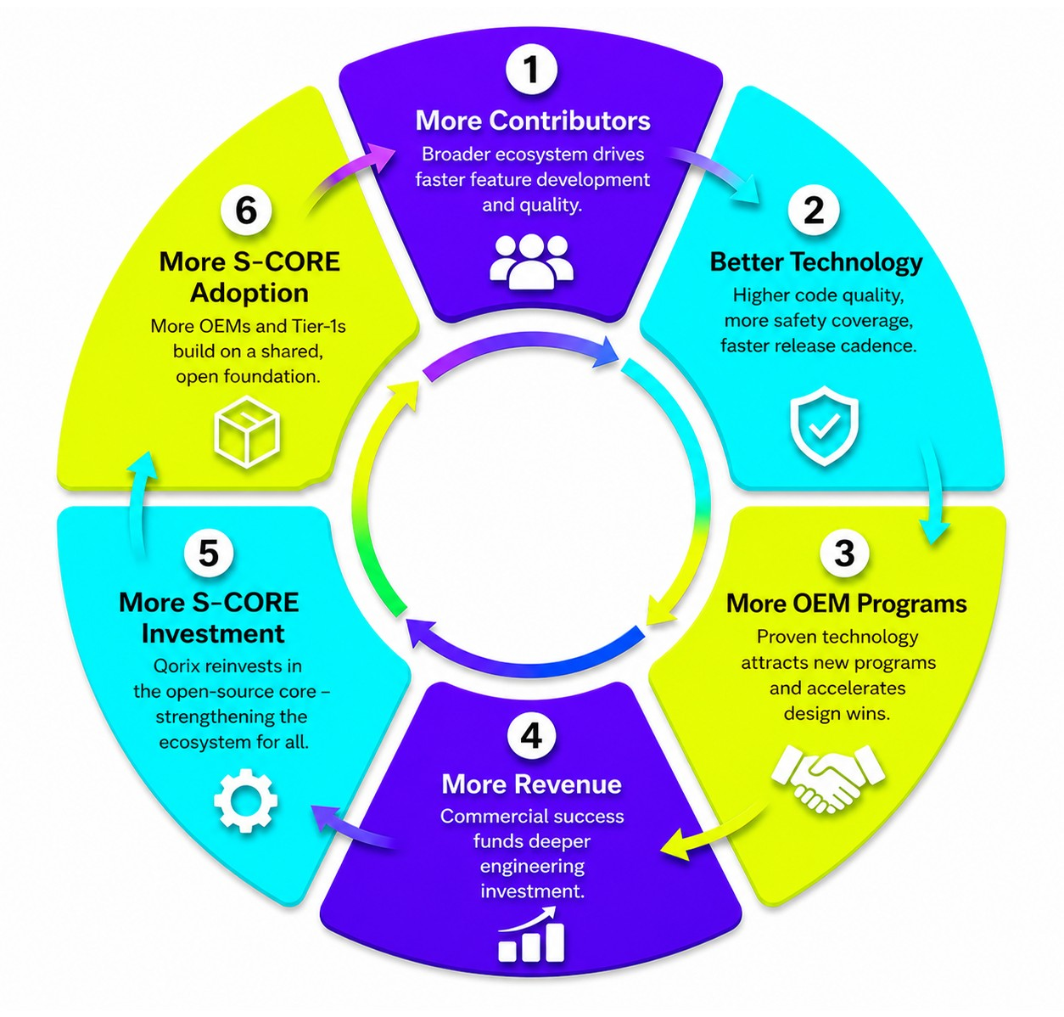
The Open Source Flywheel
THE COMMERCIAL MODEL
Commercial success sustains the ecosystem.
  Advantages for Distributors
  Larger addressable market through growing S-CORE adoption.
  Lower development cost by leveraging community innovation and shared investments.
  Faster product development from a continuously improving technology base.
  More customer opportunities as OEM confidence and adoption increase.
  Scalable business model through licensing, support, certification, and integration services.
  Advantages for OEMs / Customers
  Better technology through contributions from a broad ecosystem.
  Reduced risk with a proven and widely adopted platform.
  Faster time-to-market due to mature middleware and shorter integration cycles.
  Lower total cost of ownership through shared development and software reuse.
  No vendor lock-in thanks to an open-source foundation and multi-supplier ecosystem.
Customers benefit from better, lower-risk technolog Distributors benefit from a larger market, recurring revenue, and shared innovation.
© 2026 Qorix GmbH. All rights reserved.
Notes:
Open source only works commercially when a flywheel emerges
Distributors invest. The community grows. Adoption increases. More OEMs join. The market scales.
For OEMs: better technology, lower risk, faster time-to-market
For distributors: larger market, lower development cost, recurring revenue

Slide 16
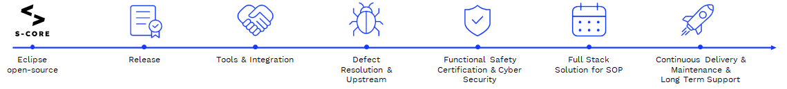
From Engineering Company to Platform Company
THE COMMERCIAL MODEL
TRADITIONAL MODEL
PLATFORM MODEL
REVENUE STREAMS
Revenue
~ Engineers
Services
  Enterprise support with defined SLAs
Development & Licensing
  Per OEM, per project, or company-wide
Subscription
  Recurring updates, security fixes & tooling
  Revenue scales with headcount
  High cost per project
  Engineering bottleneck limits growth
  Services-heavy, low-margin model
Production Royalties
  Per-ECU royalties scaling with deployments
Qorix Developer (AI SaaS)
  AI tooling for configuration & lifecycle
Custom Integration Services
  OEM-specific adaptations & engineering
Proprietary Extensions
  Proprietary add-ons beyond S-CORE
Every new OEM program multiplies revenue without proportional cost increase.
© 2026 Qorix GmbH. All rights reserved.
Notes:
Traditional model: revenue scales with headcount, services-heavy, low margins
Platform model: every new OEM program multiplies revenue without proportional cost increase
Five revenue streams: Development & Licensing, Subscription, Production Royalties, Proprietary Extensions, Services
Plus Qorix Developer as AI SaaS layer on top
Today, traditional engineering companies generate revenue primarily through engineering hours. Revenue grows with headcount, projects are service-intensive, and growth is constrained by engineering capacity.
Qorix is transforming this model by leveraging Eclipse S-CORE as the open-source foundation and building Qorix Performance as a commercial middleware platform. Instead of selling engineering time, Qorix creates reusable software products and recurring revenue streams that can be deployed across multiple OEM programs.
The platform model enables several complementary revenue streams:
Enterprise Support & SLAs – Long-term commercial support for production deployments.
Development & Licensing – Initial software development, integration, and licensing.
Subscription – Continuous software updates, security fixes, maintenance, and tooling.
Production Royalties – Per-vehicle or per-ECU royalties that scale with customer deployments.
Qorix Developer (AI SaaS) – AI-powered engineering tools for software development, configuration, and lifecycle management.
Custom Integration Services – Customer-specific engineering and hardware enablement.
Proprietary Extensions – Commercial add-ons beyond the open-source S-CORE baseline, such as diagnostics, safety, communication frameworks, or OEM-specific functionality.
Business Model
The key idea is that S-CORE provides the common open-source software platform, while Qorix commercializes it through industrialization, support, certifications, AI tooling, and production-ready extensions.
As each new OEM adopts Qorix Performance, the same platform can be reused across programs, creating recurring software revenue without a proportional increase in engineering resources.
Key Message
Qorix transforms open-source innovation into a scalable software platform business, where recurring licenses, subscriptions, royalties, AI tooling, and commercial support gradually replace project-based engineering revenue and enable sustainable long-term growth.

Slide 17
The Road Ahead

Slide 18



Eclipse S-CORE Project Roadmap with Qorix Focus
THE ROAD AHEAD
Q4 / 2024
Q1 / 2025
2025
2026
Q4 / 2026 - Q1 / 2027
2030
MVP Phase
Alignment Phase
Initial Phase
Series Stability & Evolution Phase
S-CORE Release 2.0
Release Plan
branch
Something convincible,
that the way is feasible.
SDV Project Announcement
S-CORE
MVP 0.1
S-CORE
Definition 1.0
S-CORE
Release 0.5
S-CORE
Release 0.6
S-CORE
Release 0.7
S-CORE
Release 1.0
A minimal demo
Essential libs, com, log
QNX OS
Proof of automotive grade “Qualification ability”
A minimal demo
Essential libs, com, log
QNX OS
Proof of automotive grade “Qualification ability”
A set of requirements for a core full stack.
To be used as basis for content planning in distributions.
First public implementation package.
Developed fully automotive grade.
First basis for embedding into a distribution.
Qorix focus:
Matured reference integration with automated builds per platform
Interactive frontend for playgrounds and showcases
Unit test and code coverage dashboards across modules
Stronger traceability and testing transparency
Lifecycle management
Qorix focus:
Consistent Stack: Coherent, validated foundation for OEMs and Tier-1 suppliers.
Testing & Traceability: Requirements-linked integration tests - basis for certifiability.
Rust Readiness: Formally approved for ASIL-B in S-CORE 1.0.
S-CORE Release 1.X
Details
Orga and project set-up
Goals and timeline definition
First Safety Audit, that shows that S-Core process and tooling empower development of safety qualified software as open source
First public implementation package.
Developed fully automotive grade.
First basis for embedding into a distribution.
© 2026 Qorix GmbH. All rights reserved.
Notes:
From the SDV announcement in Q4 2024 to Eclipse S-CORE Release 1.0 in Q4 2026 / Q1 2027
Every release marks a step toward production-readiness
Qorix focus shifted from release to release: consistent stack, then testing & traceability, then Rust readiness
After 1.0: continuous evolution toward 2.0 with the community
Background Info to Releases
Qorix’s contribution to Eclipse S-CORE is not a one-off initiative, but rather a consistent, cross-release development effort with a clear focus on production readiness.
Release 0.5 – Foundation:
What happened: First buildable S-CORE stack. Logging & Tracing, Persistency, Orchestration delivered.
Qorix Role: Primary developer of the Orchestration module. Note: Qorix contributions in R0.5 extend significantly beyond Orchestration and Storage, including architecture leadership, testing governance, and multiple feature increments.
Customer Benefit: Scalable, deterministic execution of mixed-criticality apps. Architectural foundation for series production.
Release 0.6 – Maturation:
What happened: S-CORE 0.6 advanced developer experience and integration maturity. Automated builds per platform introduced, new interactive frontend replaced manual setup, unit test and code coverage dashboards established.
Qorix Role: Drove matured reference integration, testing transparency, and traceability. Additional contributions to Lifecycle Management and Rust enablement.
Customer Benefit: Less friction for developers. More visibility into software quality. Stronger integration across automotive and embedded environments.
Release 0.7 – Series Readiness:
What happened: S-CORE officially defined as a continuously consistent stack. Integration tests now link directly to requirements. Rust formally approved for ASIL-B.
Qorix Role: Drove consistent stack alignment. Led testing and traceability infrastructure. Co-led Rust readiness evaluation covering toolchain qualification, compiler readiness.
Customer Benefit: Predictable integration, no architecture surprises. Certifiability foundation for ISO 26262 and ISO 21434. Future-proof safety through Rust's memory-safe design.
Release 1.0 – Series Release:
Stable production-grade open-source baseline to generate a SOP product as distributor.
Compared to v0.7, S-CORE v1.0 is expected to transition from an early technology preview to a stable, feature-complete, and production-oriented open-source middleware platform. While it will significantly improve maturity, quality, and ecosystem readiness, commercial capabilities such as hardware enablement, OEM-specific extensions, functional safety certification, cybersecurity compliance, long-term support, commercial SLAs, liability, and warranty remain the responsibility of distributors such as Qorix Performance.

Slide 19
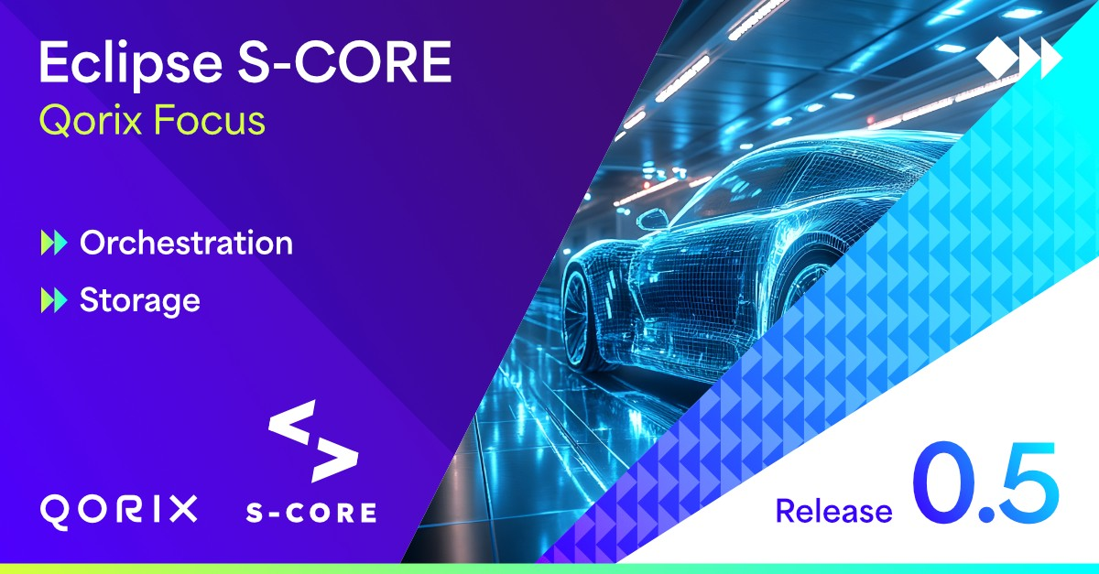
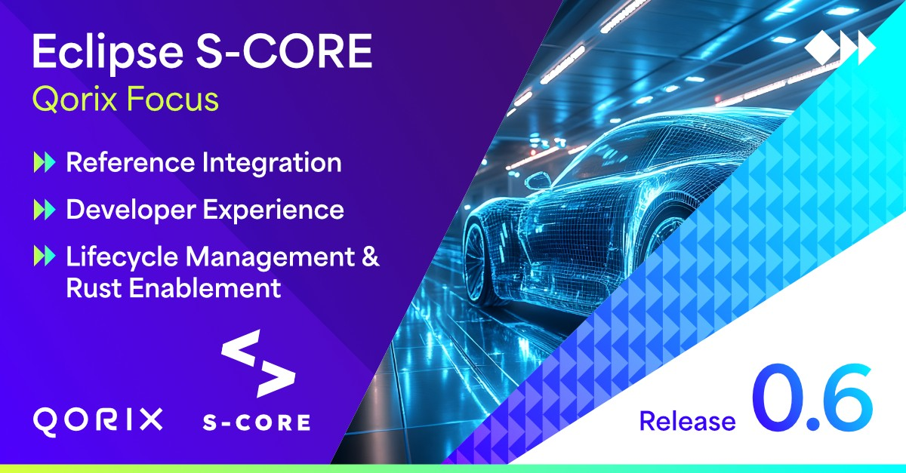
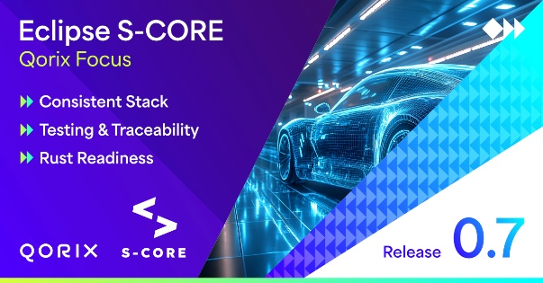
What Qorix Has Driven in Eclipse S-CORE.
RELEASE HISTORY
Release 0.5
Release 0.6
Release 0.7
WHAT HAPPENED
WHAT HAPPENED
WHAT HAPPENED
First buildable S-CORE stack. Logging & Tracing, Persistency, Orchestration delivered.
S-CORE officially defined as a continuously consistent stack. Integration tests now link directly to requirements. Rust formally approved for ASIL-B.
S-CORE 0.6 advanced developer experience and integration maturity. Automated builds per platform introduced, new interactive frontend replaced manual setup, unit test and code coverage dashboards established.
QORIX ROLE
QORIX ROLE
Primary developer of the Orchestration module. Note: Qorix contributions in R0.5 extend significantly beyond Orchestration and Storage, including architecture leadership, testing governance, and multiple feature increments.
QORIX ROLE
Drove consistent stack alignment. Led testing and traceability infrastructure. Co-led Rust readiness evaluation covering toolchain qualification, compiler readiness.
Drove matured reference integration, testing transparency, and traceability. Additional contributions to Lifecycle Management and Rust enablement.
CUSTOMER BENEFIT
CUSTOMER BENEFIT
CUSTOMER BENEFIT
Predictable integration, no architecture surprises. Certifiability foundation for ISO 26262 and ISO 21434. Future-proof safety through Rust's memory-safe design.
Scalable, deterministic execution of mixed-criticality apps. Architectural foundation for series production.
Less friction for developers. More visibility into software quality. Stronger integration across automotive and embedded environments.
Notes:
Qorix’s contribution to Eclipse S-CORE is not a one-off initiative, but rather a consistent, cross-release development effort with a clear focus on production readiness.
Release 0.5 – Foundation:
What happened: First buildable S-CORE stack. Logging & Tracing, Persistency, Orchestration delivered.
Qorix Role: Primary developer of the Orchestration module. Note: Qorix contributions in R0.5 extend significantly beyond Orchestration and Storage, including architecture leadership, testing governance, and multiple feature increments.
Customer Benefit: Scalable, deterministic execution of mixed-criticality apps. Architectural foundation for series production.
Release 0.6 – Maturation:
What happened: S-CORE 0.6 advanced developer experience and integration maturity. Automated builds per platform introduced, new interactive frontend replaced manual setup, unit test and code coverage dashboards established.
Qorix Role: Drove matured reference integration, testing transparency, and traceability. Additional contributions to Lifecycle Management and Rust enablement.
Customer Benefit: Less friction for developers. More visibility into software quality. Stronger integration across automotive and embedded environments.
Release 0.7 – Series Readiness:
What happened: S-CORE officially defined as a continuously consistent stack. Integration tests now link directly to requirements. Rust formally approved for ASIL-B.
Qorix Role: Drove consistent stack alignment. Led testing and traceability infrastructure. Co-led Rust readiness evaluation covering toolchain qualification, compiler readiness.
Customer Benefit: Predictable integration, no architecture surprises. Certifiability foundation for ISO 26262 and ISO 21434. Future-proof safety through Rust's memory-safe design.

Slide 20


Eclipse S-CORE 1.0 Is Not the Finish Line
THE ROAD AHEAD
Eclipse S-CORE
Qorix Performance
Automotive
OEM Programs
Adjacent Markets
Open Source Foundation
Production-Ready Distribution
Series Production
Beyond Automotive
Community-driven, vendor-neutral
Safety-ready middleware standard
Release 0.7 today – 1.0 on the horizon
Certified, supported, hardware-agnostic
ISO 26262 aligned – certifiability-ready
Long-term support across vehicle lifecycles
Production-readiness proven across several platforms
Faster time to market for every OEM program
SOP-ready with
S-CORE 1.0
Industrial automation & robotics
Medical & safety-critical embedded systems
Any domain where safety-critical SW matters
The platform is designed to grow.
Beyond automotive, into any domain where safety-critical, real-time middleware matters.
© 2026 Qorix GmbH. All rights reserved.
Notes:
Eclipse S-CORE Release 1.0 marks the open foundation. The journey continues.
Qorix Performance turns that foundation into a certifiable, supported product
First target: automotive OEM programs, SOP-ready with Release 1.0
Then: industrial automation, robotics, medical, every safety-critical embedded domain

Slide 21

Eclipse S-CORE provides the open foundation.
Qorix Performance makes it production-ready.
THE ROAD AHEAD

Slide 22
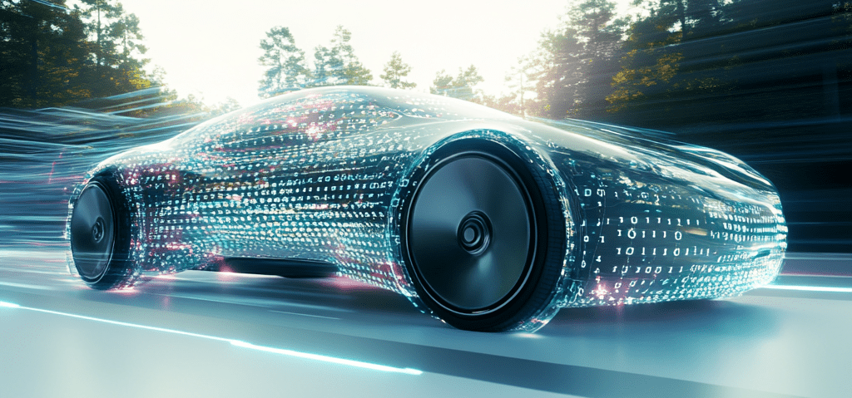









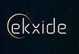


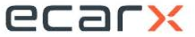
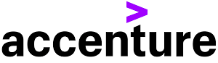
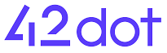





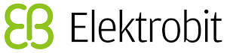











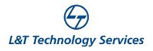


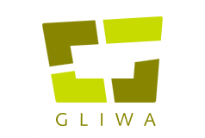

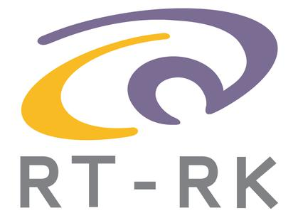















Our Partner Landscape: Stronger Together
THE ROAD AHEAD
S-CORE
OWNER
PARTNERS
CONSORTIUM
RESELLER
SILICON
© 2026 Qorix GmbH. All rights reserved.
Notes:
SDV is not a single-company story. It is an ecosystem story.
Owner: KPIT Technologies, ZF, Qualcomm Ventures
S-CORE consortium, silicon partners, resellers and a broad partner network of OEMs and Tier-1 suppliers
Stronger together. Faster to market.

Slide 23
Key Take-Aways
THE ROAD AHEAD
Eclipse
Open-source
Release
Tools & Integration
Defect Resolution & Upstream
Functional Safety
Certification &
Cyber Security
Full Stack Solution for SOP
Continuous Delivery & Maintenance &
Long Term Support
Open source does not ship cars – safety, support, certification, and liability are still required.
SDVs need a shared software foundation – no company can build it alone.
Eclipse S-CORE is the open foundation for next-generation vehicle software.
Qorix Performance transforms that foundation as distributor into a certifiable, supported, production-ready product.
OEMs pay for the customized product, risk reduction and faster SOP, not for the code itself.
Extension towards horizontal markets.
SDV
OEMs
Eclipse S-CORE provides the open foundation. Qorix Performance makes it production-ready.
© 2026 Qorix GmbH. All rights reserved.
Notes:
Open source alone does not ship cars. Safety, support, certification and liability remain mandatory.
No single company builds the SDV software stack alone
Eclipse S-CORE is the open foundation
Qorix Performance turns it into a production-ready platform
OEMs pay for risk reduction and faster SOP, not for the code itself
And: this platform grows beyond automotive

Slide 24
Markus Schupfner
Chief Executive Officer
markus.schupfner@qorix.ai

