Slide 1


After Eclipse SDV Korea Event…
LG Electronics / CTO Division
COPYRIGHT (C) 2023, ECLIPSE FOUNDATION. | THIS WORK IS LICENSED UNDER A CREATIVE COMMONS ATTRIBUTION 4.0 INTERNATIONAL LICENSE (CC BY 4.0)
Notes:
Thank you for joining today.
Before we start the main topic, I want to share a brief reflection on the recent Eclipse SDV Korea event.
With strong support from the Eclipse SDV team, LG Electronics successfully hosted the meetup, and it became a clear signal of how fast the SDV ecosystem is growing in Korea.

Slide 2
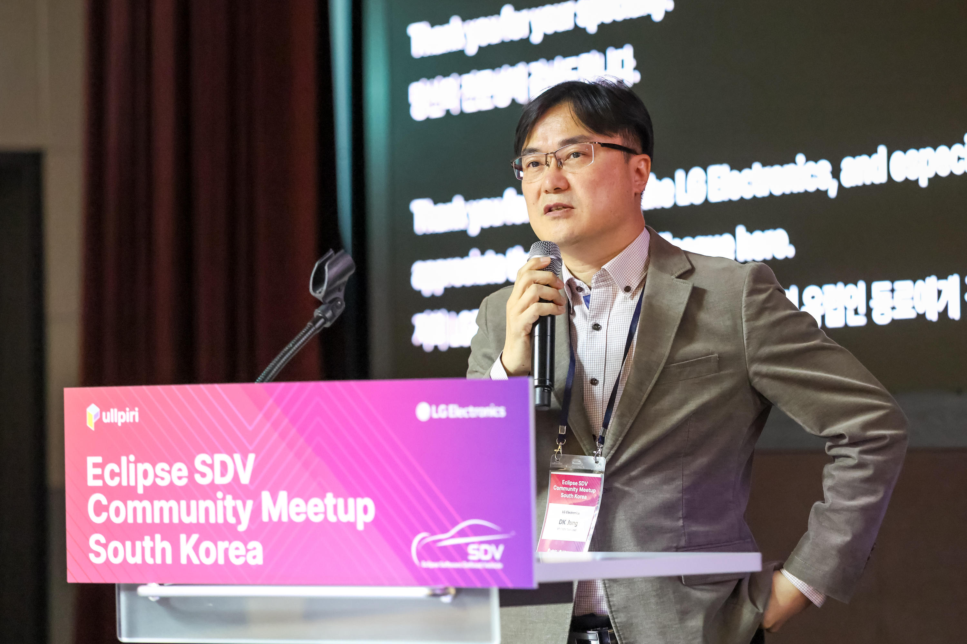
1st Presentor
DK Jung
Vice President
CTO division, LG Electronics
SDV Task Leader
Notes:
간단히 자기 소개 해주시면 됩니다.

Slide 3
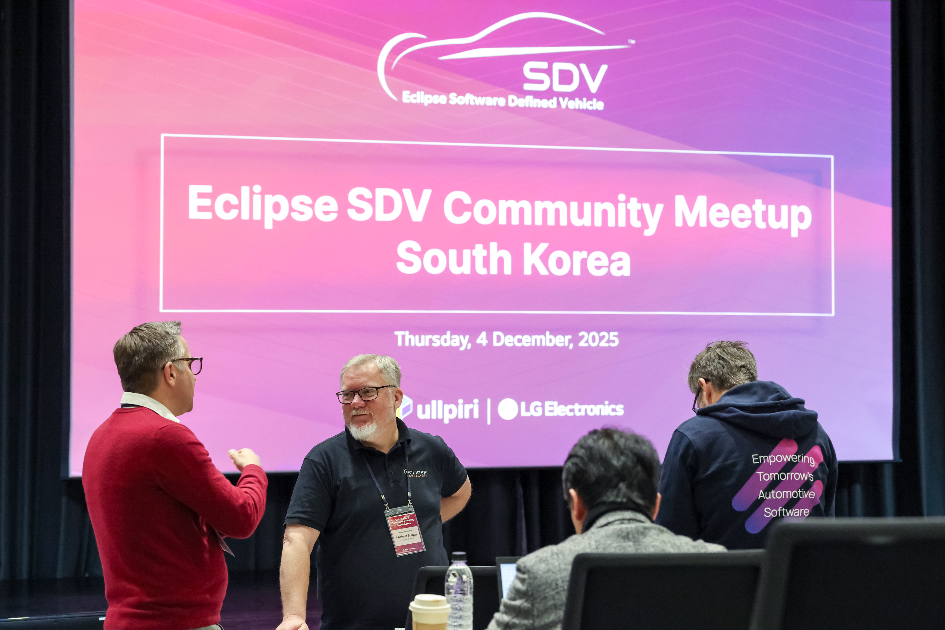
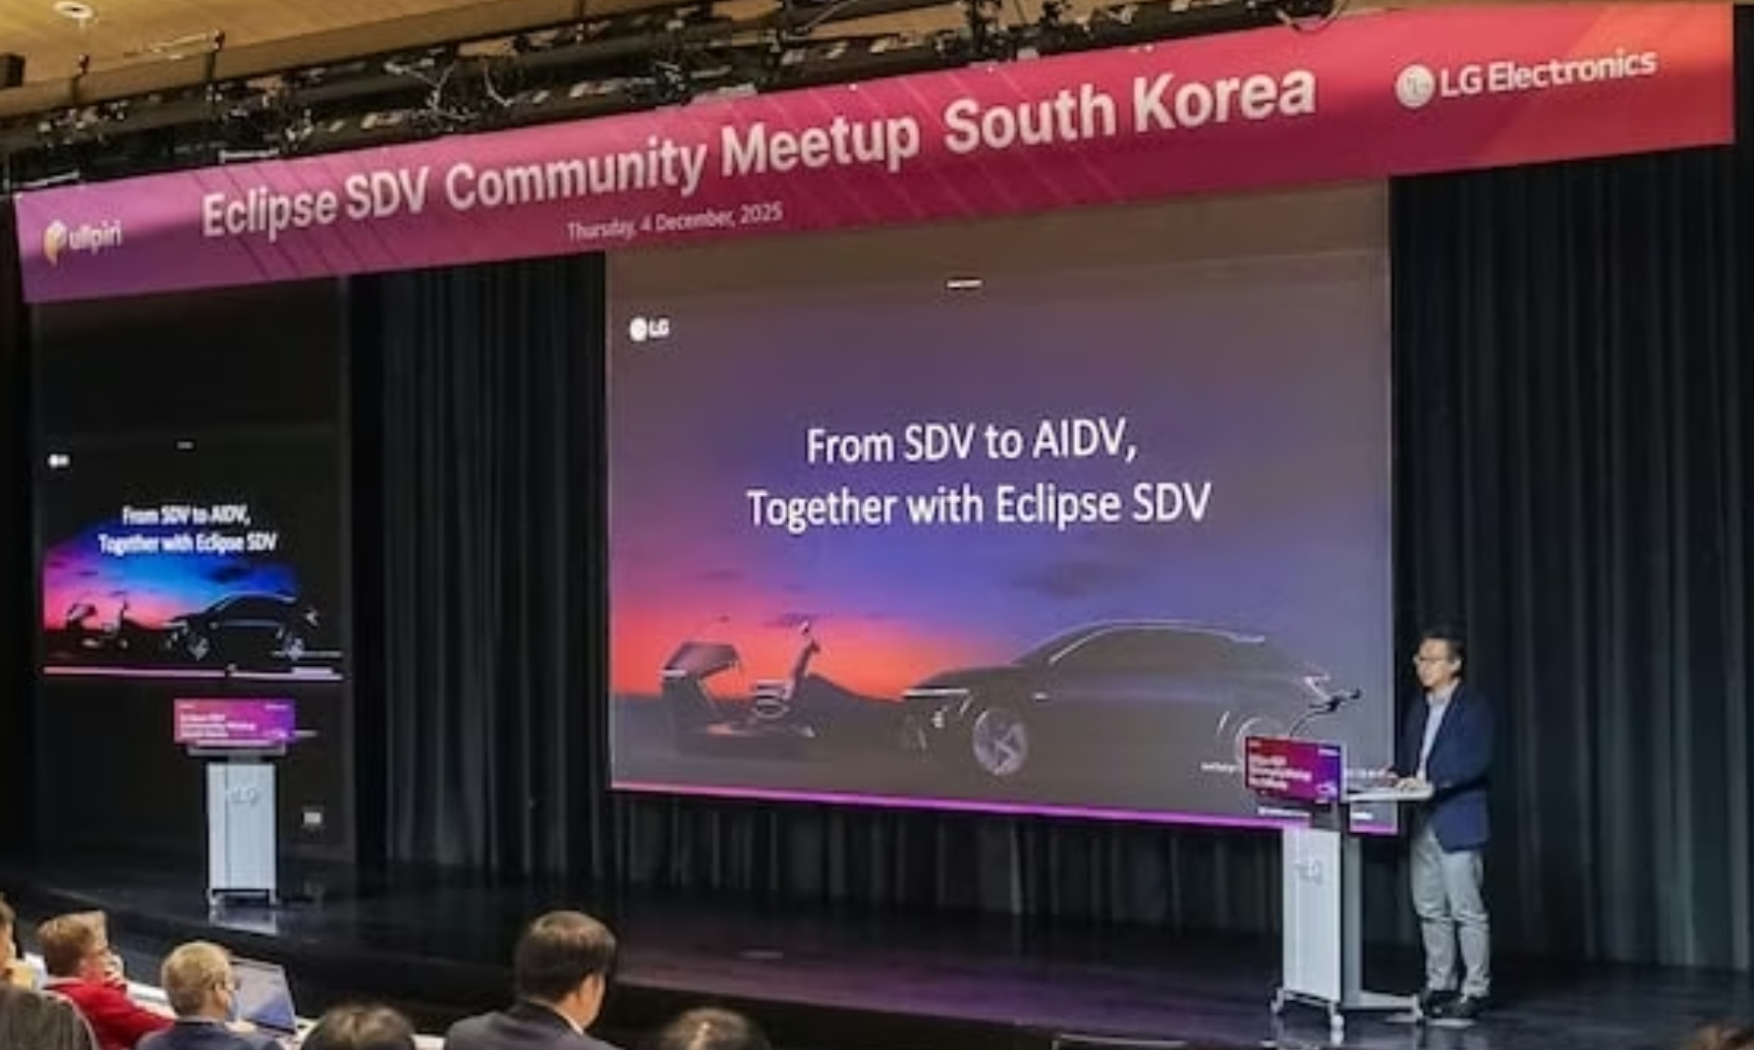
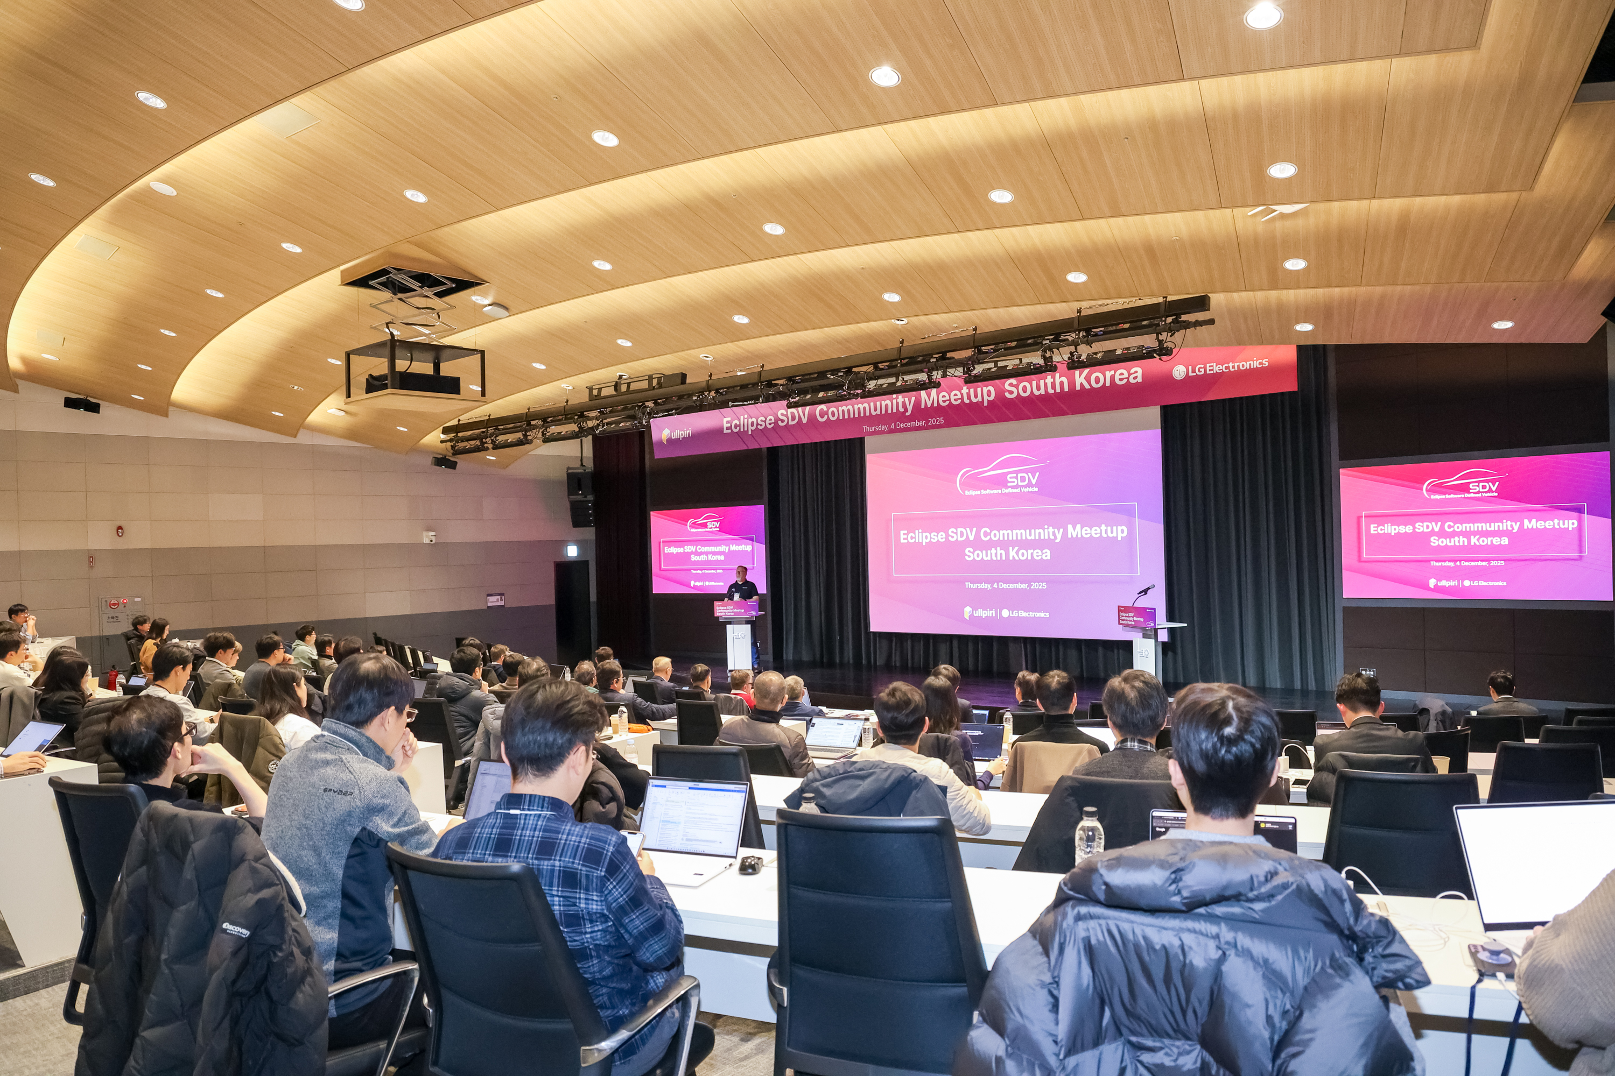
Before starting main topic…
Eclipse SDV Korea Event Achievements and Appreciation.
With the Support of Eclipse SDV Team, LGE successfully hosted the SDV event in Korea.
After the Event
Ecosystem Expansion
Open-Source SDV Platform in Korea
High interest and participation from key domestic companies
LGE has been selected as the anchor company for the government-led alliance
Notes:
First of all, we would like to sincerely thank the Eclipse management and leadership team for enabling the successful SDV event held in Korea at the end of last year.
The event had a strong impact across the Korean automotive ecosystem, significantly raising awareness of open-source SDV technologies.
Many local eco‑partner companies expressed clear alignment and a shared willingness to collaboratively build an open‑source–based SDV platform.
Major industry players showed substantial interest in participating as well.
In addition, LG Electronics has been selected as the anchor company to lead the government‑driven open‑source SDV standard platform initiative in Korea.
This momentum now forms the foundation of how we will align Korea’s SDV efforts with the global Eclipse SDV ecosystem—something I will explain in the next slide.

Slide 4
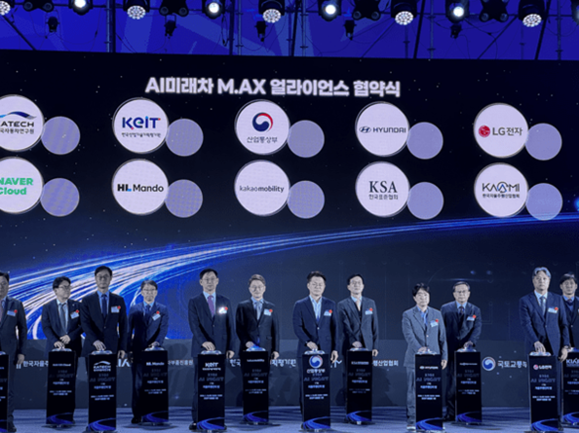




Our Position
Avoiding Fragmentation & Driving Alignment
LGE aims to strengthen the Eclipse SDV ecosystem — not create a separate or competing platform.
No Isolated Open-Source Platform
The Korean SDV platform evolves within the global Eclipse ecosystem
Alignment with S-CORE
Preventing fragmentation is key — pursuing synergy, avoiding divergence
LG's Bridging Role
Expanding the ecosystem by connecting Korean standard initiatives with Eclipse SDV
M.AX¹⁾ Alliance In Korea
1) M.AX : Manufacturing AI Transformation,
Notes:
we believe building a separate open-source platform in isolation would be inefficient.
In particular, we want to avoid fragmentation with existing Eclipse projects such as SCORE.
Instead, LG Electronics aims to play a bridging role —
leading the Korean standard while collaborating with projects like SCORE to create synergy rather than divergence

Slide 5
New Project Proposal
Timpani : A drumbeat for vehicle workloads
LG Electronics / CTO Division
COPYRIGHT (C) 2023, ECLIPSE FOUNDATION. | THIS WORK IS LICENSED UNDER A CREATIVE COMMONS ATTRIBUTION 4.0 INTERNATIONAL LICENSE (CC BY 4.0)
Notes:
Now, let me move on to today’s main topic.
We would like to propose a new Eclipse SDV project: Timpani — a drumbeat for vehicle workloads.
Over the next few slides, I’ll explain why this project is needed and how it can strengthen the SDV ecosystem.

Slide 6




Technical Background : Emerging Use Cases
Autonomous Driving and In-Cockpit AI Convergence
Safety‑critical AD and Fast-evolving In-Cockpit AI are merging into interdependent workflow
Forcing SDV Platforms to evolve beyond traditional rigid architectures.
Autonomous Driving
In-Cockpit AI
Dual Requirements: Safety vs. AI Velocity
Strict Safety + Continuous Updates
High Flexibility + Rapid Iteration
Real-time collaboration essential between AD and Adaptive AI Agents
Converging Domains
Separate Domains → One Unified Pipeline
Robust safety assurance + support for fast updates, dynamic models, flexible deployment
Required Platform Evolution
Platform Evolution
Notes:
Future SDV systems must satisfy a combined set of requirements across safety‑critical autonomous driving and rapidly evolving AI capabilities.
Autonomous driving demands strict safety, robustness, and increasingly continuous updates to maintain model accuracy and regulatory compliance.
In‑cockpit AI interaction, on the other hand, requires high flexibility and fast iteration to improve user experience and intent understanding.
These two domains now operate as a single, interdependent workflow.
Real‑time coordination between safety‑critical perception/planning and adaptive AI agents is becoming essential.
As a result, SDV platforms must evolve from tightly coupled, rigid architectures to systems that maintain strong safety guarantees while supporting the flexibility and update velocity required in the AI era.

Slide 7
Technical Background : Fail-Operational Architecture (L3/L4)
Fail‑Operational Architecture for L3/L4 Autonomy
Level‑3 and higher autonomy requires vehicles to remain operational even when a compute unit fails — demanding a shift toward coordinated Multi‑ECU / Multi‑SoC system architectures.
Why Fail-Operational is Essential
L3/L4 aims to maintain sustained autonomous operation, not just fail-safe.
From Isolated Nodes → Coordinated Multi‑ECU / Multi‑SoC
Distributed architecture, clear fallback paths, takeover path, real-time failover
All core functions must be mutually monitored and coordinated in a distributed environment.
New Software-Level Requirements
Cross-ECU monitoring & Health Management, distributed failover, deterministic scheduling
System-Level Orchestration across multiple SoCs/ECUs
Notes:
In Level‑3 and higher autonomous driving, a fail‑operational architecture becomes a critical design goal.
To achieve this, vehicles must adopt Multi‑ECU and Multi‑SoC architectures, enabling the system to continue operating safely even when one compute unit fails.
This shift means that the traditional design—where each ECU or SoC operated independently—is no longer sufficient.
Instead, a distributed architecture with clear fallback and takeover paths is required.
And this demands new software‑level mechanisms for coordination, monitoring, and system‑level management.
In short, L3+ autonomy requires a transition from isolated compute nodes to coordinated Multi‑SoC / Multi‑ECU systems with built‑in fail‑operational capabilities.

Slide 8
Technical Background : Orchestration
Two Dimensions of Orchestration: Spatial & Temporal
To satisfy SDV requirements — safety‑critical behavior, real‑time guarantees, continuous updates, and fail‑operational operation — orchestration must be addressed across two technical dimensions: Spatial and Temporal.
Spatial
(Where / Env. For Runtime)
Temporal
(When / Req. for Determinism)
App
Deployment
App 1
App 2
App 1
Execution Time
SoC1
SoC2
Cloud
App
Resource
Allocation
App 2
Dependency
App 1
App 3
CPU
Mem
Net.
Notes:
To meet the SDV requirements of safety‑critical behavior, real‑time guarantees, continuous updates, and fail‑operational continuity, we can break orchestration into two technical dimensions: Spatial and Temporal.
Spatial orchestration determines where workloads run, distributing and migrating tasks across Multi‑SoC / Multi‑ECU systems to maintain fail‑operational continuity under failures or overload.
Temporal orchestration determines when workloads run, enforcing real‑time deterministic execution so that safety‑critical functions remain protected even as AI workloads evolve or fluctuate.
Together, these two forms of orchestration provide the foundation for SDV platforms that must remain safe, real‑time, continuously updatable, and resilient in dynamic runtime environments.

Slide 9

Role of Pullpiri & Timpani
Two Dimensions of Orchestration: Spatial & Temporal
Pullpiri and Timpani deliver the two essential dimensions of orchestration — Spatial and Temporal — required for next‑generation SDV platforms.
Spatial Orchestration
Timpani
Temporal Orchestration
where workloads run
when workloads run
Allocates the compute resources
required for each workload
Enforces resource isolation and
operational constraints
Performs workload placement and
migration across Multi‑ECU systems
Global Monitoring across Multi-Nodes
Coordinates execution schedules across different ECUs
Maintains a globally aligned timing plan for mixed‑criticality workloads
Continuously monitors execution behavior and timing constraints
With Pullpiri, Triggering fallback
Notes:
Pullpiri provides spatial orchestration.
It allocates and constrains the compute resources required by each workload, manages resource isolation, and performs workload placement and migration across Multi‑SoC / Multi‑ECU systems.
Through this, Pullpiri creates a stable and controllable execution environment where workloads can run reliably even under dynamic resource conditions.
Timpani provides temporal orchestration.
It coordinates execution schedules across workloads running on different SoCs and ECUs, maintaining a globally aligned timing plan.
By continuously monitoring execution behavior and timing constraints, Timpani collaborates with Pullpiri to trigger fallback or takeover actions, forming the software basis for fail‑operational behavior in distributed systems.
Used together, Pullpiri and Timpani deliver system‑level orchestration across space and time — enabling the platform to meet the SDV requirements introduced earlier.

Slide 10
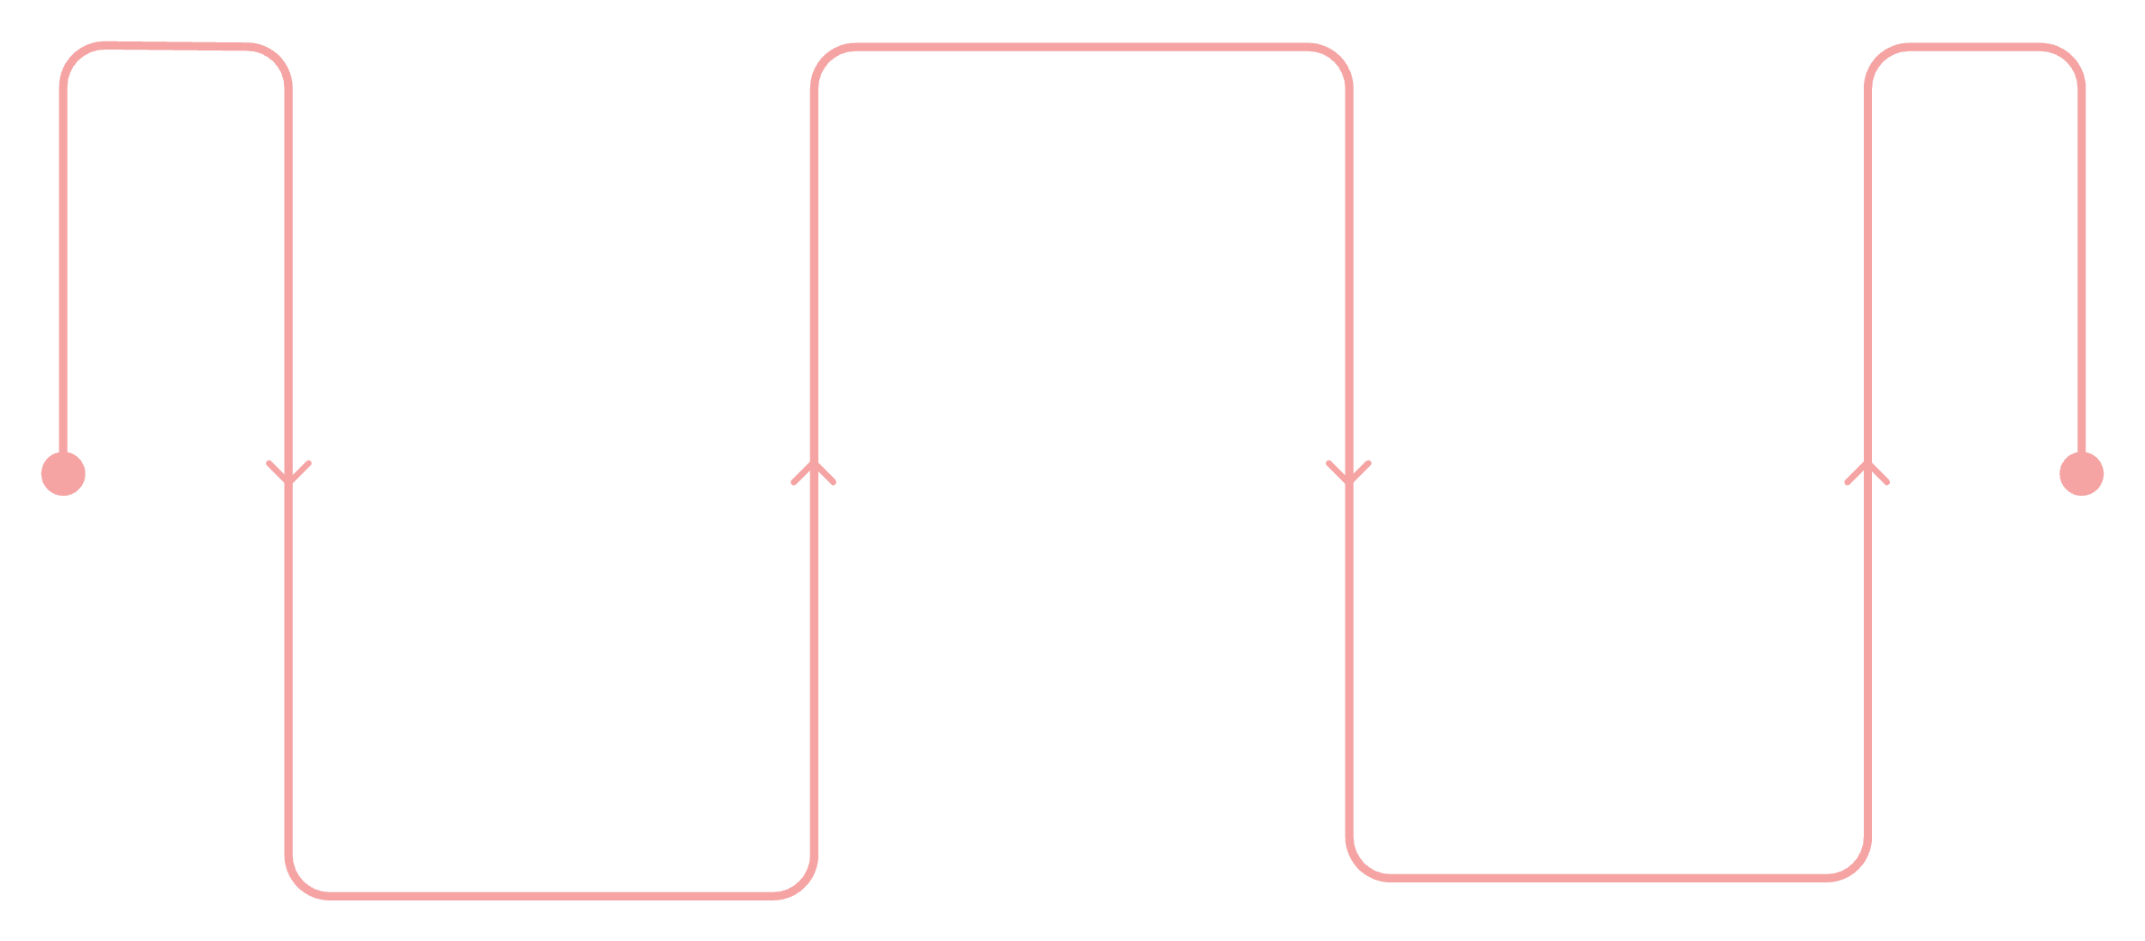
From Single Node to Multi-Node and Timpani
Deterministic Scheduling Requirements
Traditional in‑vehicle systems were locally deterministic on a single compute node.
SDVs now span multiple ECUs — requiring global‑time‑based deterministic scheduling across distributed nodes.
Traditional Model
Shift To SDV
Introducing Timpani
Multi-ECU
Distributed Execution
Global Timing
Global Time Based
Deterministic Schedule
Cross-node Scheduling
Cooperate with Pullpiri
For Fail-Operational
Single-ECU
Local Determinism
Notes:
Traditional vehicle systems relied on single‑node, locally deterministic scheduling.
But SDV platforms now operate across multiple nodes, requiring global time alignment to maintain consistent and predictable behavior.
To address this need, we propose Timpani - a new open‑source project that provides global‑time‑based deterministic scheduling across distributed nodes.

Slide 11
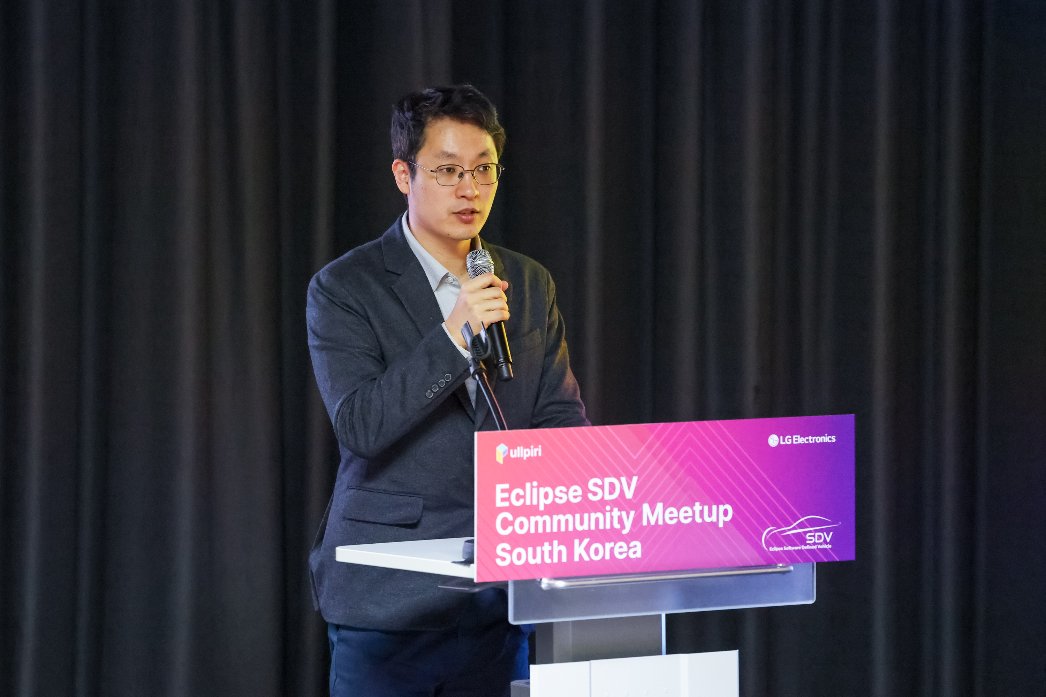
2nd Presentor
Chulhee Lee
Principal Research Engineer
CTO division, LG Electronics
PULLPIRI Project Leader
Notes:
Hello, my name is Chulhee Lee.
I am a Principal Research Engineer in the CTO Division at LG Electronics.
Within LG, I lead the development of the in-vehicle orchestration layer for next-generation SDV platforms.
Our focus is building a runtime architecture that combines real-time scheduling, mixed-criticality control, and distributed workload orchestration across vehicle ECUs.
Two core projects form the foundation of this work — Pullpiri and Timpani.
And we are contributing both of these projects to the Eclipse community as open collaboration initiatives.
Today, I will introduce the new proposal for the Timpani project

Slide 12
Timpani Architecture: How Global-Time Scheduling Works.
Order / Monitoring
Scalable Multi-Node Integration
Container-Level Management
Integrated Monitoring with eBPF
Monitoring
TIMPANI-N
TIMPANI-O
TIMPANI-N
TIMPANI-N
Linux OS
Linux OS
Linux OS
Scheduler
eBPF
Scheduler
eBPF
Scheduler
eBPF
ECU
ECU
ECU
Ethernet/TSN
Notes:
Now let me briefly explain how the Timpani architecture actually delivers global‑time‑based scheduling across multiple ECUs.
In this model, each ECU runs a Timpani‑N node, which includes a local scheduler and an eBPF‑based monitoring layer on top of Linux.
These nodes execute workloads according to a shared global timeline and report execution status back to the orchestrator.
At the top of the system, we have Timpani‑O, the orchestration layer that distributes the global execution order and collects timing information from all nodes.
This allows the entire vehicle to follow a coherent and deterministic execution rhythm, even when workloads span multiple ECUs.
All nodes communicate over Ethernet or TSN, ensuring low‑latency synchronization and enabling scalable multi‑node integration.
And because Timpani manages timing at the container level, it becomes much easier to introduce new workloads or update existing ones without breaking deterministic behavior.
The eBPF‑based monitoring built into each node gives us continuous visibility into timing constraints, execution delays, and potential violations — providing the information needed for Pullpiri to react or trigger fallback when required.
In short, this architecture provides a scalable multi‑node foundation for deterministic scheduling in next‑generation SDV systems.

Slide 13
Collaboration of Pullpiri & Timpani
How Pullpiri & Timpani Work Together
Pullpiri (Spatial) and Timpani (Temporal) operate as a coordinated orchestration layer—managing where workloads run and when they execute across distributed SDV compute systems.
Orchestration
Pullpiri
Deadline-Aware Scheduling with Fallback
Scenario-Based Orchestration via Pullpiri
Policy-Driven Mixed-Criticality Runtime Control
Notify / Request
Container
Workload
TIMPANI-N
TIMPANI-O
Monitor
Linux OS
Scheduler
eBPF
Event
ECU
Notes:
Next I’m going to speak how Pullpiri and Timpani operate together as a coordinated orchestration layer for SDV platforms.
Pullpiri handles spatial orchestration — deciding where container workloads run across ECUs.
Timpani handles temporal orchestration — determining when they execute and ensuring deterministic timing behavior.
Each ECU runs a Timpani-N node with an eBPF-based monitoring layer.
It continuously observes execution timing and reports deadline violations or abnormal patterns to Timpani-O.
When a timing violation is detected, Timpani immediately notifies Pullpiri.
Pullpiri then performs system-level corrective action — reallocating resources, migrating workloads, or activating a fallback scenario.
This enables deadline-aware scheduling with system-level fallback — combining temporal enforcement with distributed recovery.
Beyond fault handling, Pullpiri also adapts to operational scenarios.
When driving context or workload pressure changes, it adjusts workload placement and priorities across ECUs, while Timpani enforces the updated timing model.
This provides scenario-based orchestration across the vehicle.
At the highest level, the system is policy-driven.
Pullpiri defines runtime policies — such as target FPS or latency bounds — and dynamically adjusts criticality levels.
Timpani translates those policy decisions into deterministic scheduling behavior.
This creates policy-driven mixed-criticality runtime control.
Together, Pullpiri and Timpani combine spatial control, temporal determinism, and policy-based criticality management into a unified orchestration loop for distributed SDV systems.

Slide 14
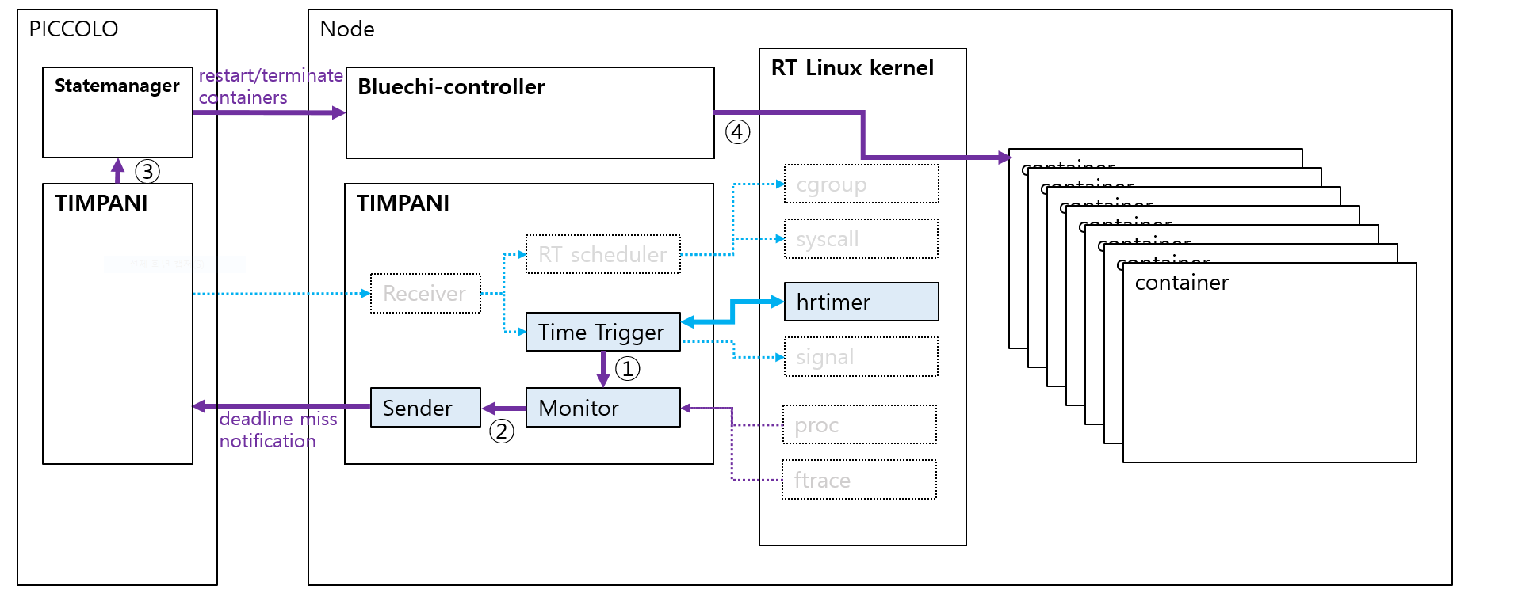
Collaboration of Pullpiri & Timpani
Communication between Pullpiri and Timpani
Timpani reports timing violations to Pullpiri, and Pullpiri responds by managing container lifecycle—forming a tight feedback loop between temporal monitoring and spatial control.
Pullpiri
Notes:
On this slide, I’d like to explain how Pullpiri and Timpani actually communicate with each other inside the system.
Timpani continuously monitors execution timing on each ECU.
When it detects a deadline miss or an unexpected timing deviation, it sends a notification to Pullpiri.
This is the temporal monitoring information flowing upward.
Once Pullpiri receives this timing signal, it evaluates the system state and decides how to maintain stability.
Depending on the situation, Pullpiri may adjust the container lifecycle — for example, restarting a workload, isolating it, throttling it, or even migrating it to another ECU if necessary.
This creates a tight feedback loop:
Timpani provides precise timing feedback, and Pullpiri responds by applying spatial control.
In other words, timing issues are not just detected — they directly drive orchestration decisions at the system level.
This mechanism is what ensures the platform can maintain deterministic behavior while still reacting dynamically to runtime conditions.

Slide 15
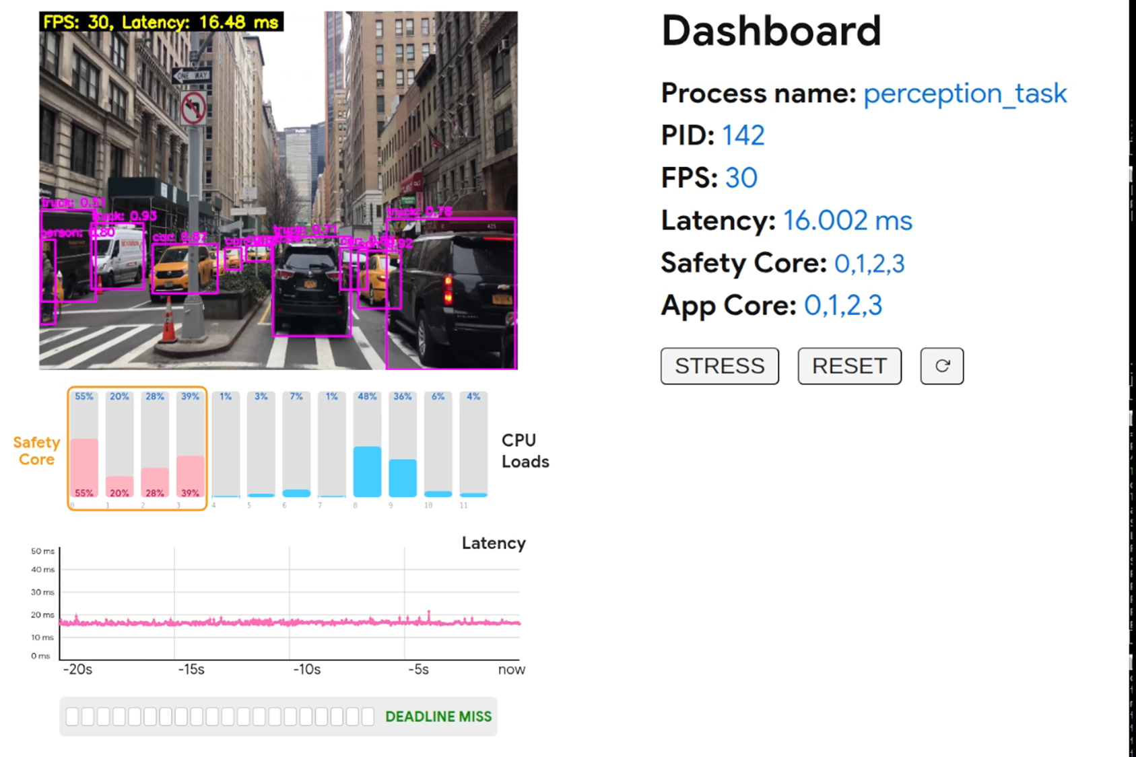
Collaboration of Pullpiri & Timpani : Demo Desc.
Perception Display
Status
CPU Cores
Latency
Notes:
I’d like to show simple demo about collaboration of Pullpiri & Timpani.
Before we move on to the demo video, let me briefly explain what you’re about to see.
For this demo, we implemented a perception algorithm using Execution Order Framework and packaged it as a containerized application.
This container is then scheduled and monitored by Timpani, which provides deterministic, container‑level execution timing.
To demonstrate how the system reacts under timing pressure, we intentionally push the perception workload into a state where it begins to miss its deadlines.
Timpani checks the execution timing of every frame, and whenever a frame exceeds its defined limit, the deadline‑miss counter increments.
For this demo, the threshold is set to 15 deadline misses.
We originally tried much lower values—like five—but the reaction happened too fast for anyone to visually notice the transition.
So 15 gives us a clear, observable behavior.
And importantly, this threshold is fully declarative, meaning it can be adjusted to any value depending on the workload characteristics or safety strategy.
Now, let me explain the graphs:
At the top, the pink bars represent the CPU cores running the perception algorithm,
while the blue bars show other workloads sharing the CPUs.
The middle graph displays FPS changes.
And at the bottom, the graph shows the deadline‑miss counter, which fills one block at a time every time a deadline miss occurs.
As the workload becomes more stressed, FPS becomes unstable, latency increases, and the bottom counter gradually fills up.
When it finally reaches 15, Timpani sends a timing‑violation signal to Pullpiri, and Pullpiri responds by reassigning CPU cores to stabilize the perception algorithm.
This is the adaptive fallback scenario you will see in the demo video on the next slide.

Slide 16

Collaboration of Pullpiri & Timpani : Demo Video
Adaptive Fallback Scenario
: IF Deadline Miss Count > 15,
CPU Core Reassignment
Pullpiri – Spatial
Resource Re-Assignment
Timpani – Temporal
Deterministic Scheduling & Report
Deadline Miss Count : 15
Notes:
Now let me show you the demo video.
On the left, you’ll see the perception output running inside the container,
and there are the dashboard showing FPS, latency, CPU allocation, and the deadline‑miss counter.
As the stress is applied, the perception workload begins missing its deadlines,
and the counter at the bottom gradually increments.
Once it reaches the threshold we configured — fifteen misses —
Timpani reports the timing violation,
and Pullpiri reacts by reassigning CPU cores to stabilize the perception process.
So as you watch the video, look for three things:
the rising deadline‑miss counter,
the shift in CPU‑core allocation,
and the perception latency becoming stable again after the fallback occurs.
OK. Let’s See.

Slide 17
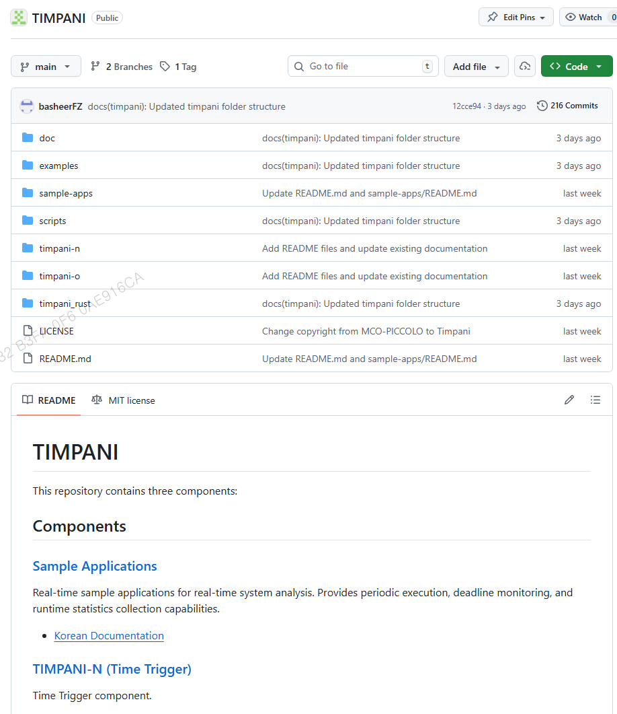
Current Status of Timpani Project.
https://github.com/MCO-PICCOLO/TIMPANI
Notes:
As the final update, I’d like to briefly share the current status of the Timpani project.
Timpani is now fully prepared for open contribution.
All the core components — the Time Trigger, the monitoring logic, and the sample applications — are already organized and publicly available on GitHub.
The architecture has been validated, and the repository is ready for community onboarding.
At this point, the only remaining step is the Eclipse project proposal process.
Once the proposal is completed and approved, Timpani will move directly into the Eclipse SDV ecosystem as an official open-source project.
So in short:
the development is ready,
the repository is open,
and as soon as the proposal phase is finished, Timpani will become part of Eclipse SDV.

Slide 18
Notes:
Thank you very much for your time and attention.
Timpani is now fully prepared for open contribution, and once the Eclipse project proposal is completed, it will immediately join the Eclipse SDV ecosystem.
We’re excited to continue this journey together with the community, and we look forward to your feedback, collaboration, and participation.
Thank you.

